Slide 1

Communication Inventions
That Changed the World Forever

Slide 2
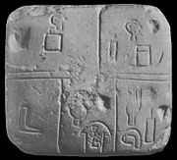
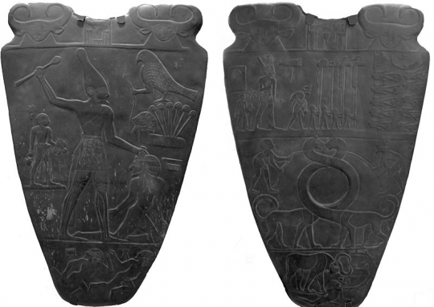
1)Writing
Written communication in the form of pictures and then an alphabet.
The initial written form of communication was a pictograph. Each picture represented different actions and objects. The earliest forms of these picture words were in 3500 B.C. in an area of the world called Sumeria, that is now Iraq.
The Egyptians came up with hieroglyphics, which was developed a few hundred years later.
The Chinese used pictographs around 2000 to 1500 B.C.
Written communication in the form of an alphabet had a foundation of symbols relating to sounds and not signs. The Phoenicians established an alphabet around 800 B.C. The Romans much later took the Greek alphabet and translated it into 26 letters. An alphabet was far more efficient than the old system of pictographs. A simple sentence might require less than 50 letters and punctuation marks using an alphabet. In comparison, that same sentence would use about 9,000 pictures to say the same thing.
A Sumarian clay tablet 3500 B.C.
Egyptian Hieroglyphics

Slide 3

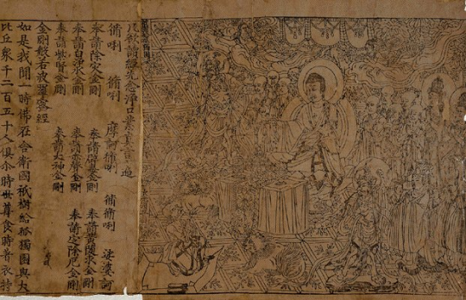
2)Paper
The invention of paper was necessary once a form of written communication was invented. Paper was the surface that made written communication manageable.
At first, clay tablets were used for written communications but they were bulky and difficult to transport. The Egyptians came up with a woven surface from the papyrus plant and painted hieroglyphics on this paper. The Greeks used a parchment from animal hides. But it was the Chinese who invented the standard writing surface of paper that is still used today. While the Chinese were using paper around 100 B.C., it was not used widely in Europe for another thousand years.
The invention of paper allowed those who could read and write to attain wealth and social status. It also made tax collecting and record keeping easier. Another way that the invention of paper had a profound influence on society was that history and journals could be written for future generations to read. Finally, the laws of the land could be recorded and developed on paper thereby establishing a posted code of civil conduct.
Paper can be made from wood fiber, hemp, cotton, linen and rice
The world’s oldest book from China, 868.

Slide 4
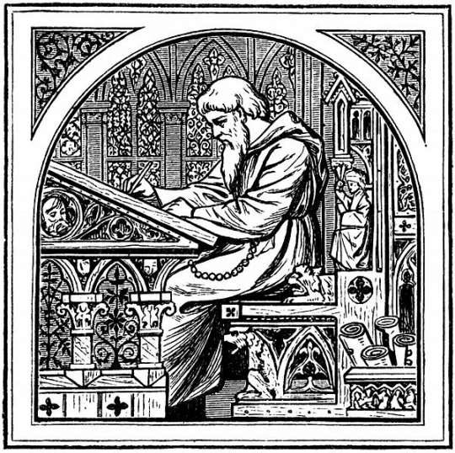
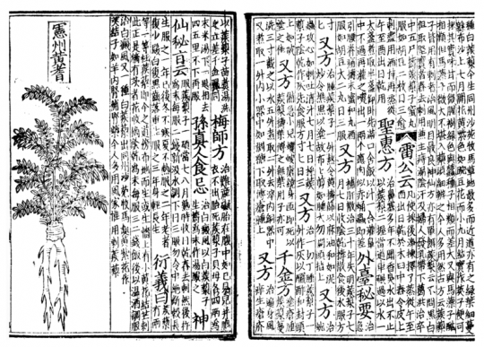
3) Print
The invention of printing satisfied the huge demand for books. After the invention of paper, there was a tremendous demand for books to be written. But all books had to be written by hand and this was tremendously time consuming and expensive. If you wanted to write a book you had to hire a scribe to write it and it was costly.
The Chinese developed a block printing system in 868 and then a kind of movable type made of clay and then wood. The Koreans even had a movable type in the 15th century. But it was in Germany where Johann Gutenberg developed the printing press that utilized movable type and allowed the Bible to be printed about 1453. This printing method spread throughout the continent of Europe. Suddenly books were being printed, although the rich were the only people who could afford them. The newspaper was officially created as the primary source of news for the masses.
A 14th century scribe.
An example of Chinese movable block type in the 13th century.

Slide 5
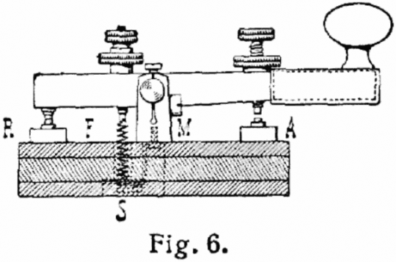
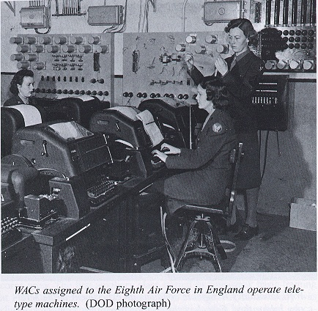
4) The Telegraph
It is impossible for those of us today to imagine life without our cell phones, but before cell phones were invented there was another huge milestone in the invention of the telegraph.
The telegraph was the fastest form of communication at that time and seen as remarkable. It could travel with a message at the speed of light. Samuel Morse was one developer of the telegraph and his “Morse code” of dots and dashes is still used today.
The telegraph was called “the great annihilator of time and space” in that it changed society itself through transportation in the railroads, the way war was conducted, the speed of communication between buyers and sellers and trans-Atlantic communication.
Most of all, the telegraph was pivotal in the formation of news services and agencies.
Morse’s Telegraph, 1837

Slide 6
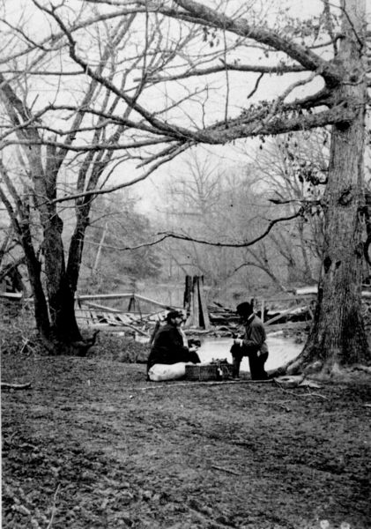
5) Photography
The invention of the camera was first evident in the photographs taken during the Civil War. Suddenly war was a horror in the visual sense that was never understood even in the most graphic written descriptions. Photojournalism where “a picture says a thousand words” became popular as a picture could be internalized faster than the written words.
For the first time historical information could now be journalized in pictures and images.
Civil War Photo, 1862 – Bull Run area

Slide 7
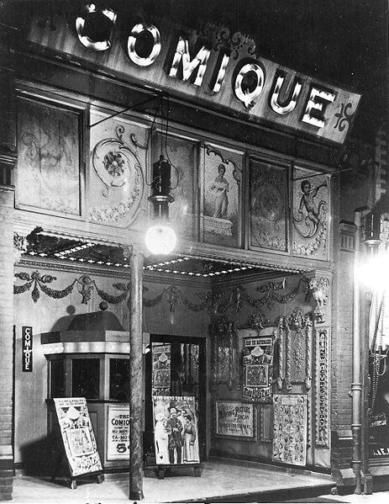
6) Cinema
The technology of the camera led to moving pictures and the video capabilities that we have today. Movie theaters and “nickelodeons” became big hits. By 1910, there were more than 10,000 such movie houses in America. Soon filmmakers began to see the power in producing films and the potential for a huge business.
A Nickelodeon Movie Theater in Canada, 1910

Slide 8
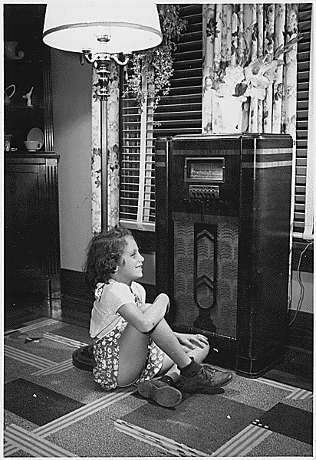
7) The Radio
Advances in wire telephony and the consequences of the war allowed radio to be brought into many homes worldwide. The radio was a source of entertainment as well as news for a multitude of families. The radio became the major communication source for people to receive their news.
Young girl listening to the family radio.

Slide 9
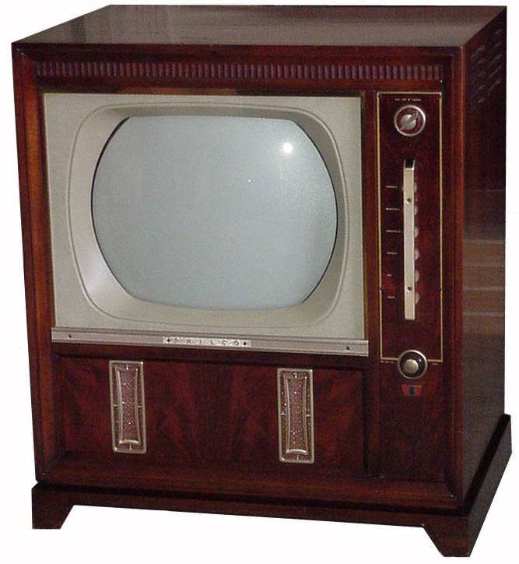
8) The Television
Once again the technological advancements of war paved the way for television in the 1950’s. The television in the 1950’s and 1960’s was the most wanted appliance. About 10 million Americans had a television set in the 1950’s. It soon became a huge consumer of time. People watched their news each evening as well as their various television shows. The entertainment industry now branched off from films into television. Television became a massive form of communication and generated social changes. We watched the Vietnam War and the assassination of John F. Kennedy on our televisions.

Slide 10
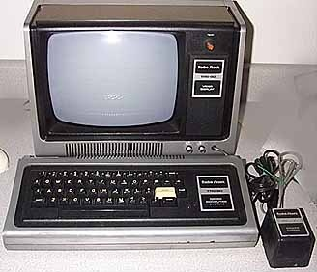
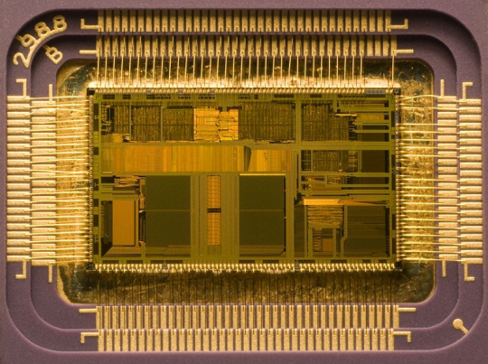
9) The Computer and Internet
The digital revolution allowed computers to instantly relay information to all parts of the world. In the blink of an eye, through computers and the Internet mass communications was changed forever by bringing the people of the world together.
Newspapers and magazines are now online, as well as on paper. Music-sharing sites are online for distribution both legally and illegally. Businesses can be anywhere whether in a downtown office or in a bedroom. You can buy and sell anything online. You can pay your bills and do your banking online. You can meet people in chat areas and have online relationships. Everyone has a website and politics has invaded the Internet as well. In 2004 in the United States, 1 dollar of every eight dollars was spent online. Emailing is now more popular than “snail mail.”
Al Gore, the Internet’s creator?
Radio Shack home computer, 1970
A microprocessor.

Slide 11
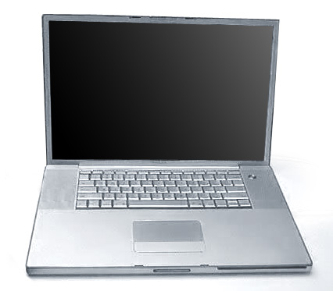
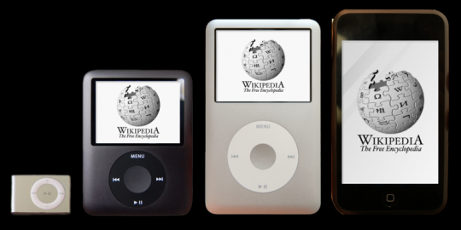
10) Wireless Technology
Wireless portable media has overtaken our society in the presence of wireless laptops, cell phones and PDAs. Everywhere we look in public places we see the huge impact of our wireless connections. It is difficult to remember life without a cell phone or a wireless connection. I often wish I had stock in a cell phone company as I scan my own monthly bill. But with the speed of technology everything we buy today will only be more advanced tomorrow. Technology quickly becomes obsolete as something new is introduced.
Apple PowerBook, 2006
Apple iPods

Slide 12

I wonder what technology will look like in the next 100 or even 1000 years. I can’t even begin to imagine the greatest communications inventions of the next millennium!

