Slide 1

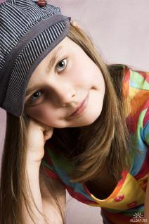
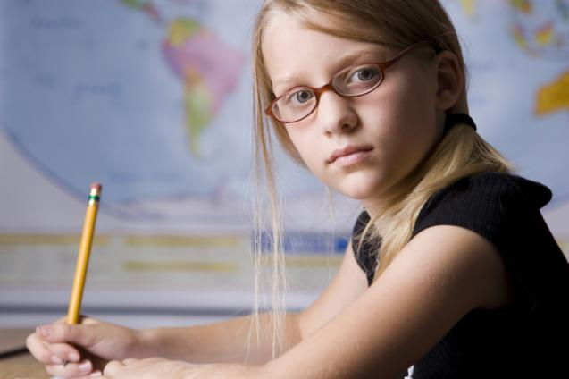
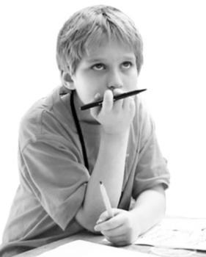
Learning More
About Each Other

Slide 2

sociable, independent, talkative, responsible, creative, shy, curious, friendly
We are different

Slide 3
We are different
Name
Sisters/brothers
Favourite subject
Hobbies
Pets

Slide 4
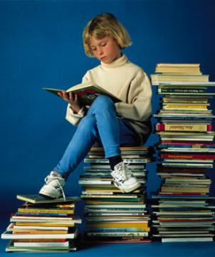
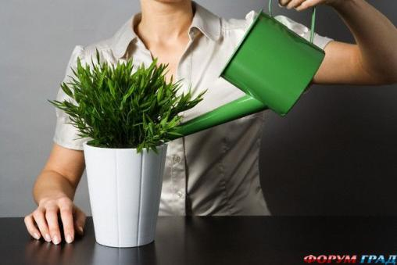
I like to…
What do you like to do?
read books
water my flowers

Slide 5
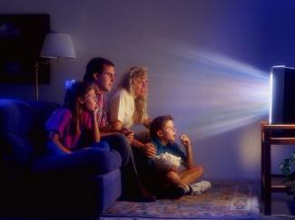
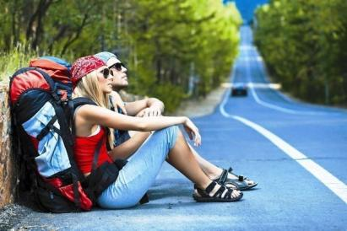


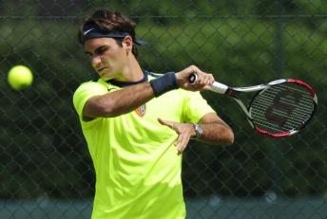
watch films
travel
take pictures/photos
study
do sports

