Slide 1

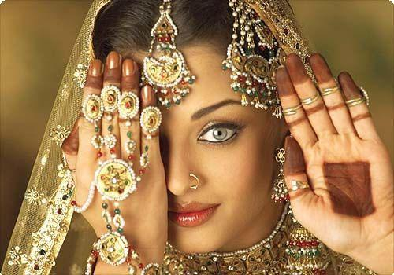

THE BEST OF INDIA
Конкурс презентаций "Я мыслью улечу к брегам туманным Альбиона»
Работу выполнила
Бондарева Наталья Александровна
Учитель иностранных языков
МКОУ Петропавловская СОШ
«Сообщество взаимопомощи учителей Pedsovet.su»

Slide 2
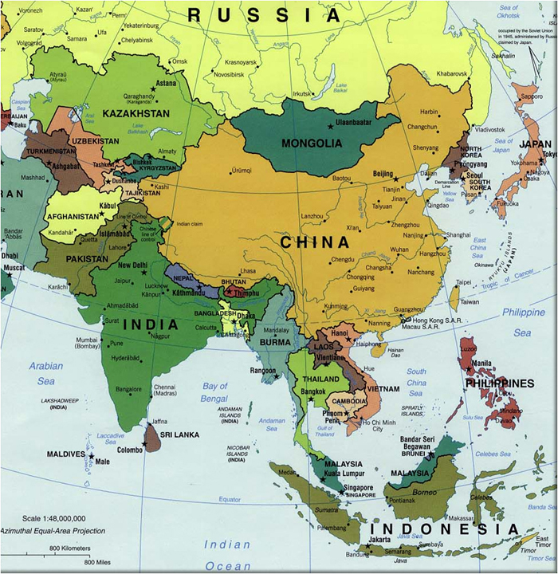
The geographical position
The official name of India - is the Republic of India, a country in South Asia.
India shares borders with Pakistan, China, Nepal, Bhutan, Bangladesh and Myanmar. India has sea borders with Maldives, Sri Lanka, Indonesia.

Slide 3
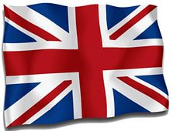
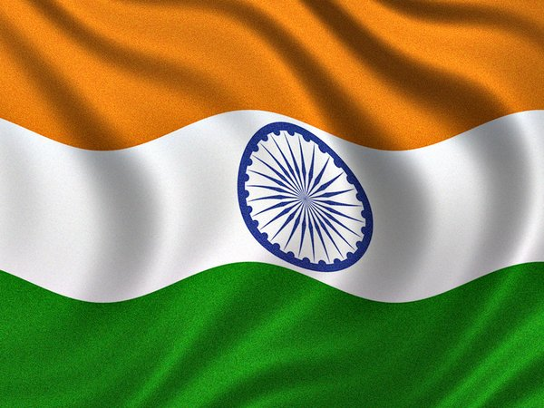
Indie is a one of English-speaking countries.
Hindi, the most common language in India, the official language of the government in India . English, which is widely used in business and administration, has the status of "subsidiary official language" , it plays an important role in education.

Slide 4
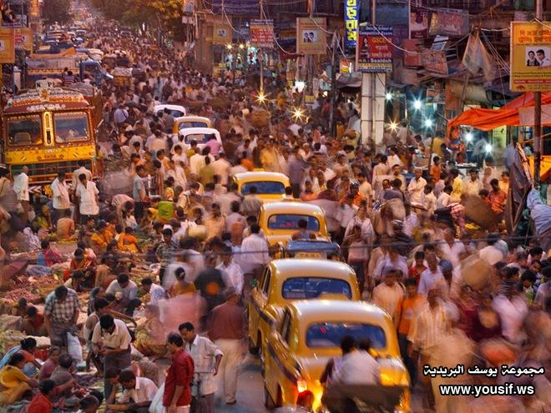
India is the seventh largest country by area(3 287 263 km²), the second largest by population(1.22 billion people in 2010) and the most largest democratic country in the world .The Capital of India is New Delhi.

Slide 5
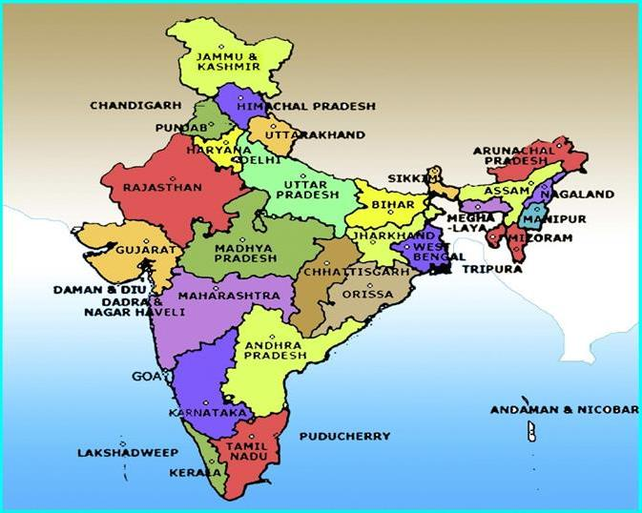
India is a federal republic consisting of twenty-nine states, six union territories and the National Capital Territory of Delhi.

Slide 6
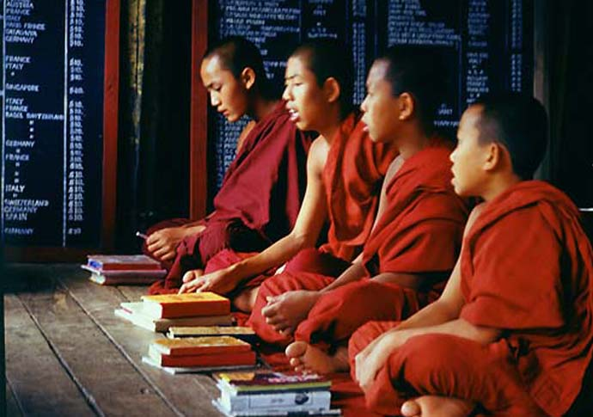
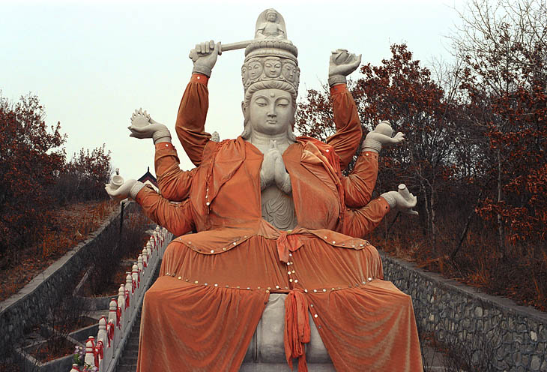
Religion
More than 900 million Indians profess Hinduism. Other religions are: Islam Christianity , Sikhism , Buddhism and Jainism .

Slide 7
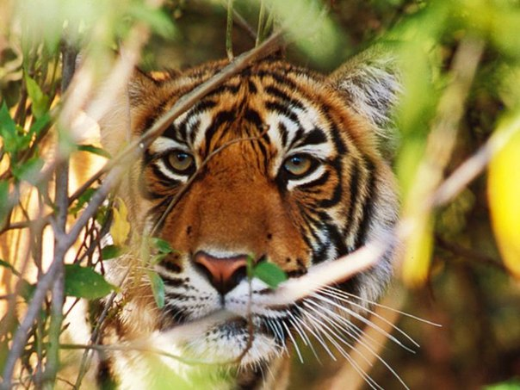
Symbols
The national animal of India is a tiger . Tiger symbolizes power, strength, grace, vivacity, intelligence and endurance of the Indian nation. Since time immemorial, the Tigers were royal animals.
The territory of India is home to more than half population of tigers in the world.

Slide 8
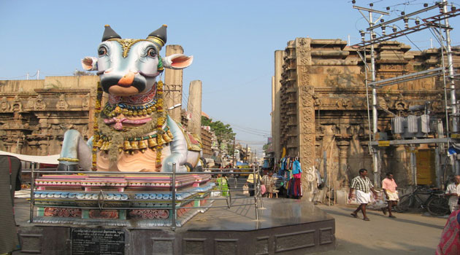
In India, all animals are sacred, but cows take the main place. Hindus Cow is equal to the status of the mother, because the mother cow has such qualities as humility, kindness, wisdom and serenity.

Slide 9
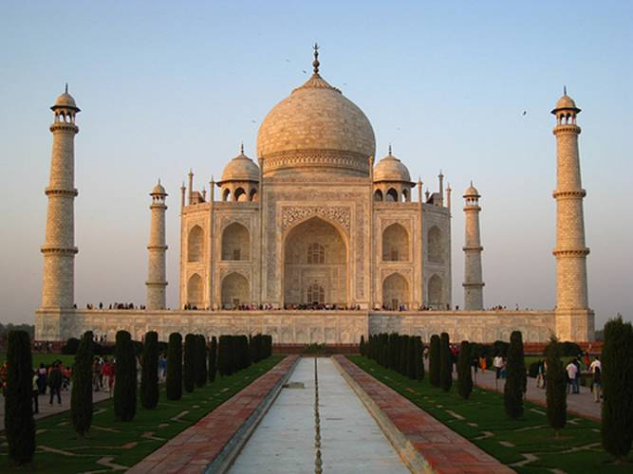
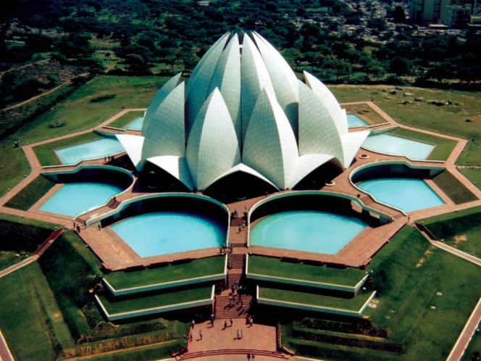
Sights
Taj Mahal
This huge mausoleum is located in Agra and built of white marble on the orders of Mughal emperor Shah Jahan in memory of his beloved wife.
Lotus Temple
Lotus Temple - the main Baha'i Temple in India and neighboring countries, built in 1986. Located in New Delhi - capital of India. The huge building of the white Pentelic marble in the form of blossoming lotus flower - one of the most popular tourist attractions of Delhi.

Slide 10
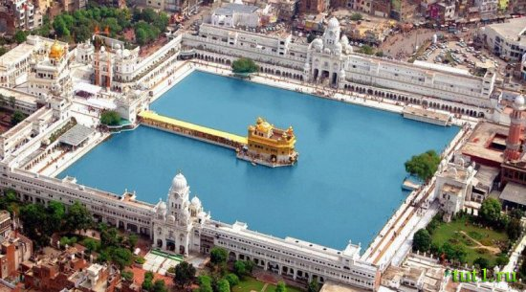
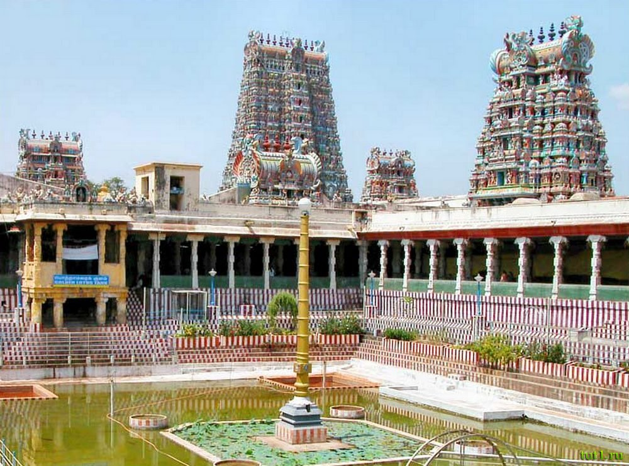
Harmandir Sahib
He is known in the world as the Golden Temple. In reality, the temple is covered with a real gold.
The temple of the goddess Meenakshi, the symbol of love between Shiva and Meenakshi . The temple has 14 towers, which reach height of 50 meters. The heart of the temple is hall with a thousand columns, the center of which is a pool of holy water.

Slide 11
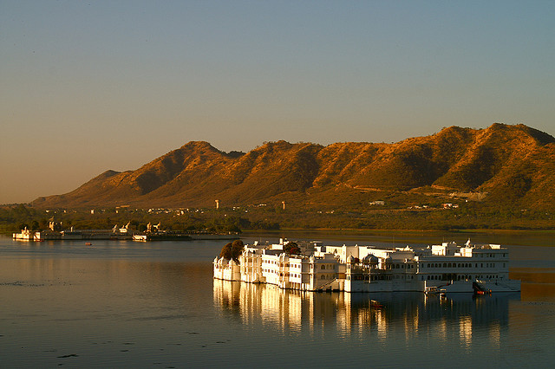
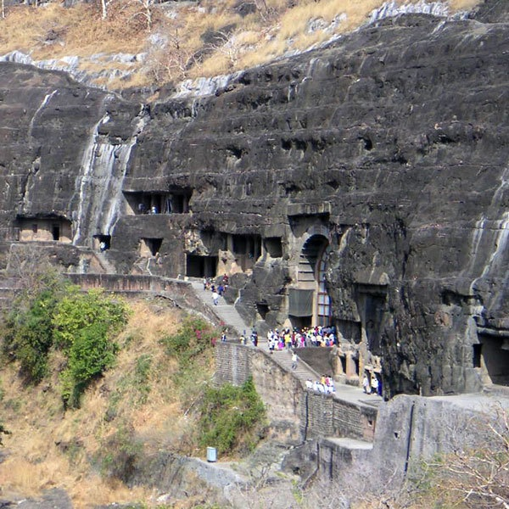
Palace Lake Pichola in Udaipur
This palace was built in the middle of the lake in the 18th century as a royal summer palace. Today it is a luxury 5-star hotel.
Ajanta Caves
Ajanta caves were carved in the rock in the second millennium BC. These caves were abandoned and forgotten until 1819. You can see there a lot of ancient frescoes, carved into the rock.

Slide 12
Do you want to try your chance ?
How well did you remember the information about India?
Let’s go!

Slide 13
Вопрос 1.
How much people live in India?
more than 1 billion
100 million
1 billion

Slide 14
Вопрос 2.
Taj Mahal is ....
Church
mausoleum
Palace

Slide 15
Вопрос 3.
What animal is a symbol of India?
an elephant
a tiger
a chimp

Slide 16
Вопрос 4.
What are the main religions in India?
Hinduism
Buddhism
Islam
Christianity

Slide 17
Вопрос 5.
What country is it ?
India
Australia
Russia

Slide 18
Congratulations!
You are very attentive!
Thank you for your attention!

Slide 19
Источники информации
tonkosti.ru/Индия
indiada.ru/
https://ru.wikipedia.org/wiki/Индия
lifeglobe.net/entry/2657
redigo.ru/geo/Asia/India/places/attractions

