Slide 1
SEASONS
Teacher: Galina Trubnikova

Slide 2

POEM “SEASONS”
Autumn is yellow,
Winter is white,
Spring is green,
Summer is bright.

Slide 3
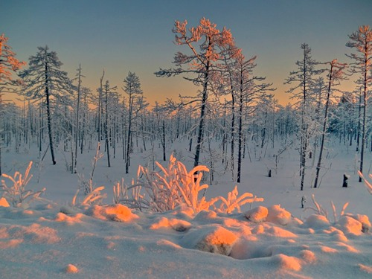
IT’S WINTER

Slide 4
What is the weather like?
It snows.
It is cold.
It is frosty.
We can skate.
We can ski.
We can play snowballs.
We can sledge.

Slide 5
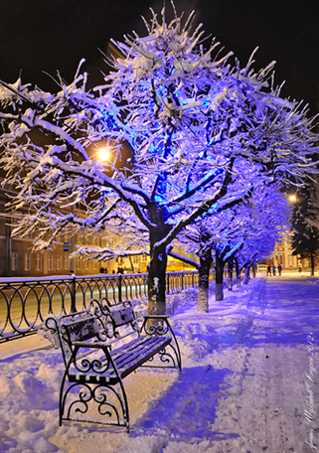
MONTHS
December
January
February

Slide 6
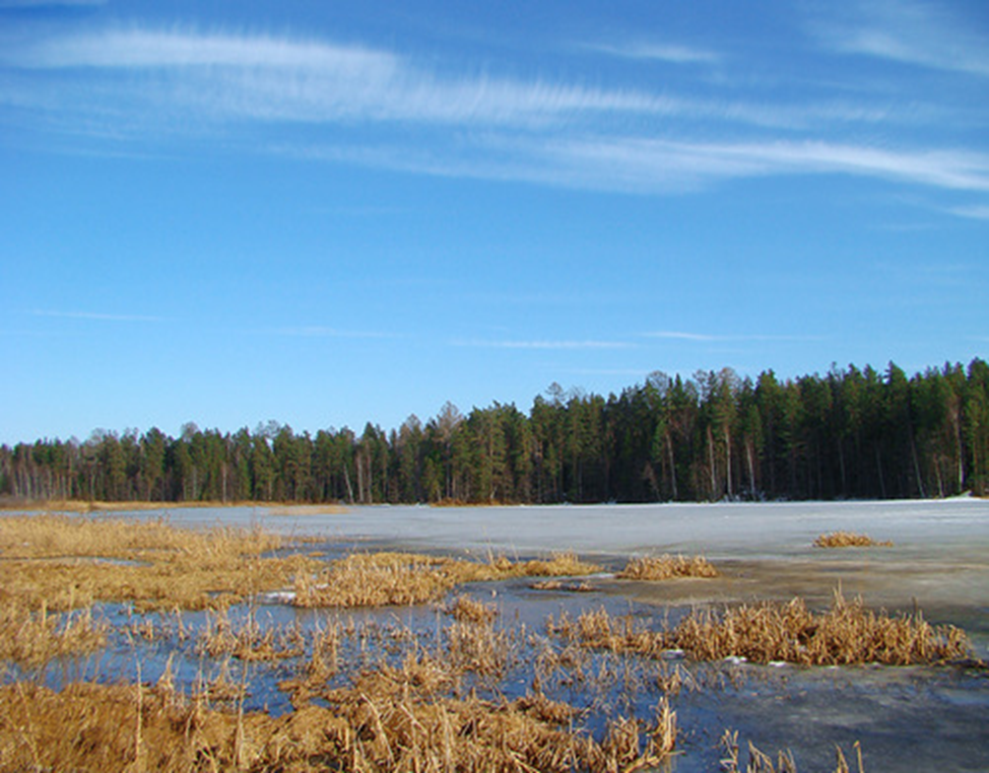
IT’S SPRING

Slide 7
What is the weather like?
It is sunny.
It is nice
and warm.
We can ride a bike.
We can roller-skate.
We can play football.

Slide 8
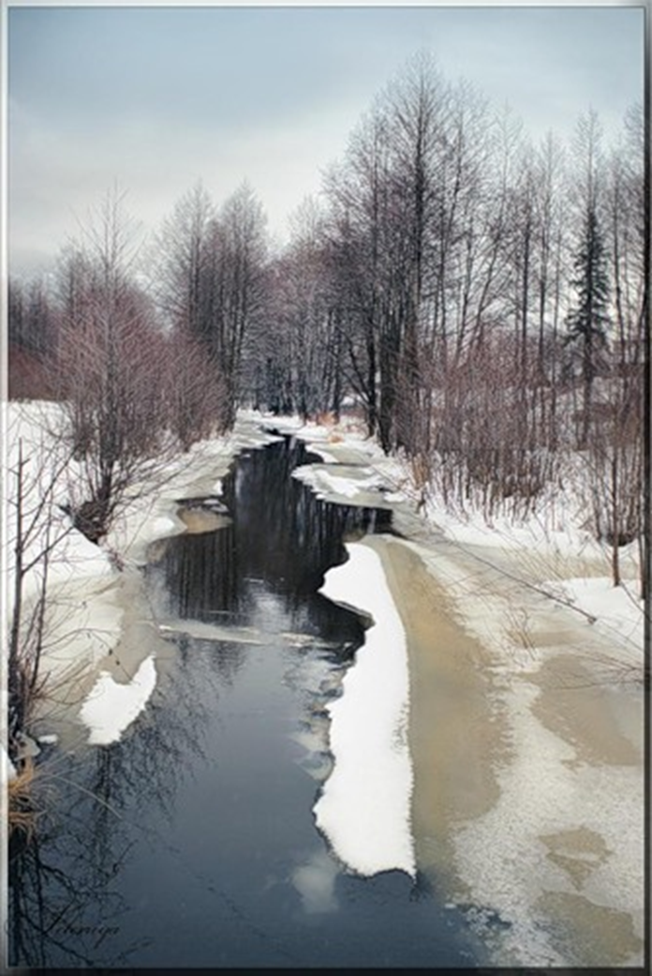
MONTHS
March
April
May

Slide 9
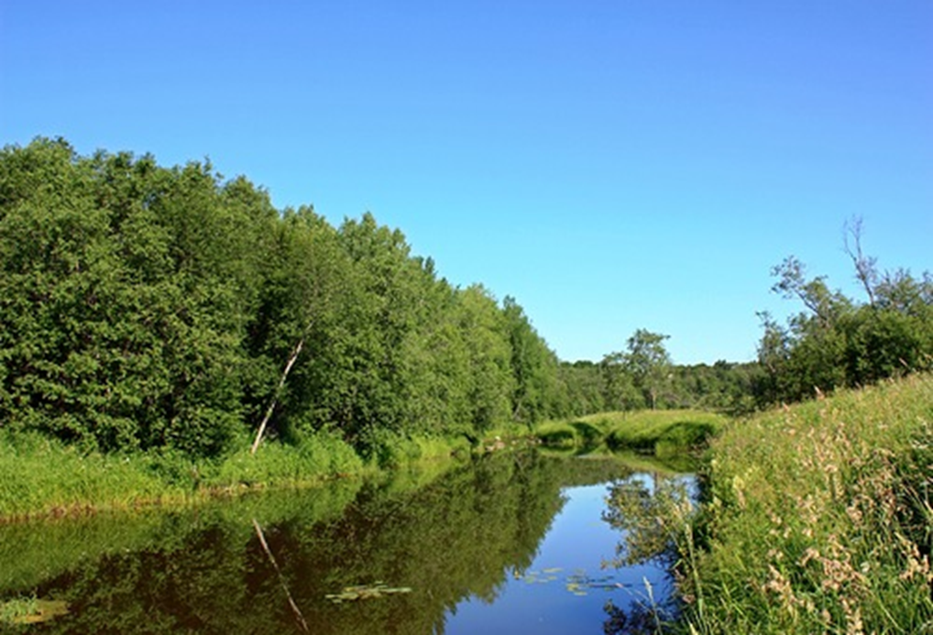
IT’S SUMMER

Slide 10
What is the weather like?
It’s warm.
It is sunny.
It’s terribly hot.
We can swim.
We can play volleyball.
We can play on the beach.
We can go fishing.

Slide 11
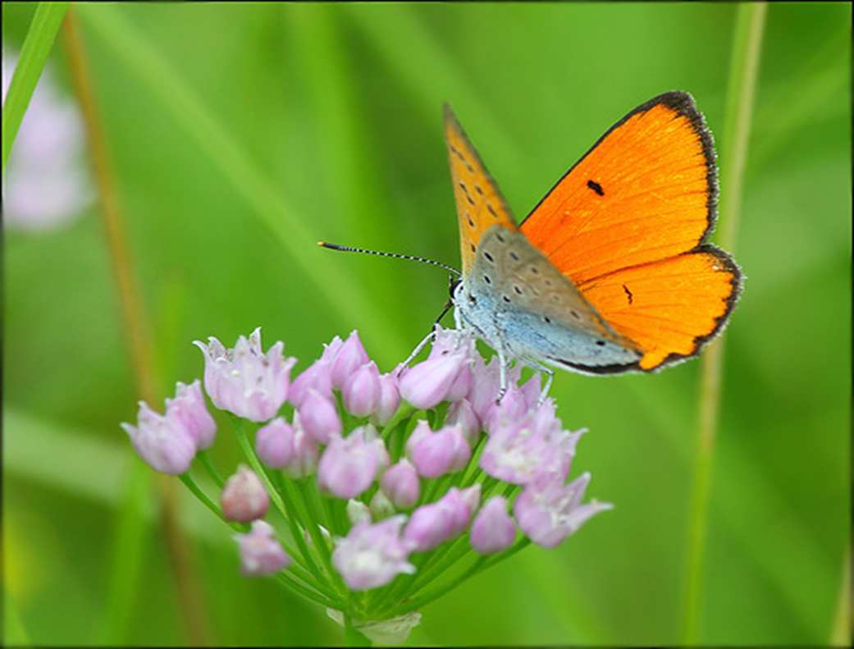
MONTHS
June
July
August

Slide 12
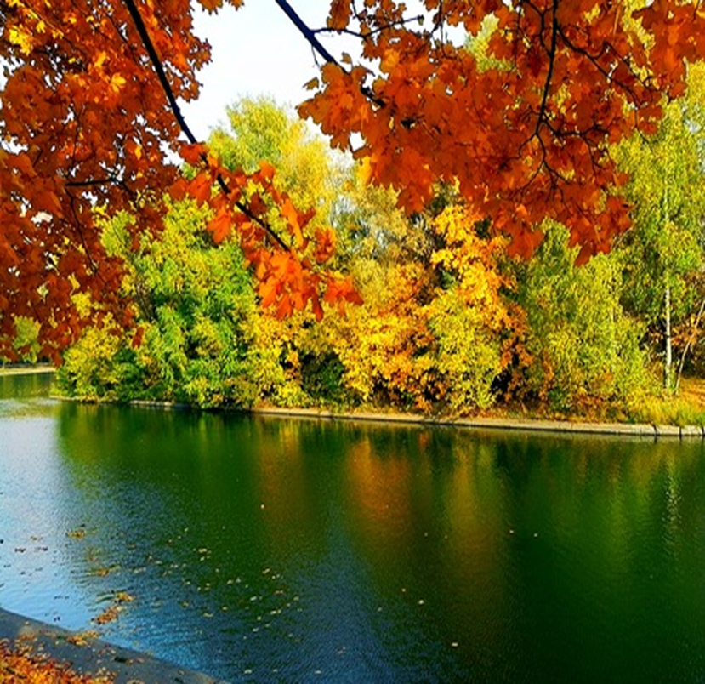
It’s autumn

Slide 13
What is the weather like?
It rains.
It is windy.
It is cloudy.
It is cool.
We can stay at home.
We can walk in the forest.
We can go boating.

Slide 14
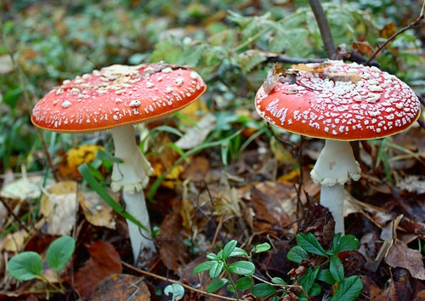
MONTHS
September
October
November

