Slide 1
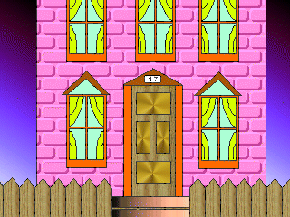
Welcome to
“ A Fairy Cafe”

Slide 2

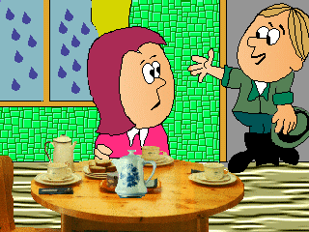
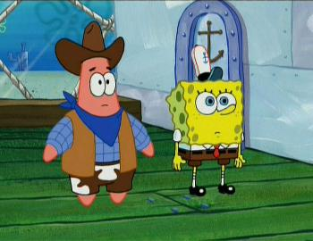
Introduction
I am very glad to see you in my cafe. You can have a good time here.
There are excellent workers, who will serve your table quickly and well.

Slide 3

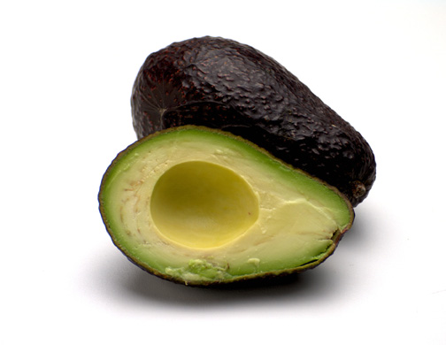
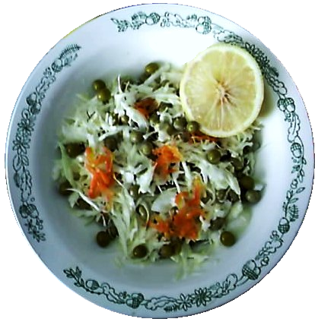

The menu is not so various, but all the dishes are tasty and cooked with love.
For the starter you can choose:
Borsch
Chicken broth
Salad with cabbage and peas

Slide 4



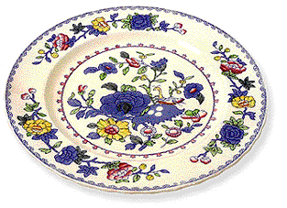
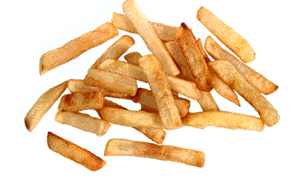

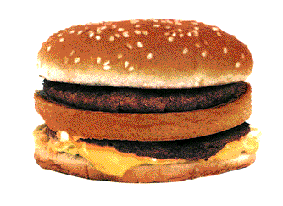
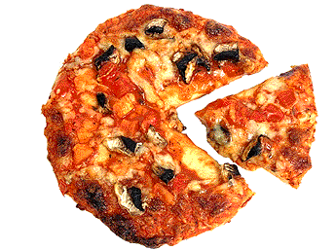

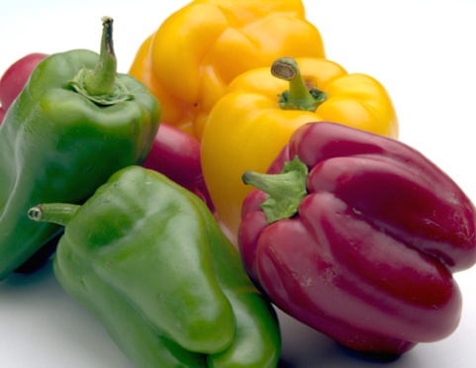
For the main course we have:
Bacon and eggs;
Chips;
Cornflakes;
Pepper with rice
stuffing;
Baked pumpkin;
Mashed potatoes;
Stewed cabbage;
Sandwich, which is our most favourite dish

Slide 5



There are also some meat courses:
Fried pork with apples;
Pies with beef liver;
Boiled chicken.

Slide 6
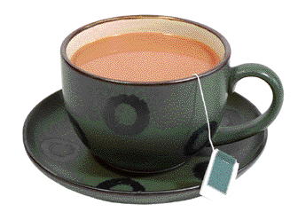
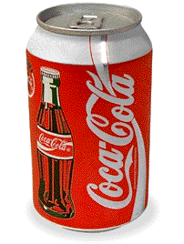




Drinks
Non alcoholic drinks:
Tea;
Coffee;
Fruit juice;
Coca-Cola.
Alcoholic drinks:
Vodka;
White wine;
Red wine.

Slide 7
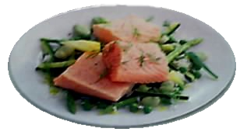

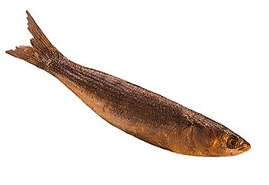

I’d like to suggest you some fish-courses or sea food:
Smoked herring;
Salad with hunchback salmon;
Crayfish;
Crab.

Slide 8
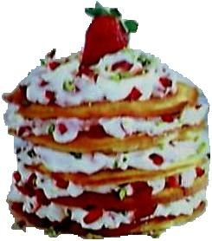

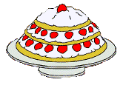

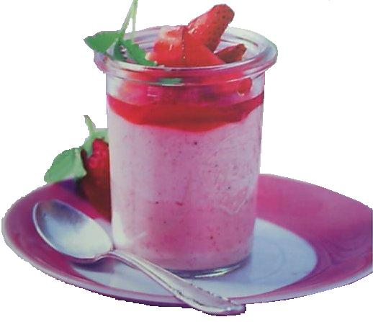

Dessert
There are several different dishes, some of them are specially for Christmas:
Fruit cake with and pancakes
Cherry pie
Cherry cake with cream
Sponge cake
Ice-cream with cream and strawberry
Strawberry with whipped cream

Slide 9
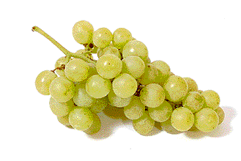



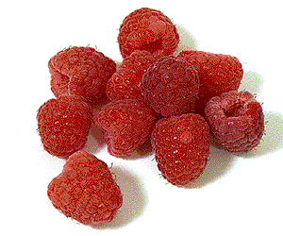
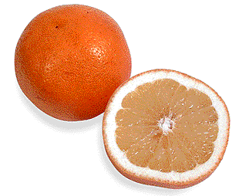

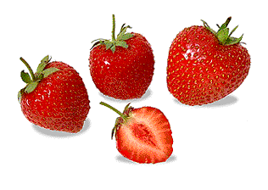
For dessert there are also some fruit and berries:
Grapes
Pear
Pineapple
Raspberry
Strawberry
Peach
Oranges
Apple

Slide 10

Good bye!
Look in next time!

