Slide 1
MUSIC
IN THE MODERN WORLD
Учитель английского языка
МОУ СОШ №13
Шакина Н.Е.
:

Slide 2

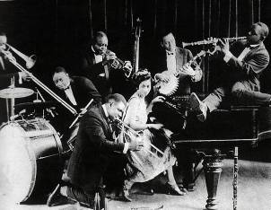
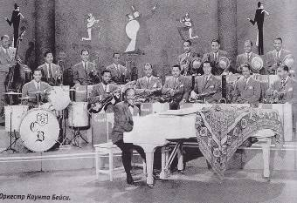
Jazz
Popular music first played by Afro-American groups in the Southern USA in the early 20th century characterised by improvisation and strong rhythms is called traditional jazz; similar music played by large bands of dancing, a later variation much influenced by the blues to produce an unhurried emotive style, is called modern jazz.

Slide 3
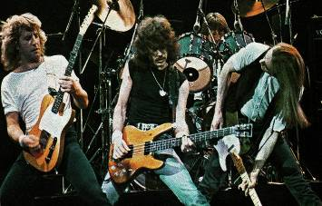
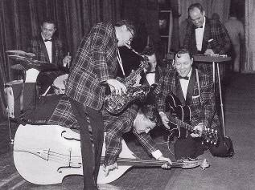
rock`n`roll
In the 50s in pop music of the USA rock’ n’ roll appeared. It was based on the Afro-American style rhythm and blues. One of the pioneers of it was a young talented lorry-driver from Memphis Elvis Presley. He had a charming voice and a nice manner of singing

Slide 4
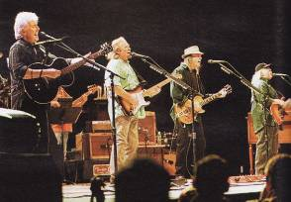

country rock, folk rock
Country music (or country and Western) is a blend of popular musical forms originally found in the Southern United States and the Appalachian Mountains. It has roots in traditional folk music, Celtic music, gospel music and old-time music and evolved rapidly in the 1920s.^{[1]}

Slide 5
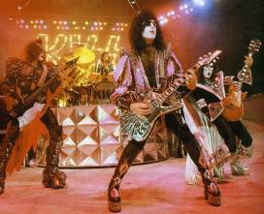

(rock opera)
A rock opera is a musical work, usually in the genre of rock, that presents a storyline told over multiple parts, songs or sections. A rock opera differs from a conventional rock album, which usually includes songs that are not unified by a common theme or narrative. A rock opera tells a coherent story, though details are often vague.

Slide 6

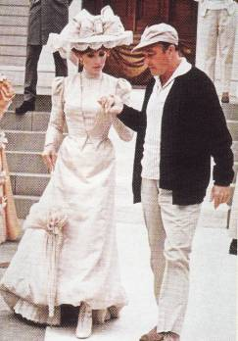
musical
The musical, in all its various forms, is very much a living art form.

Slide 7
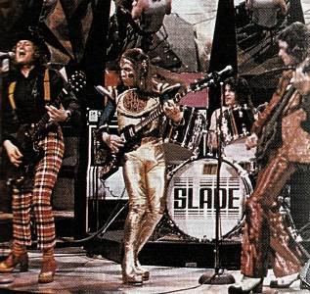
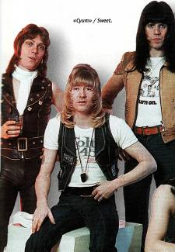
glam rock
Glam rock emerged out of the English Psychedelic and art rock scene of the late 1960s, defined by artists such as T. Rex, Roxy Music, Steve Harley & Cockney Rebel, and David Bowie, also with origins in the theatrics of groups such as The Cockettes, performers such as Lindsay Kemp,

Slide 8
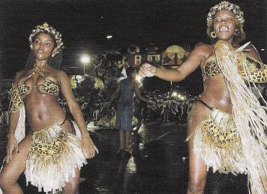
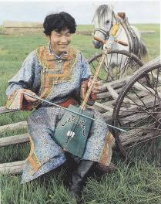
Ethnic music
Ethnic music possesses a strong historical character. Its music form and lyric content can be traced back to earlier forms or origins. For instance, the ethnic music of Greece uses the same music forms as Greek religious music (Byzantine chant), both based on the music forms (modes) of ancient Greece.

Slide 9
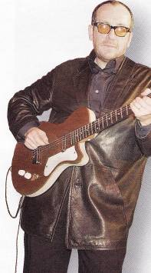
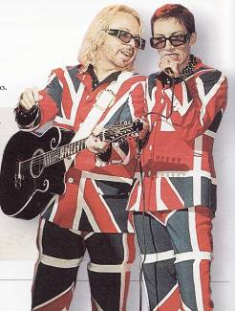
new wave
Punk rock attracted devotees from the art and collegiate world and soon bands sporting a more literate, arty approach, such as Talking Heads, and Devo began to infiltrate the punk scene; in some quarters the description New Wave began to be used to differentiate these less overtly punk bands.

Slide 10
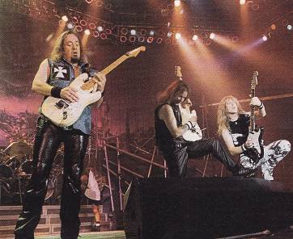
heavy metal
The term "heavy metal" was first used in a musical sense in the '60s song "Born To Be Wild" by Steppenwolf when they referred to "heavy metal thunder."

Slide 11
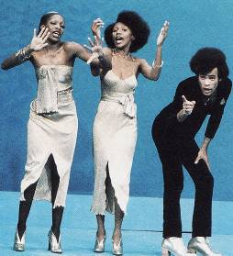
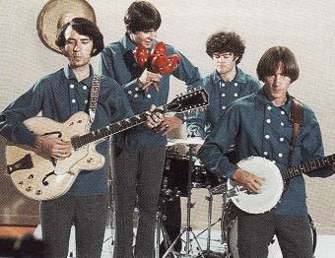
pop music
Pop music is modern music of an uncomplicated character, played mainly on electric guitars and drums often with a singer. There are many styles of pop music such as rap, rave and others

Slide 12
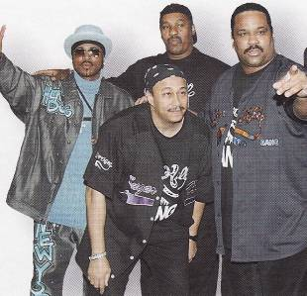
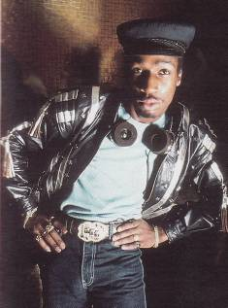
The history of rap music or hip hop music begins in the early '70s. Most music buffs know hip hop music history has a rich past with its roots in several related music styles. If you look at history of rap music, it clearly shows its origins and influences in the popular African American and Latino street culture of New York City and surrounding areas.

Slide 13

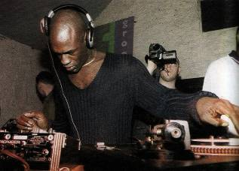
rave
Rave or rave party is a term first used in the 1980s and 90s to describe dance parties (often all-night events) with fast-paced electronic music and light shows.^{[1][2]} At these parties DJs and other performers play electronic dance music, including house, trance, techno and jungle (often collectively referred to as "rave music"),^{[2]} with the accompaniment of laser light shows, projected images and artificial fog.

Slide 14
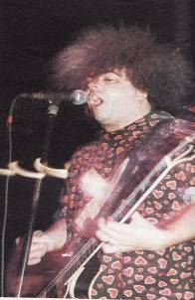

Alternative rock (also called alternative music, alt-rock or simply alternative) is a genre of rock music that emerged in the 1980s and became widely popular in the 1990s. Alternative rock consists of various subgenres that have emerged from the independent music scene since the 1980s, such as grunge, Britpop, gothic rock, and indie pop.

Slide 15
Experimental music
Experimental music refers, in the English-language literature, to a compositional tradition which arose in the mid-twentieth century, applied particularly in North America to music composed in such a way that its outcome is unforeseeable. Its most famous and influential exponent was John Cage (Grant 2003, 174). More loosely, the term "experimental" is used in conjunction with genre names to describe music within specific genres that pushes against their boundaries or definitions, or else whose approach is a hybrid of disparate styles, or incorporates unorthodox, new, distinctly unique ingredients (Anon. [n.d.]a). Similarly, it has sometimes been used to describe "transethnic" music: the mixture of recognizable music genres. A quite distinct sense was current in the late 1950s to describe computer-controlled composition, and the term at that time also was sometimes used for electronic music and musique concrète. "Experimental music" has also been used in music journalism as a general term of disapprobation for music departing from traditional norms.
.

Slide 16
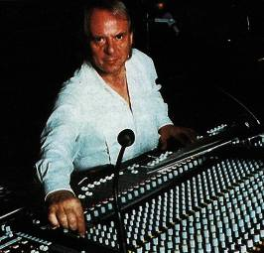
avant-garde
Avant-garde (French pronunciation: [avɑ̃ɡaʁd]) means "advance guard" or "vanguard".^{[1]} The adjective form is used in English, to refer to people or works that are experimental or innovative, particularly with respect to art, culture, and politics.
.

Slide 17
The world of music is around us. Music can leave us indifferent or it can provoke powerful and complex feelings. So music plays a very important role in people’s lives. It reflects our mood and emotions. You can hardly find a person who doesn’t like or need music, who never sings or dances.

