Slide 1

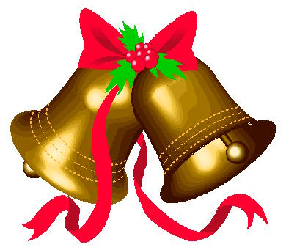

Christmas

Slide 2

We would like to tell you about Christmas in America.
Christmas Day has been a federal holiday in the United States since 1870. People in the United States celebrate Christmas Day on December 25. The day celebrates Jesus Christ's birth. People decorate Christmas trees, decorate their homes, visit family or friends and exchange gifts.

Slide 3
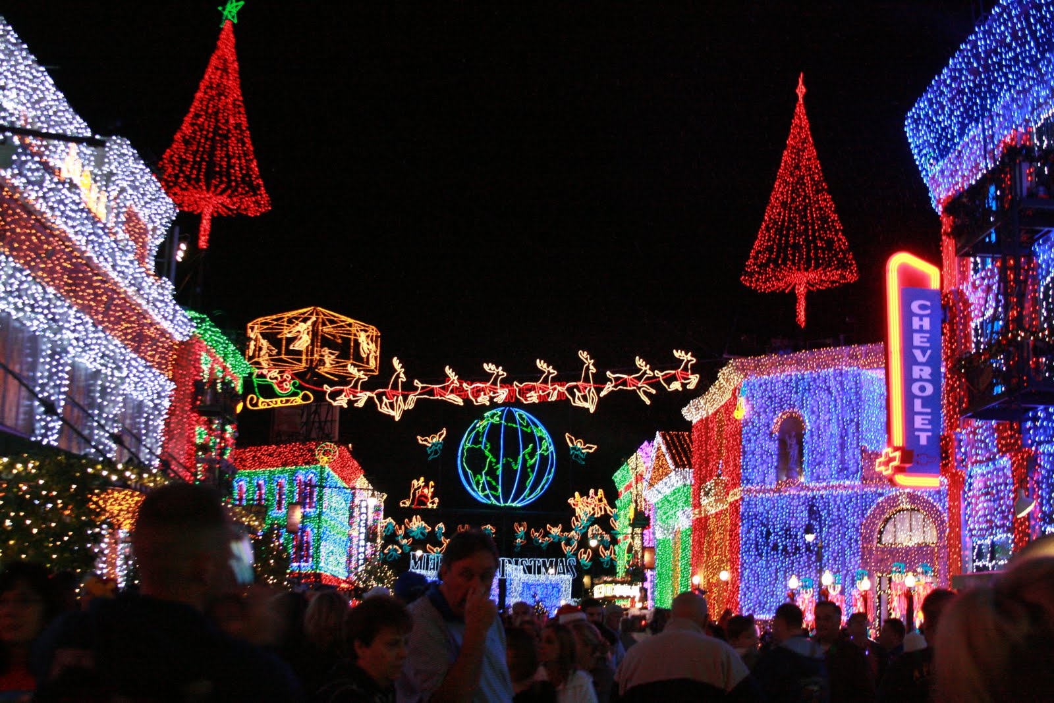
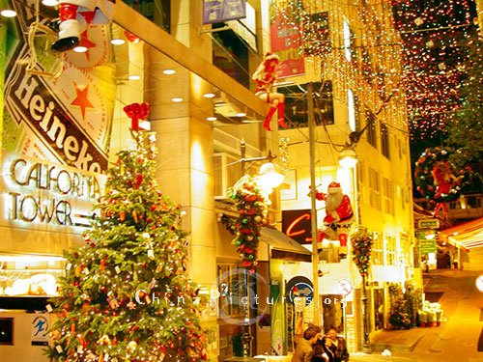
The Christmas and holiday season begins around the end of November, the day after the U.S. holiday of Thanksgiving. Though Christmas decorations and music playing in stores sometimes extend into the period between Halloween and Thanksgiving.

Slide 4
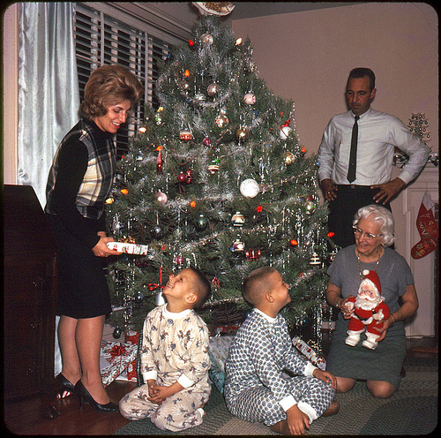
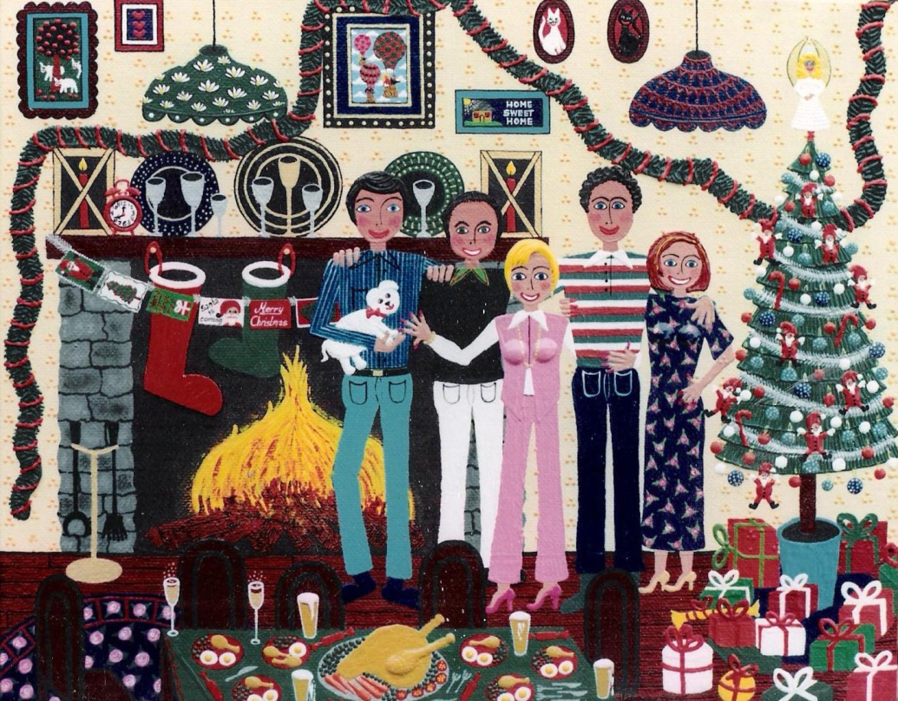
Schools are closed during the period between Christmas and the New Year’s Day holiday, which is a time commonly used to spend time with family.

Slide 5
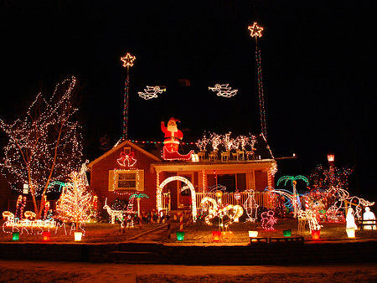
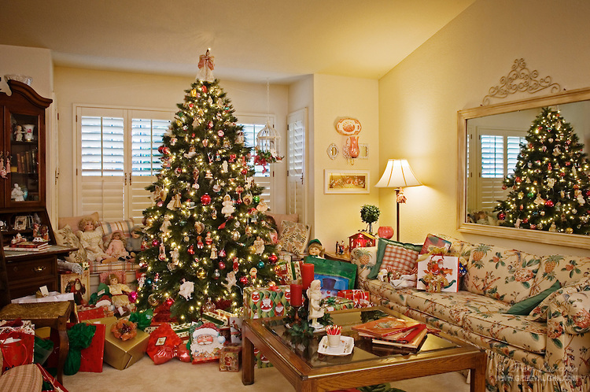
The interior and exterior of houses are decorated during the weeks leading up to Christmas Eve. The Christmas tree usually stands centrally in the home, decorated with ornaments, tinsel and lights, with an angel or a star symbolizing the Star of Bethlehem at the top.

Slide 6
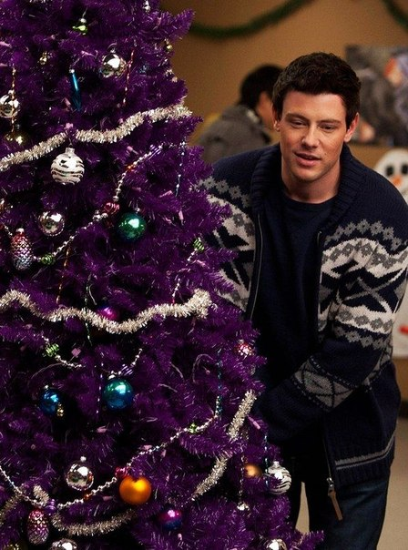
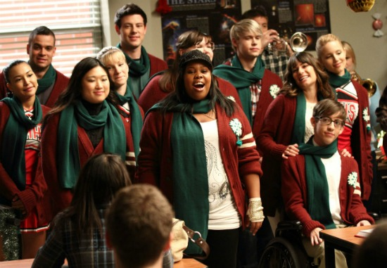
Christmas is favorite holiday in the American schools too.

Slide 7


Slide 8
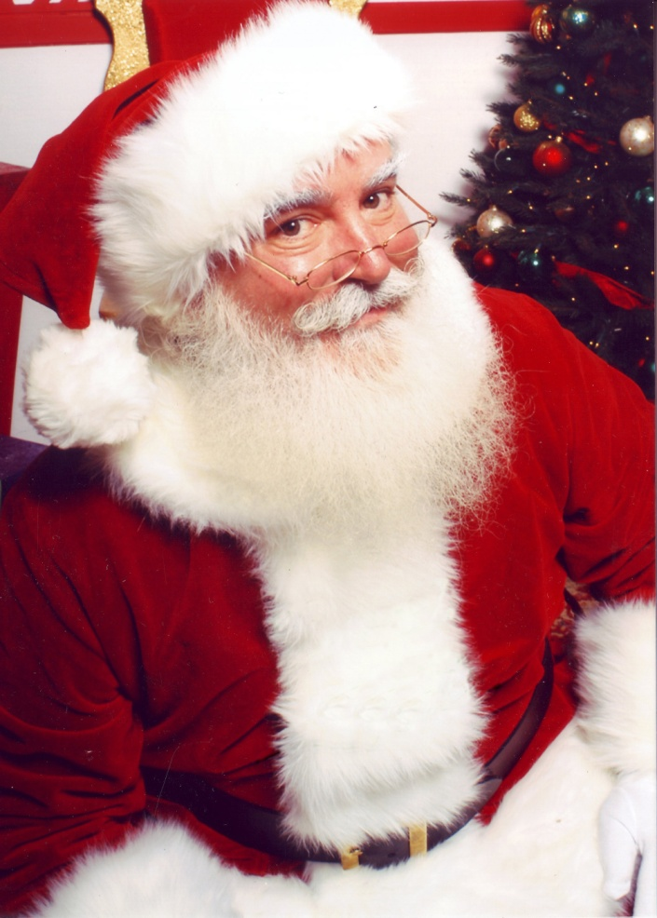
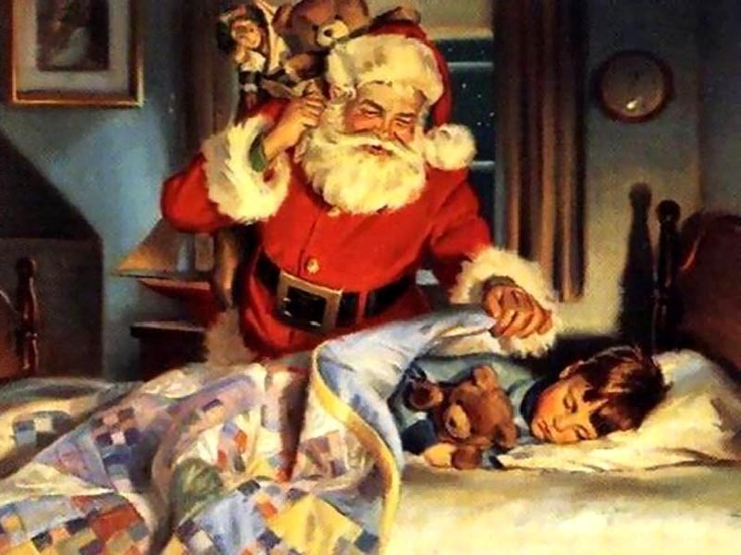
Christmas Eve is popularly described as "the night before Christmas". Better known as Santa Claus, he visits homes while children are sleeping the night before Christmas morning.

Slide 9
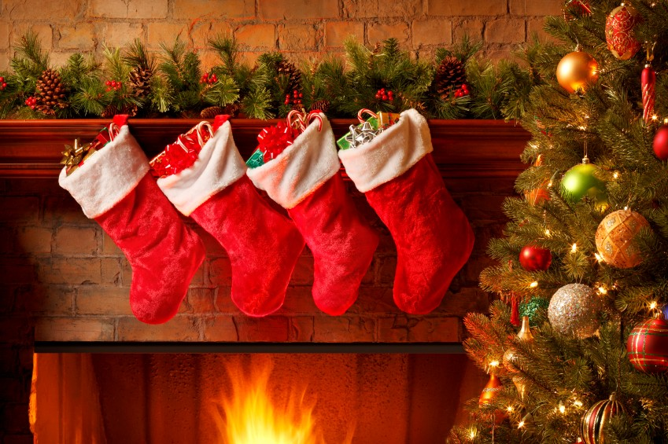
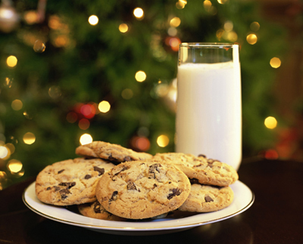
Christmas stockings are hung on the mantelpiece for Santa Claus to fill with little gifts.
It is tradition throughout the United States for children to leave a glass of milk and plate of Christmas cookies for Santa Claus.

Slide 10
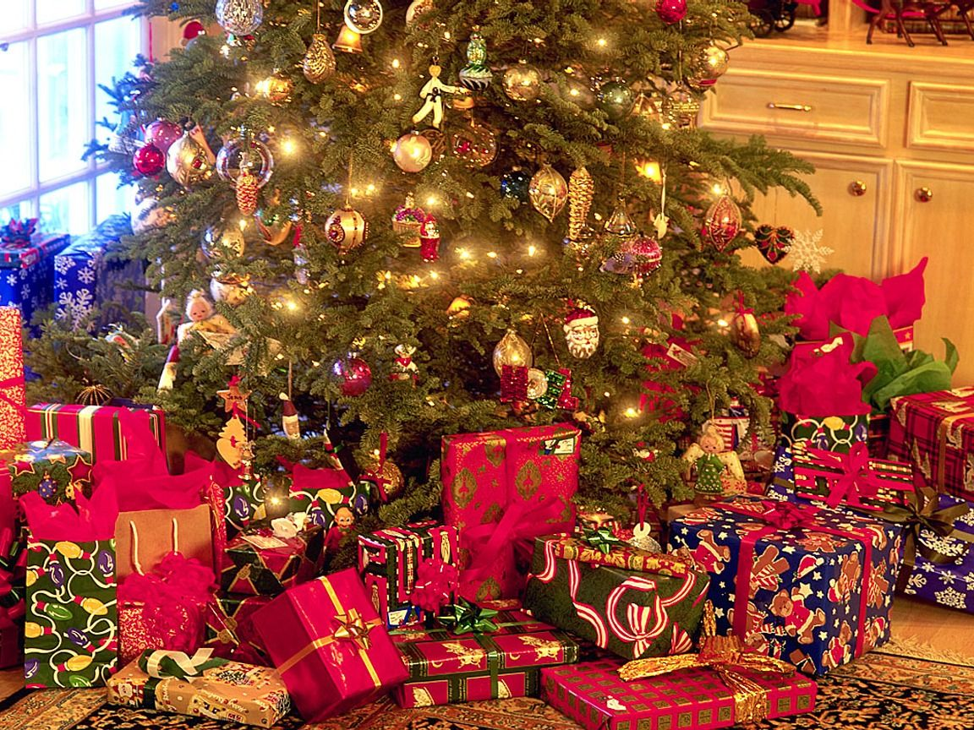
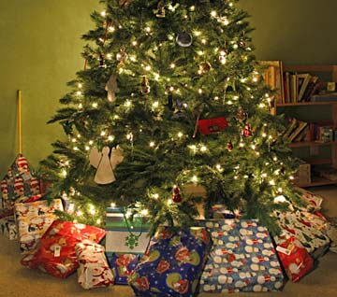
Family wrapped presents are placed near the tree, including presents to be given to pets. Friends exchange presents and tell each other, "Do not open before Christmas!" Presents are most commonly opened on the morning of Christmas Day; other families choose to open presents on Christmas Eve, depending on family traditions. Usually children are allowed to play with their new toys after.

Slide 11
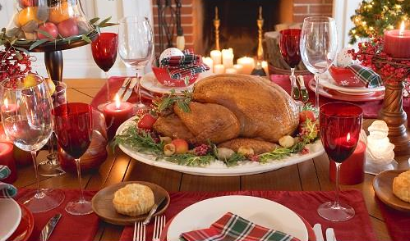
The traditional Christmas dinner usually features either roasted turkey with stuffing or roast beef and Yorkshire puddings. So much variety of sweet pastry with cinnamon and nutmeg are served on the dinner. Certain dishes such as casseroles and desserts are prepared with a family secret recipe. Fruits, nuts, cheeses and chocolates are enjoyed as snacks.

Slide 12
Christmas is the special holiday in America, it’s a magical time for kids and for adult. It’s time, when you can think about happy or sad things that make you remember what's really important. It’s time when you can wish Merry Christmas to family, friends and even to strangers, because you know that it would be nice to them. It’s time of Christmas songs, of bright lights, the smell of trees. It’s time of beauty. It’s time of MAGIC.
By the way!!! Today Is Christmas!!!

Slide 13


