Slide 1
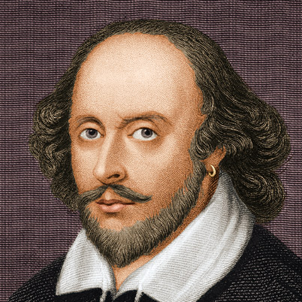
William Shakespeare
1564-1616
MY GAME

Slide 2
1. WHEN WAS W.SHAKESPEARE BORN?
Was born on April 23, 1564

Slide 3
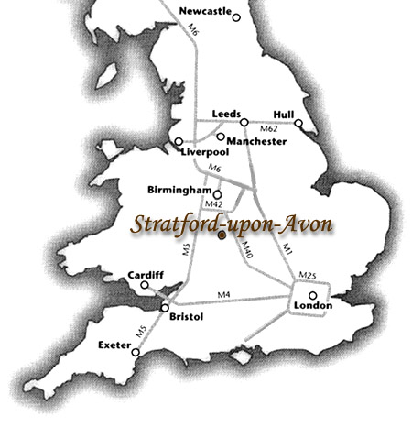
2. Where was he born?
Stratford-Upon-Avon, England

Slide 4
3. What was his father?
a glove maker
and Mayor of Stratford.

Slide 5
4. What was his mother’s name?
Mary Arden

Slide 6
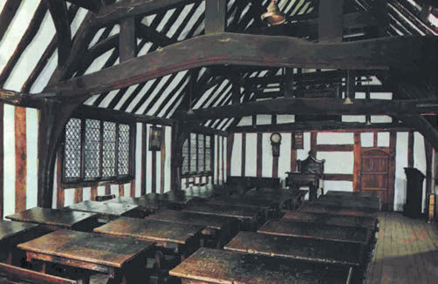
5. Where did he study?
the King’s New School

Slide 7
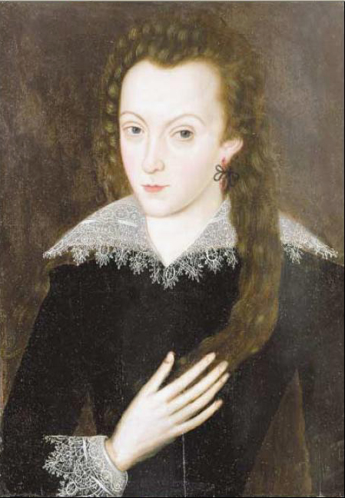
6.When did William married?
at age 18

Slide 8
7. How many children did he have?
3

Slide 9
8. When did he moved to London?
around 1591

Slide 10
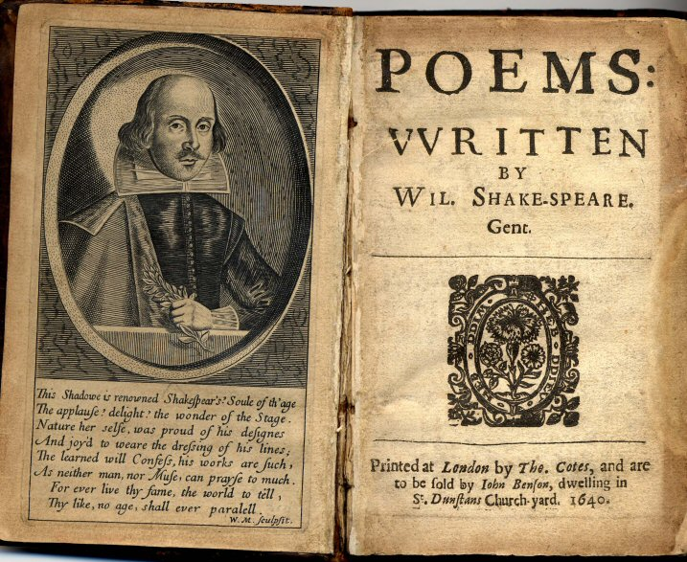
9. How many sonnets did he write?
Wrote 154 sonnets

Slide 11
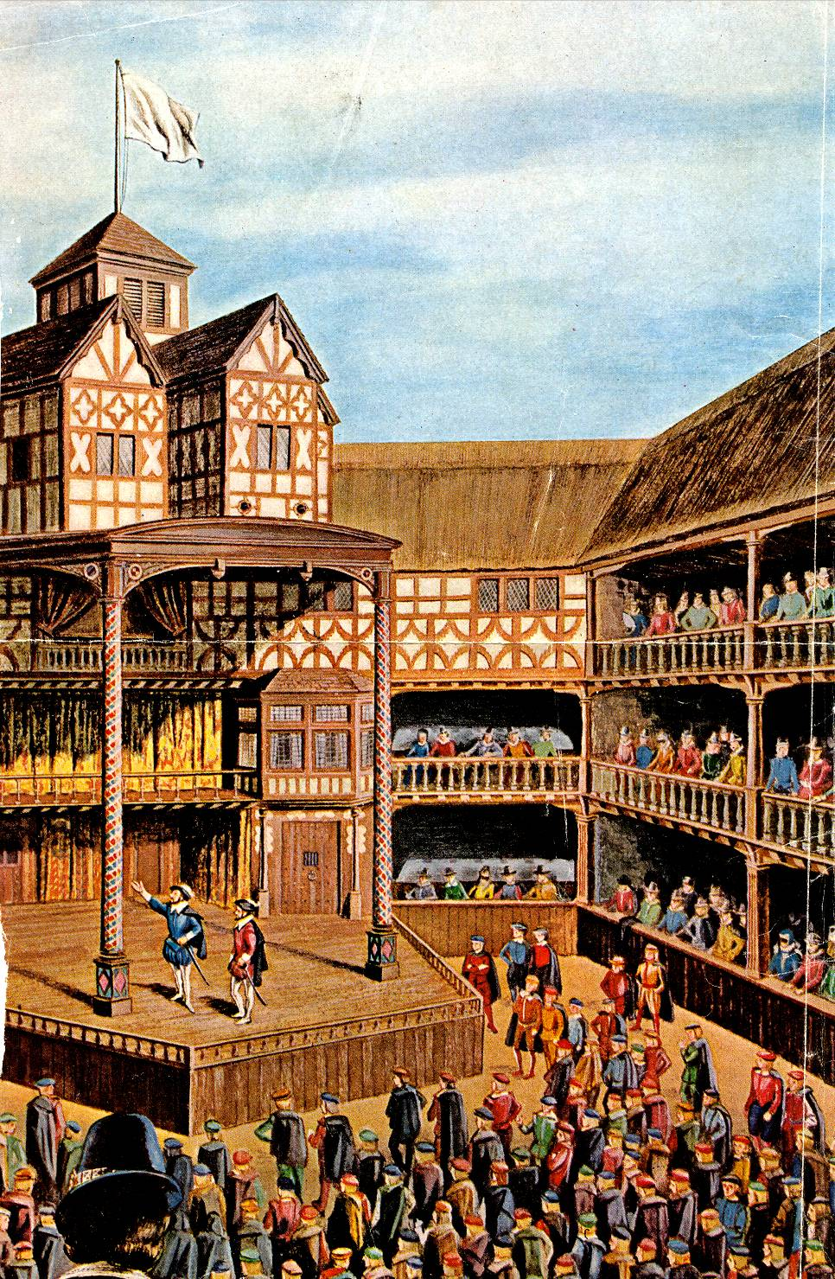
10.When did he build the Globe?
1599

Slide 12
11. Brevity is the soul of wit
Стислість сестра таланту

Slide 13
12. Salad says
Молодо - зелено

Slide 14
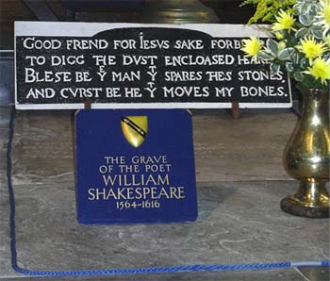
13. When did he die?
1616

Slide 15
William Shakespeare
Shakespearianisms | Author’s translation
What is a piece of work is a man! (“Hamlet”) | Що за витвір мистецтва - людина! (М.Лозинський)
Brevity is the soul of wit. (“Hamlet”) | Стислість – сестра таланту. (А.Чехов)
Curiosity killed a cat. (“Macbeth”) | Цікавість до добра не доведе. (Б.Пастернак)
All is well that ends well. (“Macbeth”) | Все добре, що добром закінчується. (М.Лозинський)
Something is rotten in the state of Denmark. (“Hamlet”) | Не все добре в Данському королівстві (Б.Пастернак)
A fool’s paradise. (“Romeo and Juliet”) | Світ фантазії. (Б.Пастернак)
Salad days. (“Antonius and Cleopatra”) | Молодо – зелено. (Б.Пастернак)

