Slide 1
My family.
I have a mom, dad, uncle, brother and aunt, sister, grandpa, grandma.

Slide 2
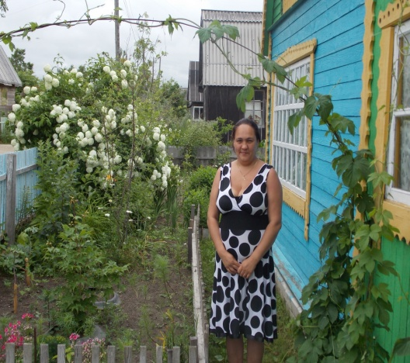
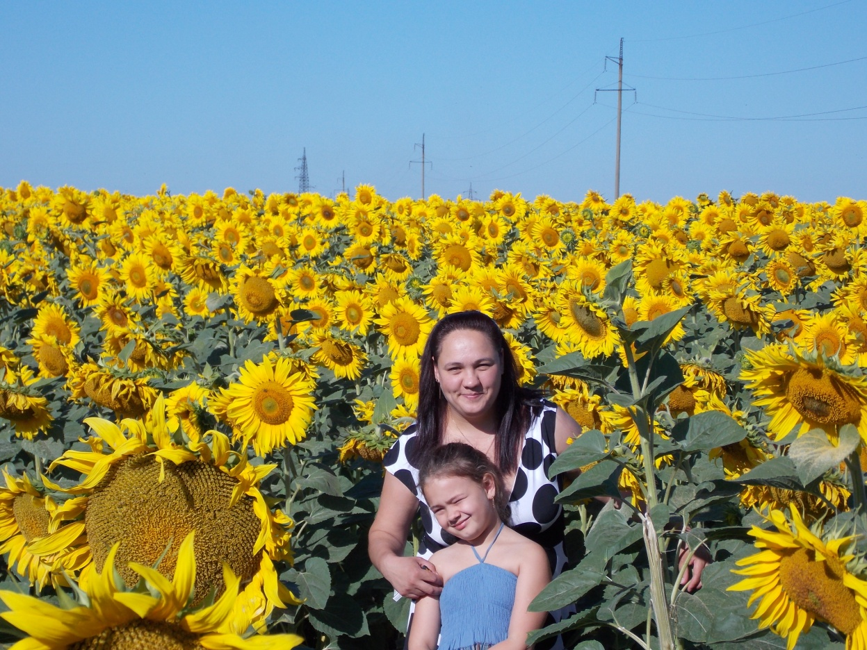

My mom.
My mom name Karina her 35 years. She works as doctor.

Slide 3
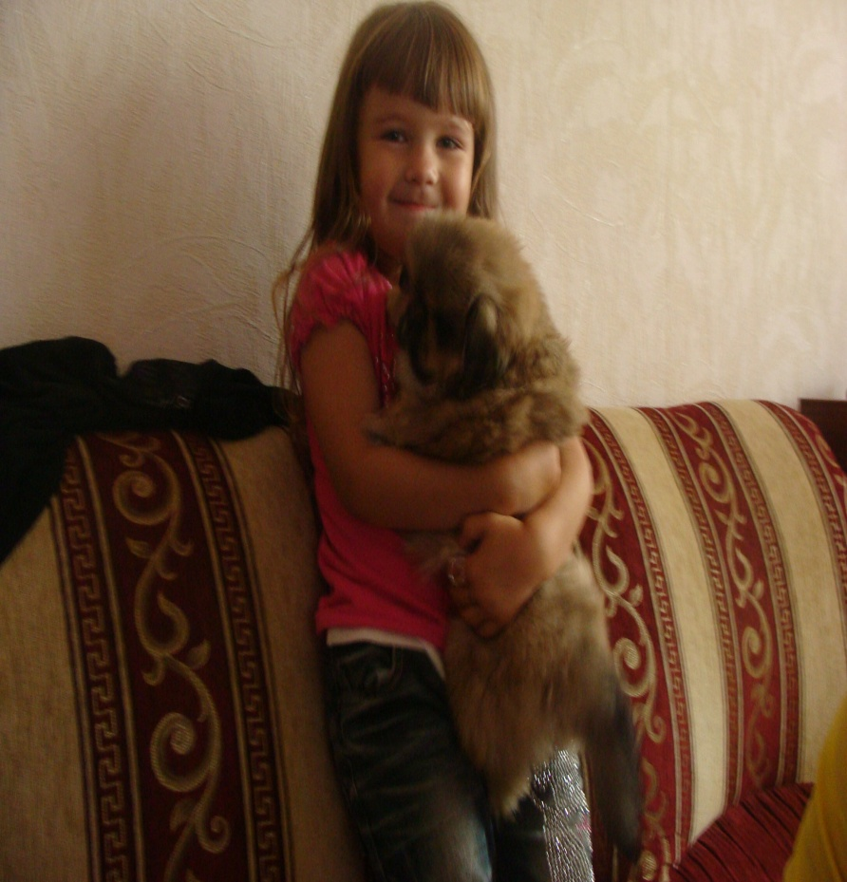
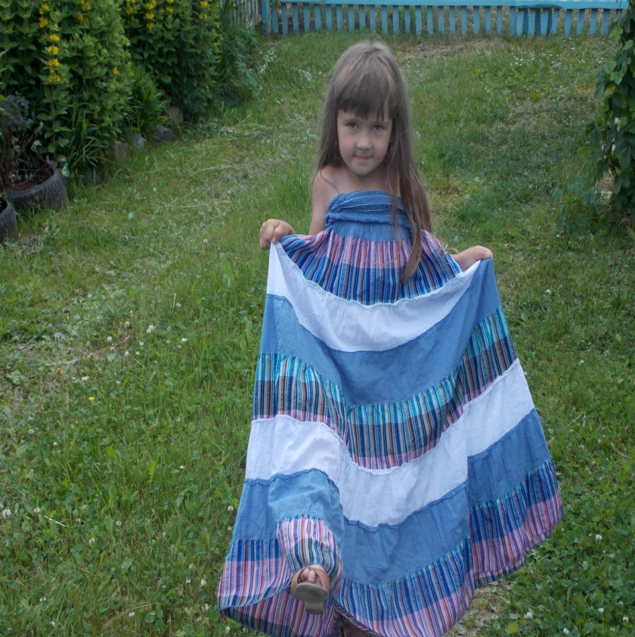
My sister.
My sister it name Yana. She 6 years old. She learn in 1 School, in 1 g class.

Slide 4
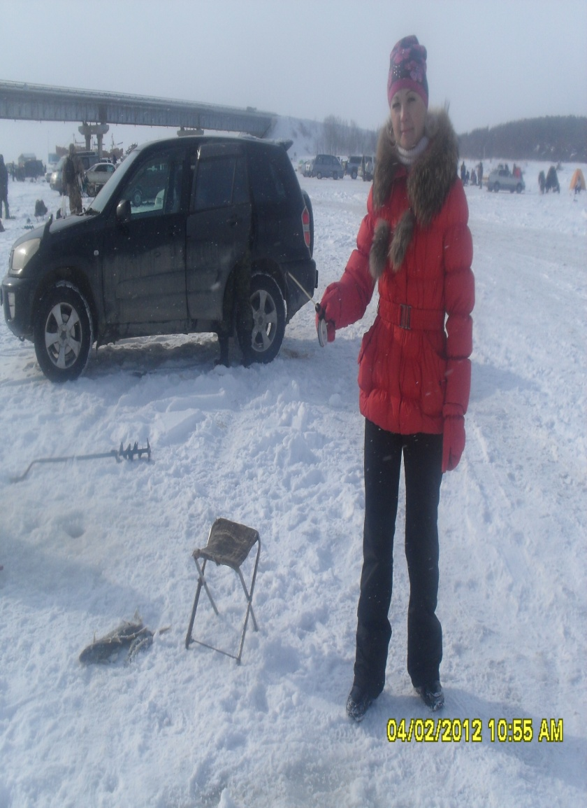
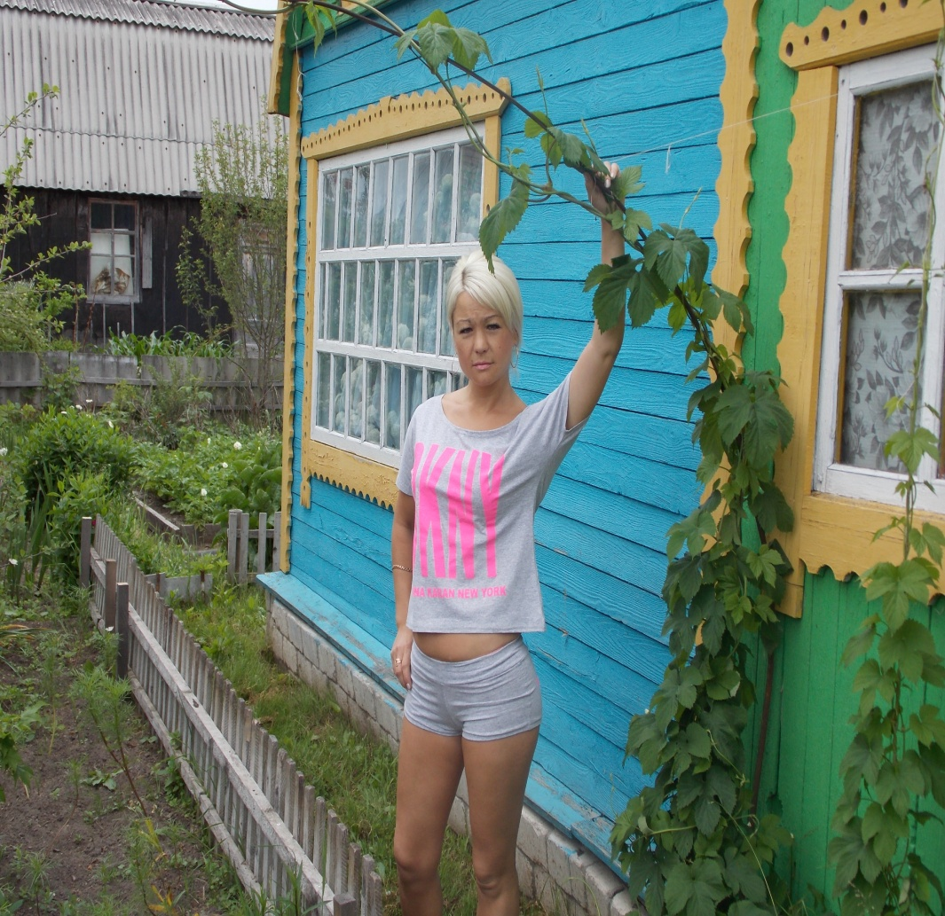
My aunt
My aunt name Oley it 37 years. She worked as a salesman.

Slide 5
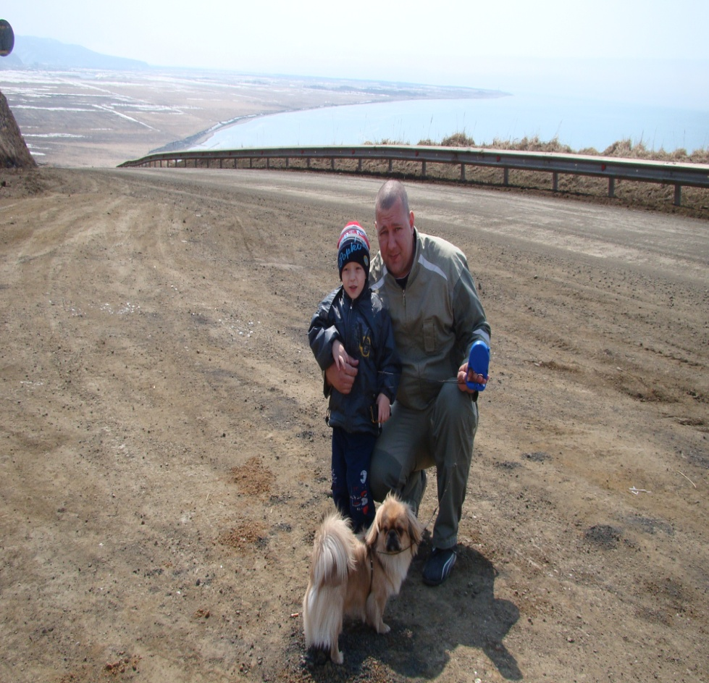
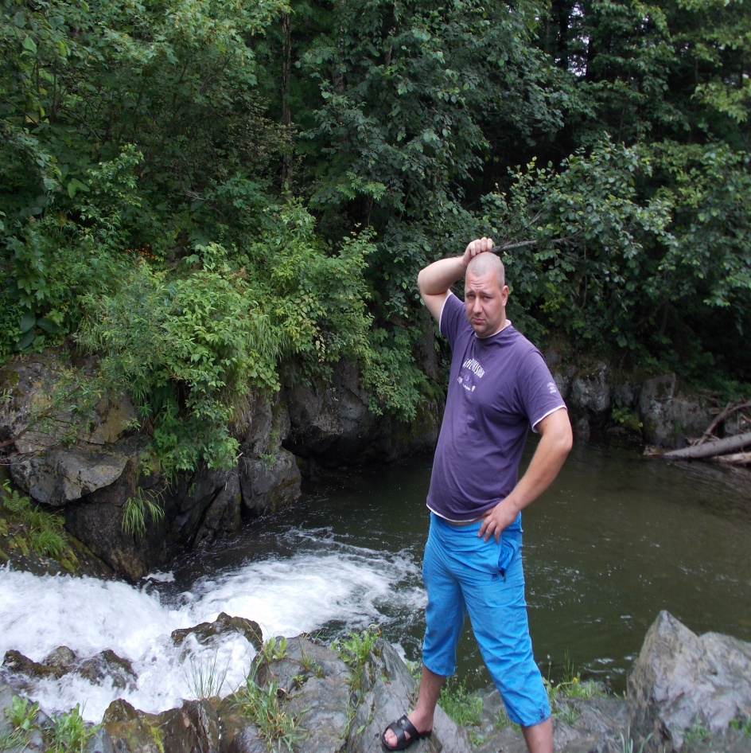
My dad
My dad name Anton it 34 year. He works as a driver.

Slide 6
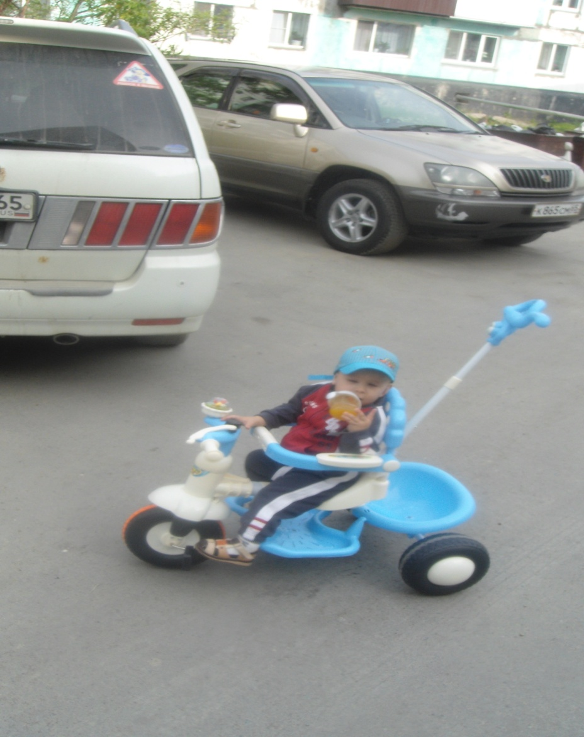
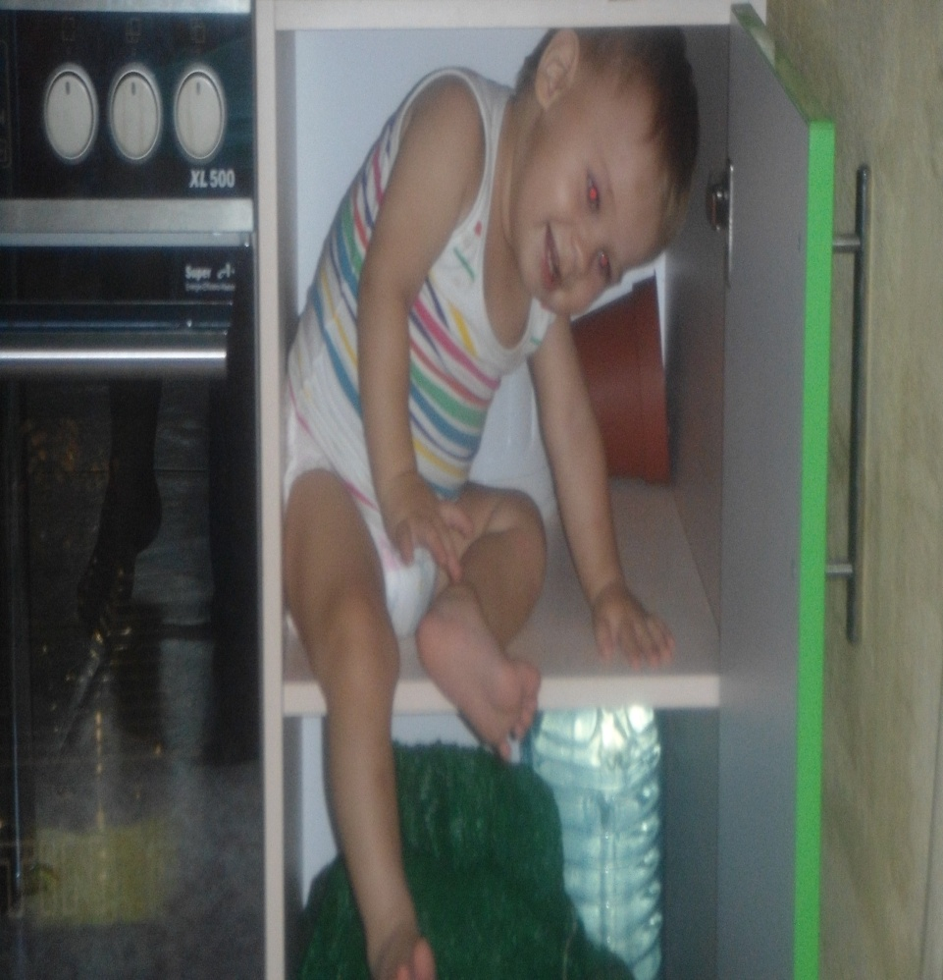
My brother
My brother name Egor it 1 year.

Slide 7
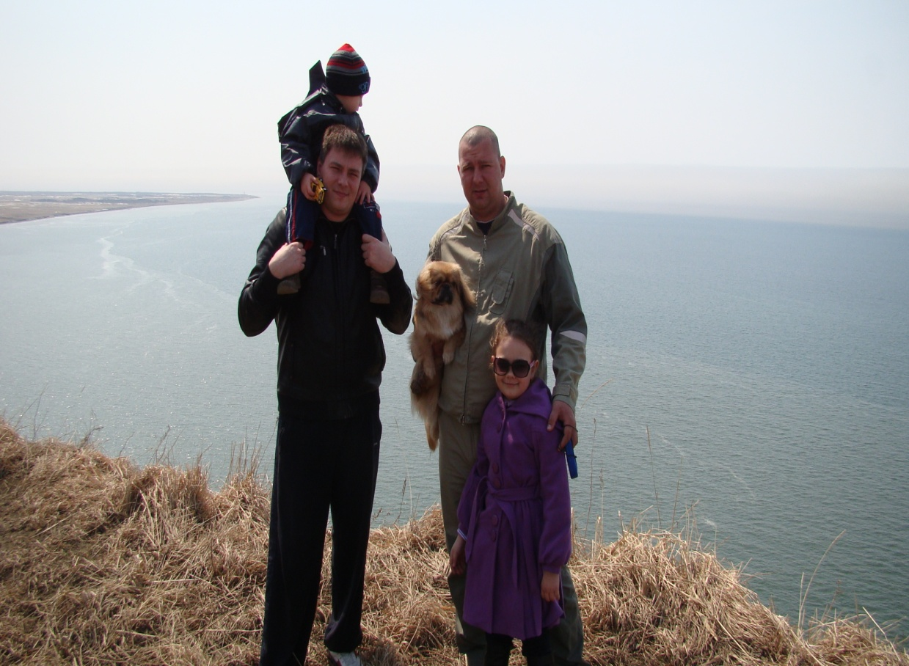
My uncle
My uncle name Jurassic it 37 years. He works for the police.

Slide 8
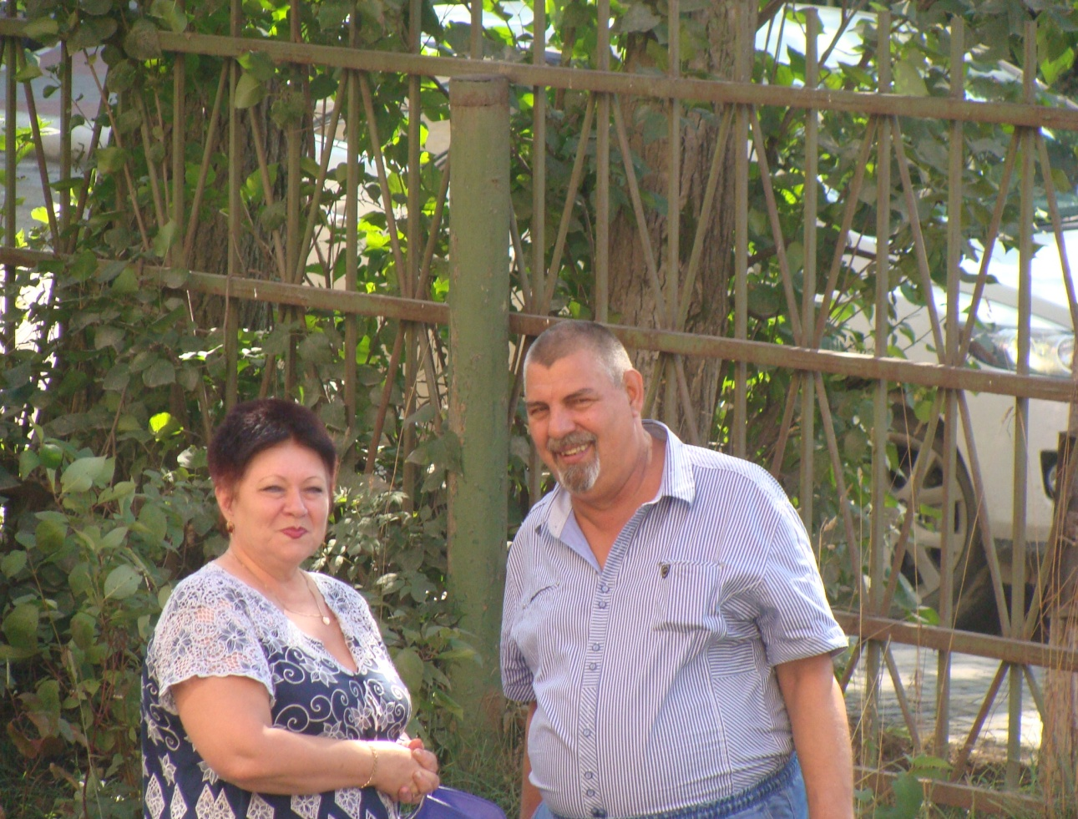
My grandma
My grandma name Nadia it 60 years. She works in the pension fund.

Slide 9

My grandpa
My grandpa name Valera it 62 years. He works fisherman.

Slide 10

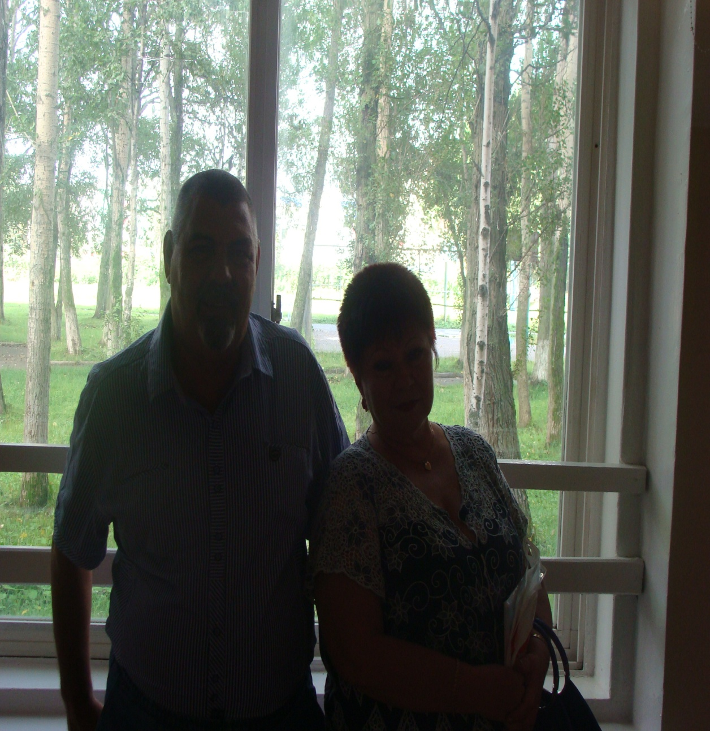
My whole family!

Slide 11

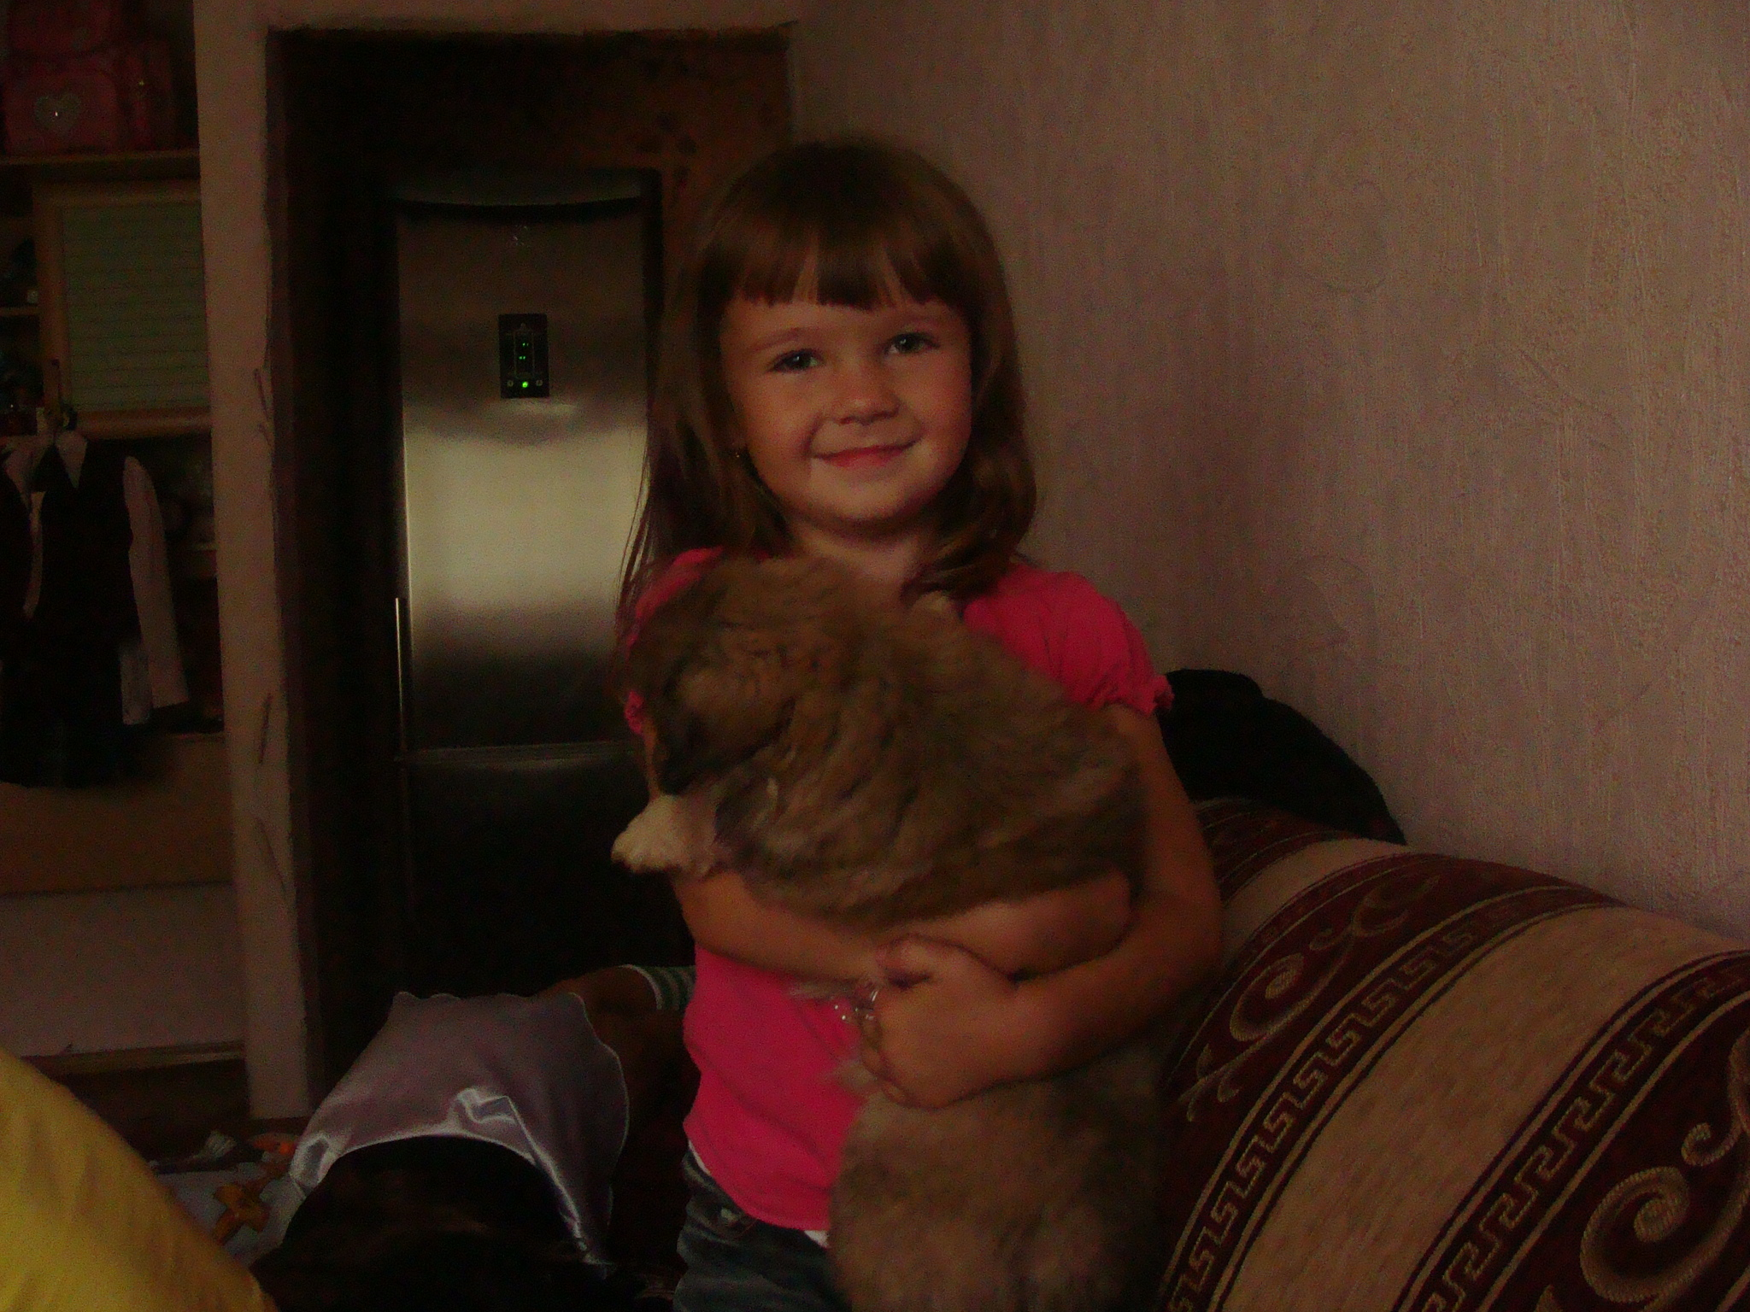

Slide 12

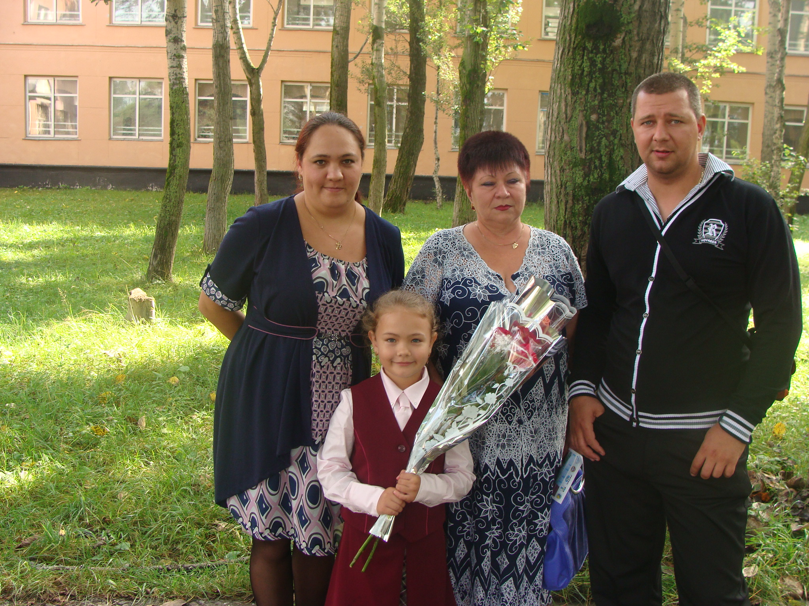

Slide 13
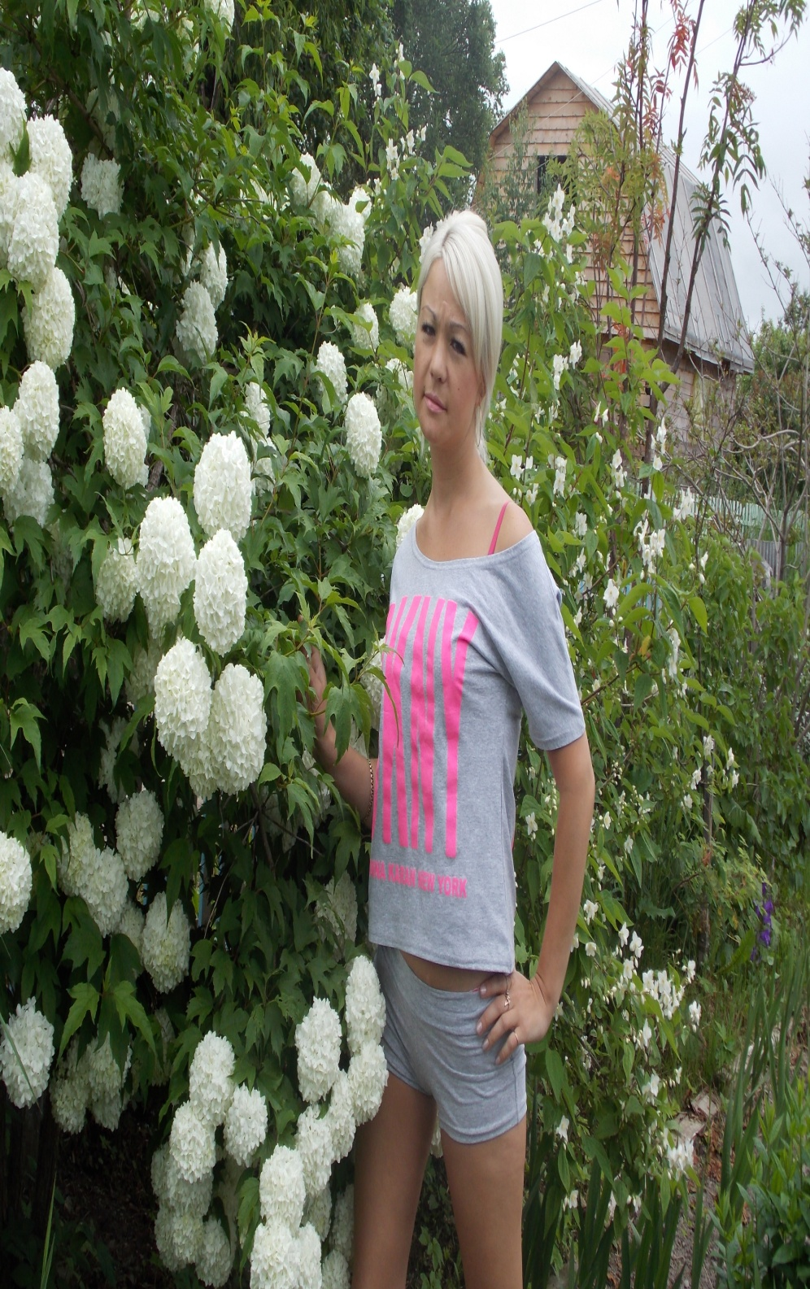


Slide 14
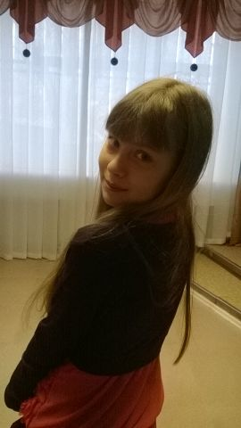
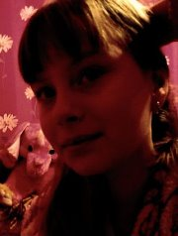
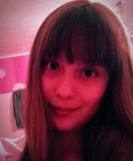
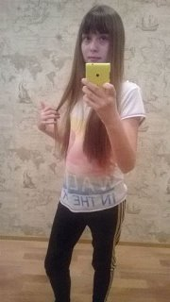
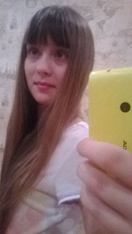

Slide 15

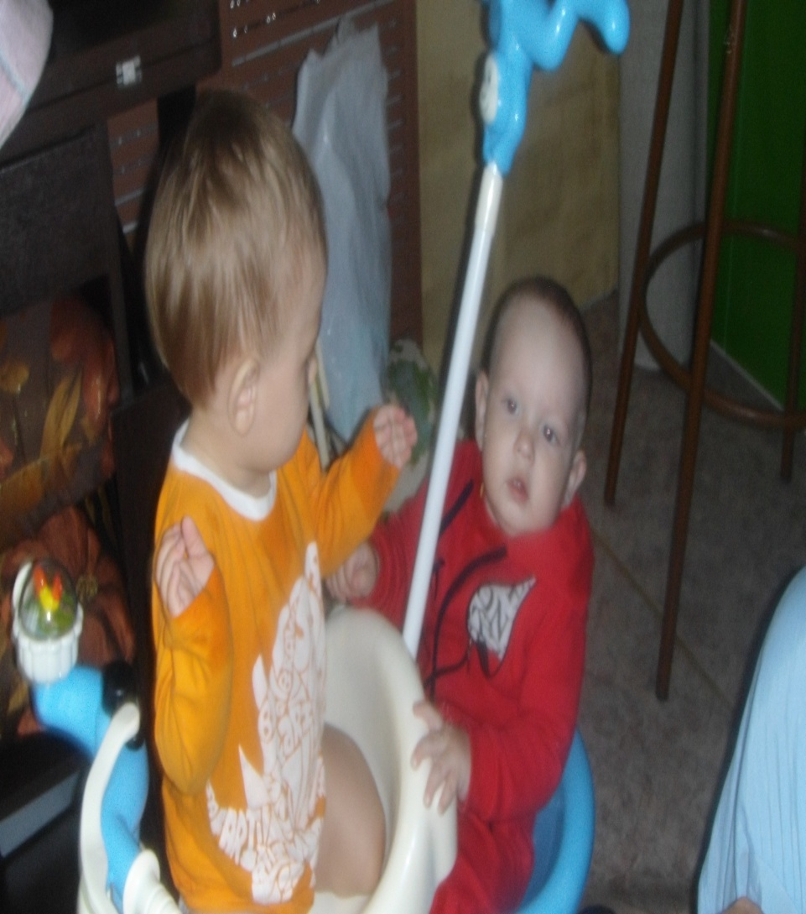

Slide 16
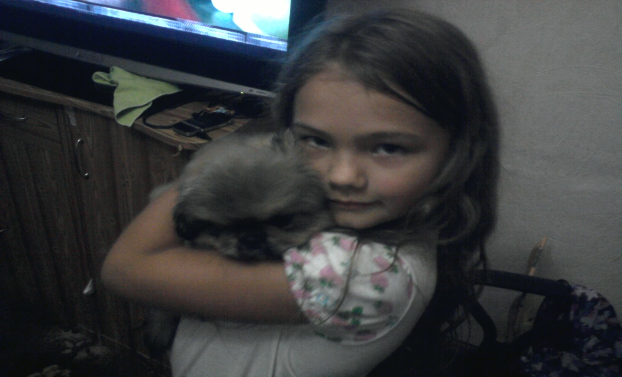
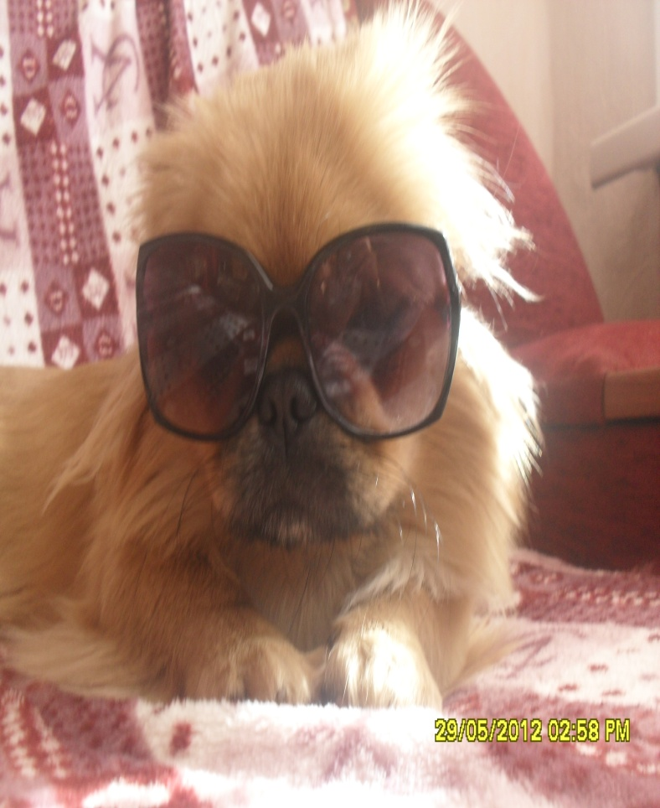
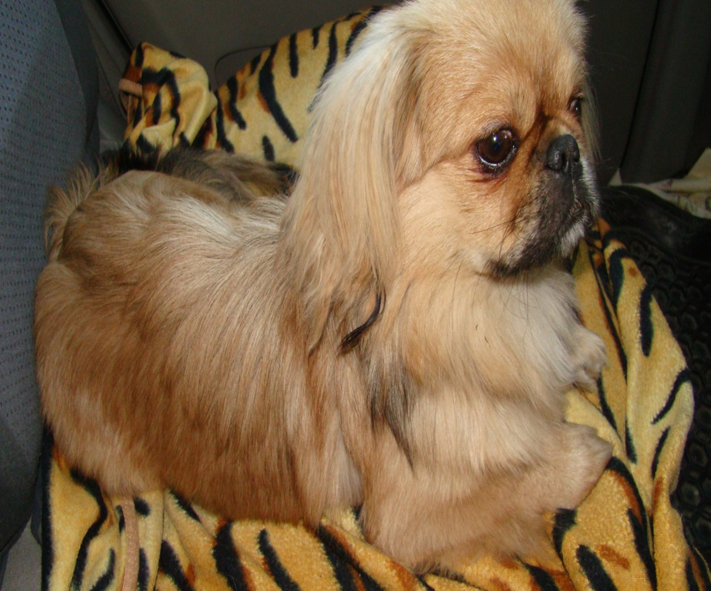

Slide 17
Thank you for attention!

