Slide 1

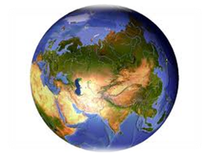

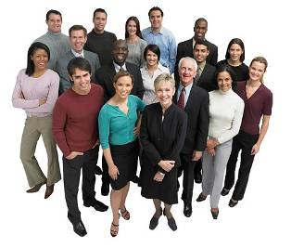
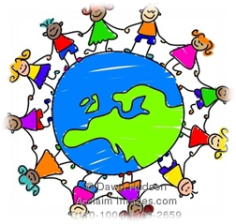
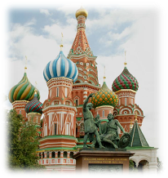
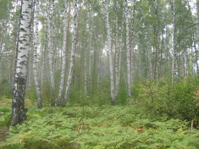
The eleventh of October
Tuesday

Slide 2

“Around the world”

Slide 3
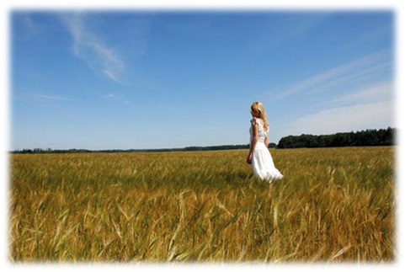
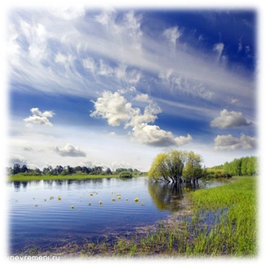
[ɪ] [ou] [i:] [ɜː]
big home peace earth
twig dome we world

Slide 4
[ɪ] [ou] [i:] [ɜː]
home big earth
world dome we peace twig

Slide 5

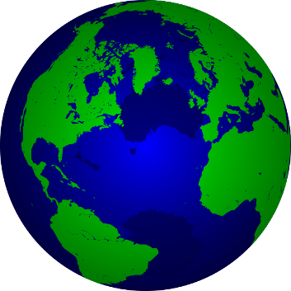

We live in the world so vast and big,
We live in the world so hard to twig,
We live on the Earth, that`s our home,
Let`s all live in peace under heaven`s dome.

Slide 6






We live in the world so vast and big,
We live in the world so hard to twig,
We live on the Earth, that`s our home,
Let`s all live in peace under
heaven`s dome

Slide 7
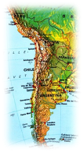

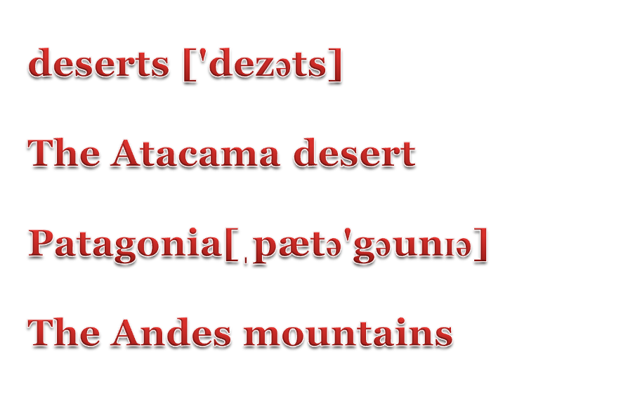
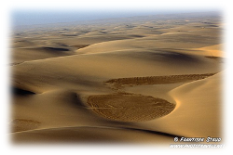
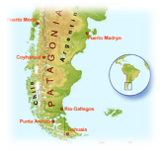
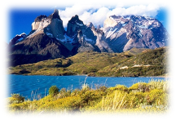

Slide 8

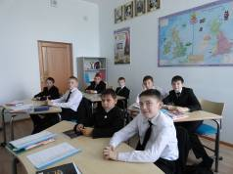

Say if the following statements are true or false
 | True | False
1. Chile is in south Africa | F | F
2. The capital city is Santiago | R | U
3. There is no snow in the south | R | I
4. There are deserts in the north of the country | E | T
5. The Central Valley has a lot of lakes | R | N
6. There are a lot of wonderful places to visit | D | I

Slide 9
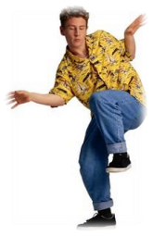
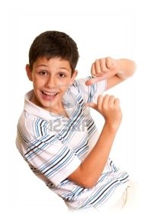
Let`s dance!!!!!!!!!!!!
Hi, my friend, dance with me,
It is easy, you can see,
One step back, one step out,
Then you turn yourself around.
It`s so great to dance with you,
And it is not hard to do,
One step back, one step out,
Then you turn yourself around.

Slide 10


Put the parts of the text into the logical order and guess what county is the test about

Slide 11
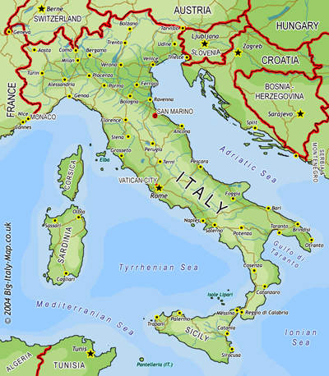

Slide 12
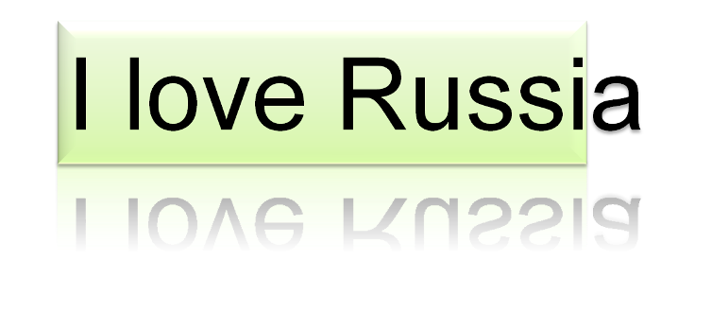





Slide 13

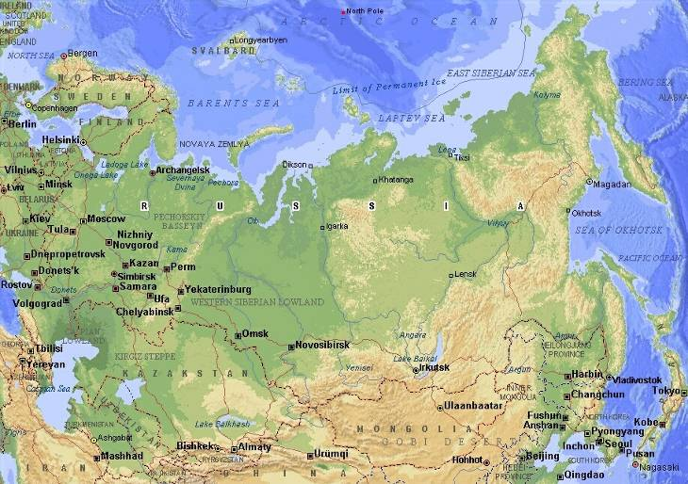
The Russian Federation

Slide 14
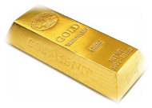
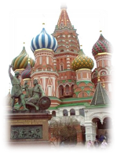
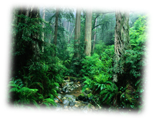
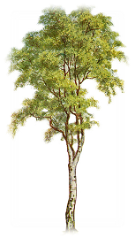
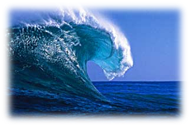
 |  |  |  | 1.
2.
 | 3.
 |  |  |  |  |  |  | 6.
4.
 |  |  |  |  | 5.
 |  |  |  | 7.

Slide 15
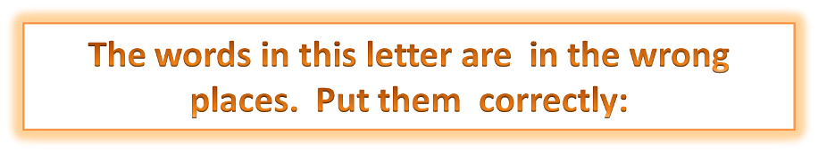
Hi!
My name is
12 years old.
I live in Dennis.
I am Australia.
I speak Australians.
People in my country are
English.
Bye for now.

Slide 16



To: Russian pen-friends
From: Dennis Grey
Theme: Meeting new friends
Hi!
My name is Dennis. I live in Australia. I’m 12 years old. I am Australian. I speak English .People in my country are Australians.
Bye for now.

Slide 17

Homework: write a letter to a penfriend
“5” – 60-65 слов
“4” – 50-55 слов
“3” – подобно образцу

