Slide 1

Christmas Facts
Выполнил: Матвеева Н.А.
учитель английского языка
Пролетарского района
Города Тулы
20.12.13

Slide 2

The 26th of December
is known as Boxing Day because it was the day the family opened a gift box for the poor.

Slide 3
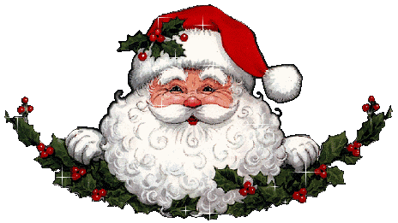
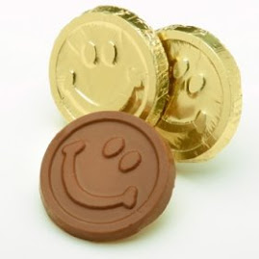
Gold – wrapped chocolate coins
commemorate St. Nicolas who gave bags of gold coins to the poor.

Slide 4

A traditional Christmas dinner
in early England included a pig᾿s head with mustard sauce. It was usually followed by roast peacock.

Slide 5
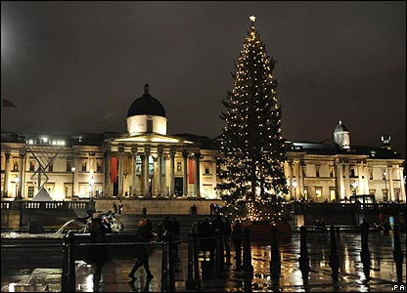
The Christmas tree
Displayed in Trafalgar Square in London is an annual gift to the UK from Norway since 1947. The Norwegian spruce given is a token of appreciation of British friendship during World War II from the Norwegian people.

Slide 6
Christmas trees
became popular in the UK from 1841when Prince Albert erected a tree in Windsor Castle following a German tradition. Fir trees have been decorated at Christmas time in Germany since the 8 century.

Slide 7
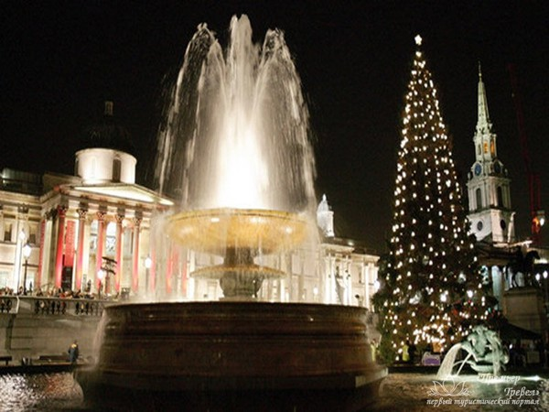
Christmas tree
It can take between 4-15 years to grow a Christmas tree of typical height(6-7 feet).
The world᾿s biggest Christmas tree (76 m high) was put up in America in 1950.
In the USA, Christmas tree are now called «Holiday Trees».

Slide 8
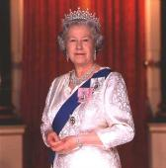
The Queen᾿s Christmas speech
was first televised in 1957.

Slide 9
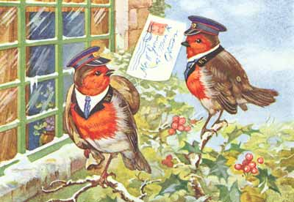
The first Christmas card
Was designed in1843by English artist
J. C.Horsley. Robins on cards were a joke 150 years ago when postmen wore red tunics and were named after them.

Slide 10

A Christmas wreath
A Christmas wreath hanging on your front door symbolizes a sign of welcome and long life for all who enter.

Slide 11

The poinsettia
is a traditional Christmas flower. In Mexico (its original birthplace), the poinsettia is known as «The flower of the Holly Night»

Slide 12
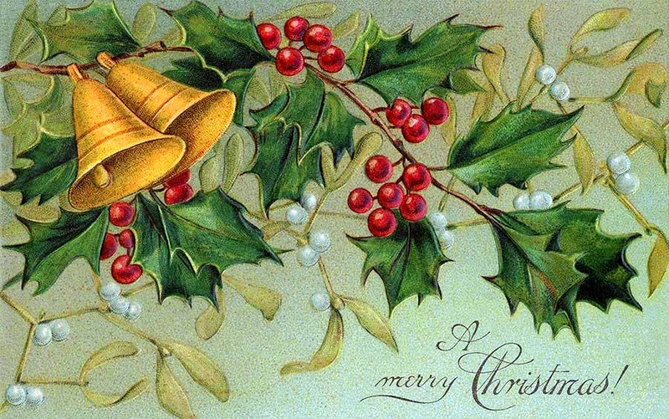
Misletoe
At Christmas, it is traditional to exchange kisses beneath the hanging misletoe. In ancient Scandinavia, misletoe was associated with peace and friendship.

Slide 13
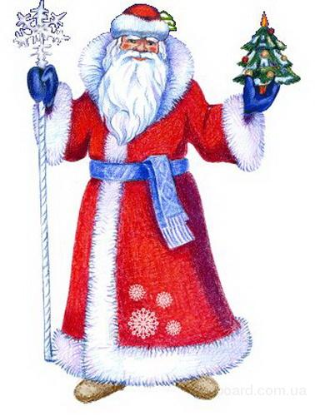
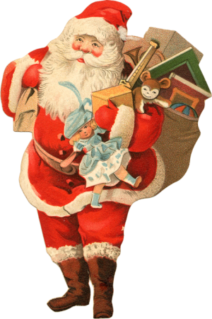
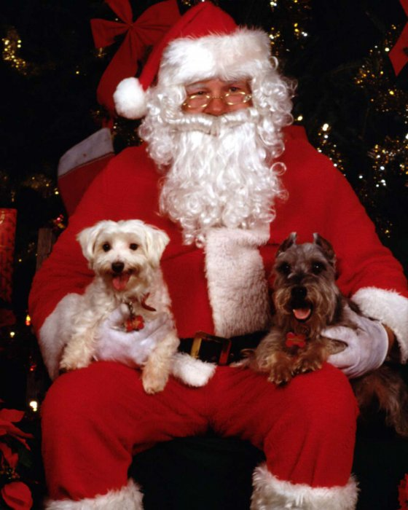
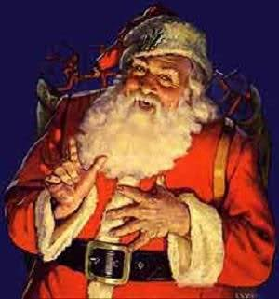
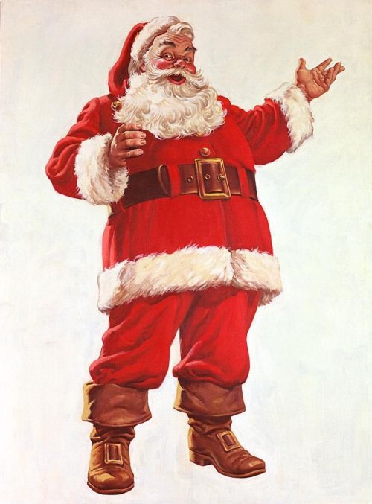
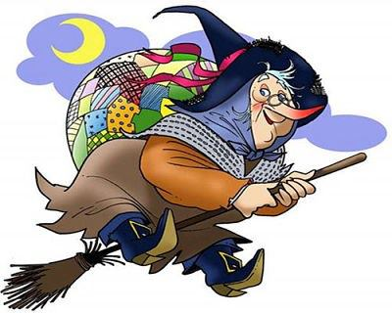
Santa Claus
has many different names around the world including Father Christmas in the UK, Pere Noel in France, Kriss Kringle in Germany, La Befana in Italy, Julinesse in Denmark, Grandfather Frost in Russia, Papa Noel in Spain.

Slide 14
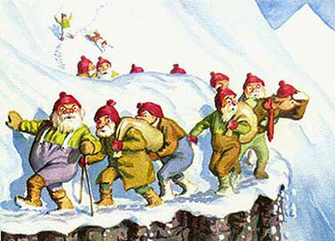
13 Santas in Iceland
There are 13 Santas in Iceland, each leaving a gift for children. They come down from the mountain one by one, starting on December 12 and have names like Spoon Liker, Door Sniffer and Meat Hook.

Slide 15
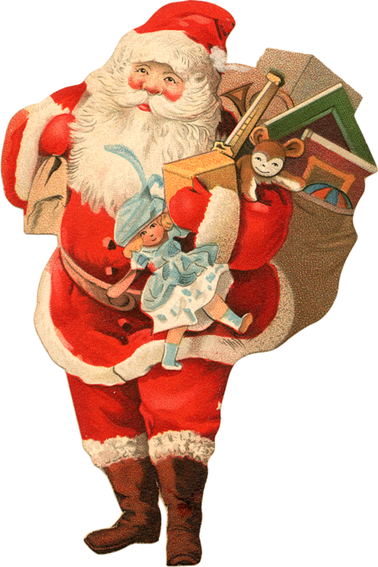
The very first Santa pictures
often depicted him wearing a variety of different colour coats including green, blue and mauve. The modern day depiction or picture of Santa Claus wearing a red coat only became standard in the 1920᾿s.

Slide 16
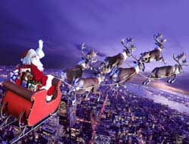
Rudolph
The red-nosed
reindeer was
invented for
a US firm᾿s
Christmas
promotion
in 1938.

Slide 17
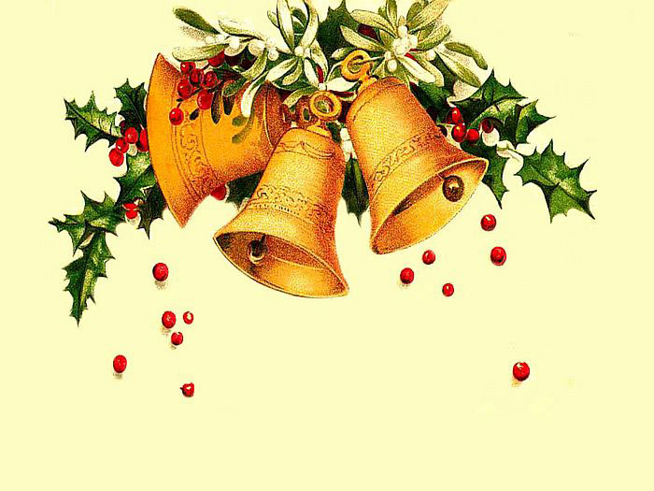
»
One of the most popular Christmas songs, «Jingle Bells» was actually written for Thanksgiving.

Slide 18
Christmas
become a national holiday in America on June, 26,1870.

Slide 19
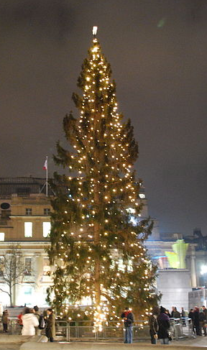
Electric lights
for trees were first used in 1895.

Slide 20

Merry Christmas

