Slide 1

Political parties of Great Britain
Created by Anastasiya Korol

Slide 2
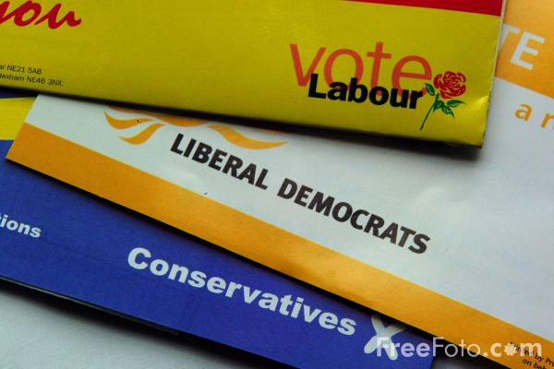
The main parties in the UK
The Conservative party
The Labor party
The Liberal Democrats

Slide 3
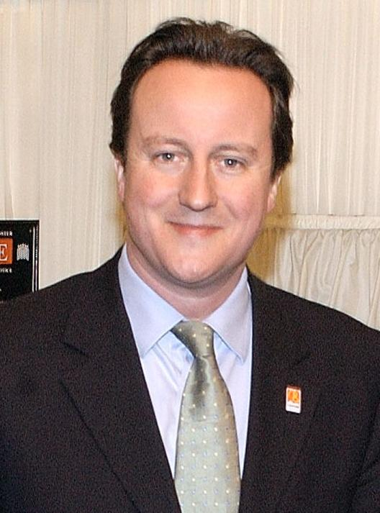
The Conservative party
The Conservative party goes back to the Tories, or Royalists, who originated in King Charles' reign.

Slide 4

The Conservative party believes in free enterprise and the importance of a capitalist economy, with private ownership preferred to state control.

Slide 5
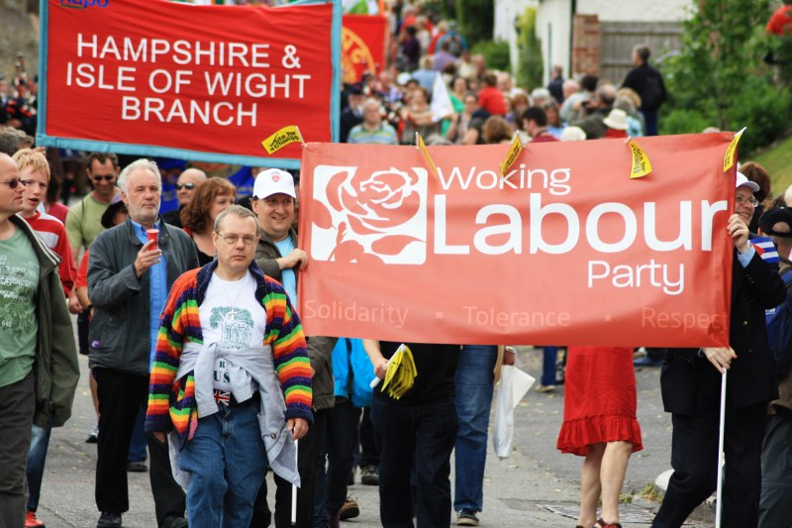
The Labour party
The Labour party believes that private ownership and enterprise should be allowed to flourish, but not at the expenses of their traditional support of the public services.

Slide 6

The Liberal Democrats
believe that the state should have some control over the economy, but that there should be individual ownership.

Slide 7

Other political parties
The Green party offers economic and industrial policies that relate directly to the environment.
The Green Party

Slide 8

Other political parties
The Scottish nationalist party wants independence for Scotland within the European Community.
The Scottish Nationalist Party

Slide 9

Other political parties
The Welsh Nationalist party is determined to preserve the Welsh language and culture as the foundation of a distinct Welsh identity within the UK.
Plaid Cymry

Slide 10

The Welsh Nationalist party
Its radical wing has resorted to arson attempts as a means of protest.

