Slide 1

Months
Бикурева А.А.
МАОУ СОШ №38 г.Набережные Челны Республика Татарстан

Slide 2
Phonetic exercise
I have four pets.
They live in my house.
My dog and my cat,
My parrot and my mouse.

Slide 3
Answer questions:
What season do you know? Name them.
What season do you like? Why?
What season don’t you like?Why?
What is your favourite season? Why?

Slide 4

I like this season. I can swim, ride a bike and play football. It is hot and sunny.

Slide 5
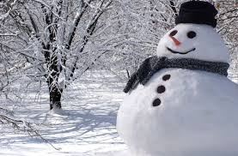
I like this season because I can ski, skate and play hockey. It is cold.

Slide 6

I like this season because I go to the school.

Slide 7
Let’s do exercise 1 page 64
Answer questions:
What season is before autumn?
What season is after autumn?
What season is after winter?
What season is before winter?
What do you like to do in this season?

Slide 8

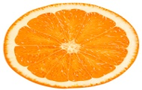
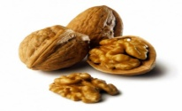
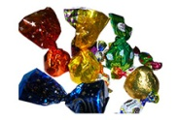
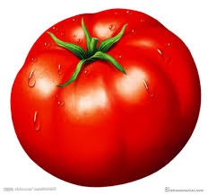
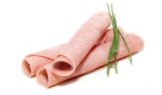
1
3
2
M
I
L
K
O
R
A
N
G
E
N
U
T
T
O
M
A
T
O
6
4
H
A
M
S
W
E
E
T
S
5

Slide 9



Months
January July
February August
March September
April October
May November
June December

Slide 10
August March
April May
December November
February October
January September
July
June

Slide 11
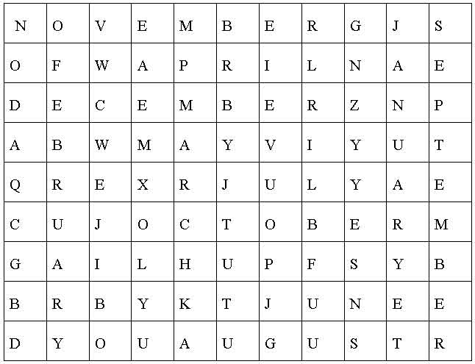

Slide 12
Список используемых ресурсов
http://everydiet.ru/wp-content/uploads/2012/09/moloko.jpg молоко
http://kushaem-vkusno.com/uploads/taginator/Nov-2012/apelsin.jpg
апельсин
http://www.ayzdorov.ru/images/Travi/greckii-oreh.jpg грецкий орех
http://fotodes.ru/upload/img1341331458.jpg помидор
http://img06.rl0.ru/eda/c464x302/s2.afisha-eda.ru/Photos/120304025019-120328131730-p-O-vetchina.jpg ветчина
http://supercook.ru/decoration/images-decoration-sweet/buket-sweet-00-01.jpg конфеты
http://4.bp.blogspot.com/-Oe4qsz5wKuI/UODqqKjKo7I/AAAAAAAADu4/nYTYPnnU2eA/s400/December2.jpg
http://calendar.phillipmartin.info/march.gif
https://encrypted-tbn0.gstatic.com/images?q=tbn:ANd9GcR1NGdGBCPG6AN-btE9tkt33hHyw6fNLWPAk4hYraBmuH4a_CHlYE4q2o0T
http://www.usiter.com/uploads/20111120/kreativnie%2Boboi%2Bkrasochnoe%2Bleto%2B81889333261.jpg
http://www.emuvalleyrhodo.com.au/images/autumn_evrg.jpg
http://www.walkerprestons.co.uk/wp-content/uploads/2013/11/winter-accident.jpg

