Slide 1
Vampires in movies and TV series
The presentation was prepared by: Maxim Tselischev

Slide 2


Constantine(2005)
Constantine tells the story of irreverent supernatural detective John Constantine, who has literally been to hell and back.

Slide 3


Twilight (2008)
A teenage girl risks everything when she falls in love with a vampire.

Slide 4


Blade(1998)
A half-vampire, half-mortal man becomes a protector of the mortal race, while slaying evil vampires.

Slide 5


Van Helsing (2004)
The notorious monster hunter is sent to Transylvania to stop Count Dracula who is using Dr. Frankenstein's research and a werewolf for some sinister purpose.

Slide 6


Queen of the Damned (2002)
The vampire Lestat becomes a rock star whose music wakes up the queen of all vampires.

Slide 7

The Strain (2014-, TV Series )
A thriller that tells the story of Dr. Ephraim Goodweather, the head of the Center for Disease Control Canary Team in New York City. He and his team are called upon to investigate a mysterious viral outbreak with hallmarks of an ancient and evil strain of vampirism. As the strain spreads, Eph, his team, and an assembly of everyday New Yorkers, wage war for the fate of humanity itself.

Slide 8
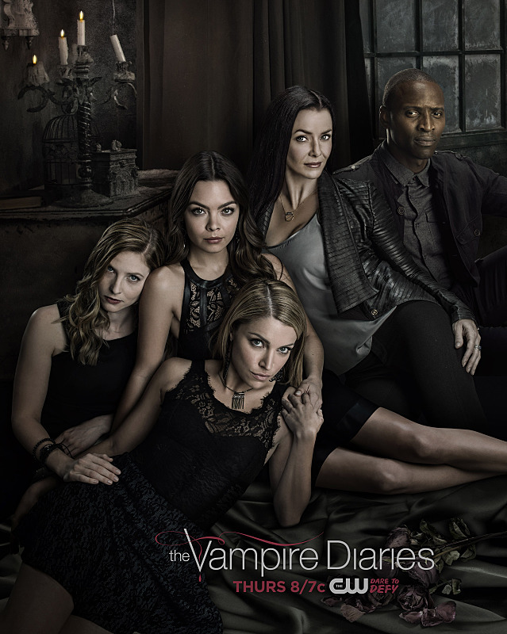
The Vampire Diaries (2009-, TV Series )
A teenage girl is torn between two vampire brothers.

Slide 9
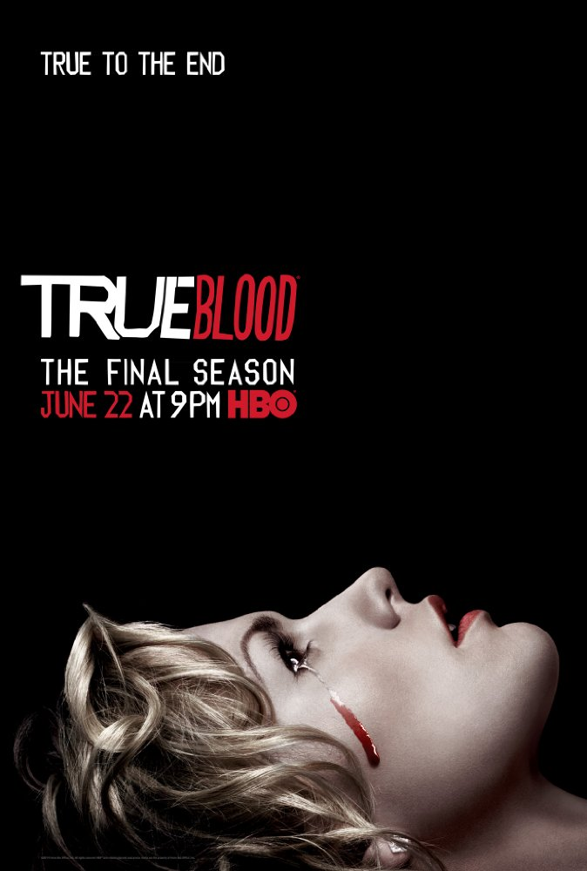

True Blood ( TV Series (2008–2014))
Telepathic waitress Sookie Stackhouse encounters a strange new supernatural world when she meets the mysterious Bill, a southern Louisiana gentleman and vampire.

Slide 10
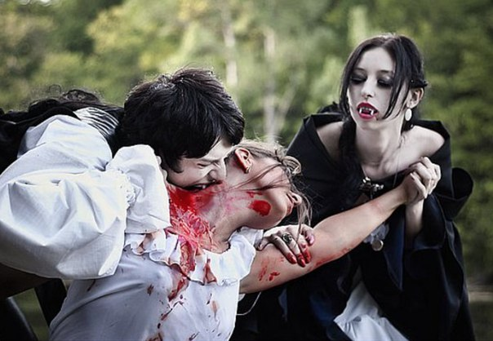
The end

