Slide 1
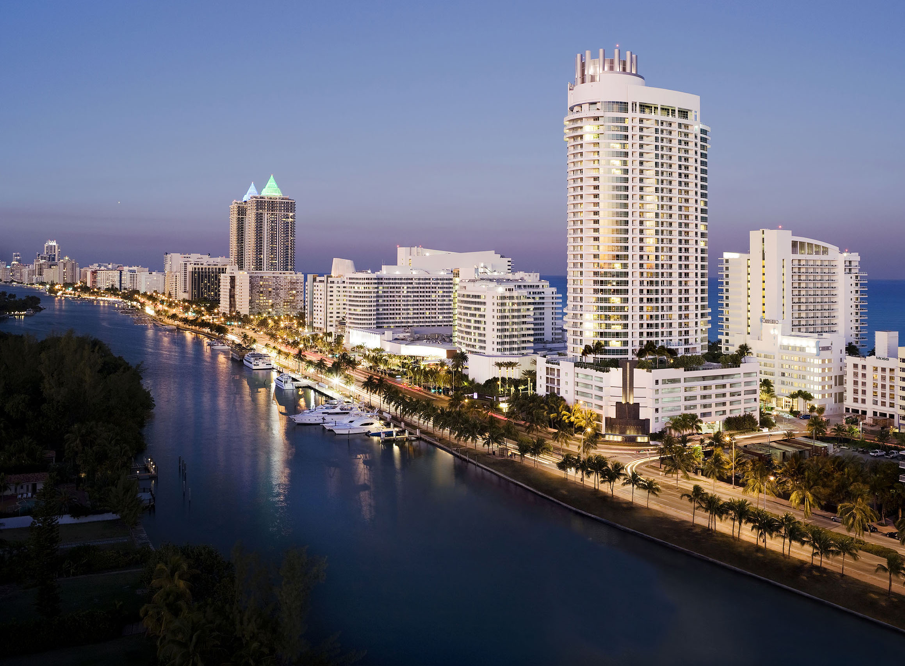
Florida

Slide 2
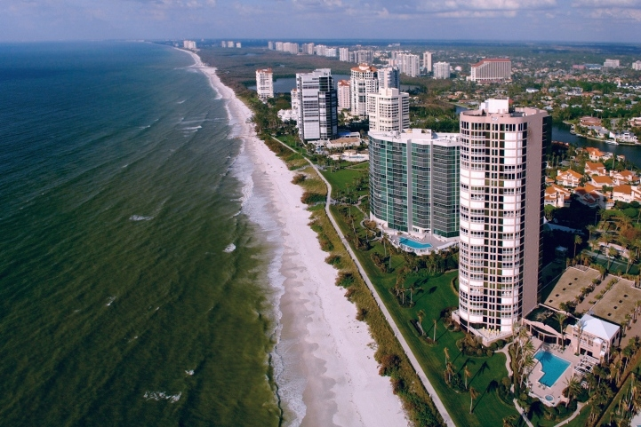
Florida received statehood in the United States in 1845. Its economy is necessary, mainly, on tourism, agriculture and transportation which developed at the end of the 19th century.

Slide 3
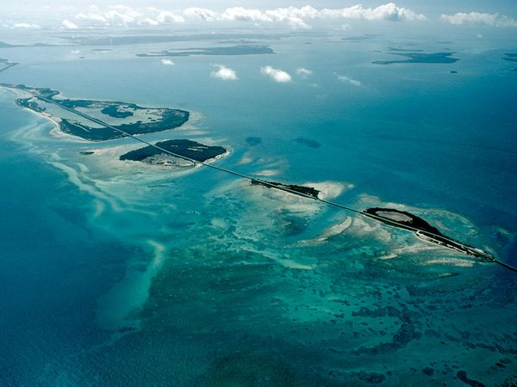
The most part of Florida is located on the peninsula between the Gulf of Mexico, the Atlantic Ocean and the Florida Strait.
Florida - one of the biggest states to the East from the river Mississippi, and only Alaska and Michigan is more in water area.

Slide 4
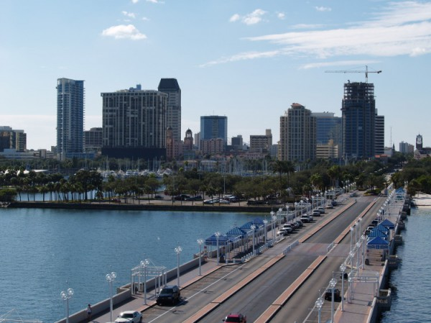
The peninsula Florida occupying the most part of staff, was stretched to the south to the most southern point of the USA - the cape Seibl (the Sable of the Cape) - approximately on 610 km and has average width about 200 km. In the south the peninsula is bent round a chain of island Keys of Florida.

Slide 5
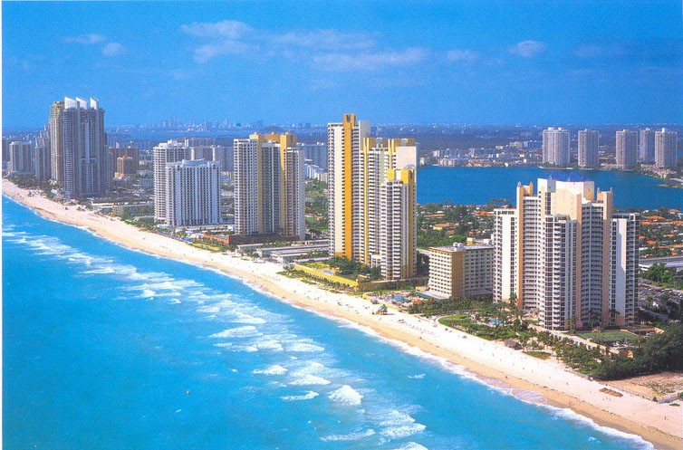

The climate of Florida calls most valuable and important "natural resource". The most part of the peninsula has a humid subtropical climate, but in the south of Florida hotter climate – tropical.
The climate annually attracts to the state one million tourists and new citizens – those who loves high temperature and evergreen palm trees.
In the winter the southern Florida – one of the warmest places on the North American continent. Average temperatures of January there about 18 ° - 21 °C.

Slide 6
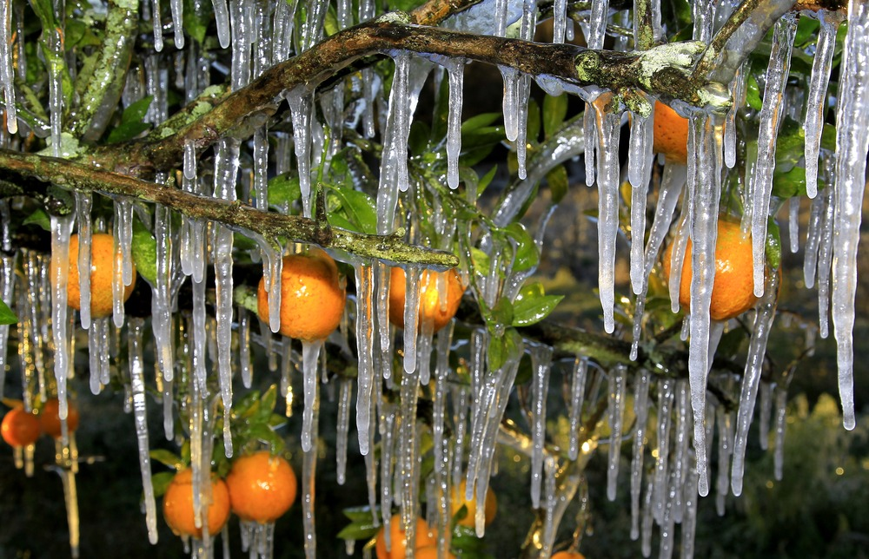
Florida – the leading state of USA on production of a citrus. Annually two thirds of a crop of the country do a citrus collected in groves of Florida. Usually it is oranges and grapefruits.
Only once within last 100 years the crop of a citrus of Florida was lost as a result of a sudden cold snap. It occurred in the late eighties.

Slide 7
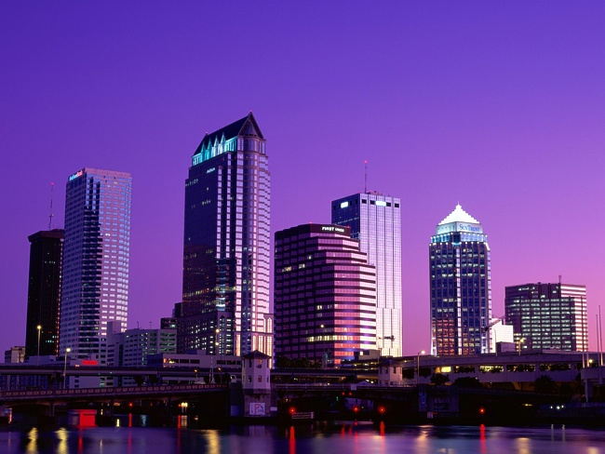
The most popular tourist centers of Florida – Miami, Miami Beach, Fort Lauderdale, Palma Bich, St. Petersburg, Panama City, Pensacola.

Slide 8


