Slide 1

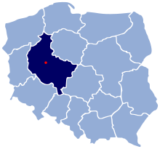

By Łukasz Mazurkiewicz
& Michał Mazurkiewicz
Swarzędz - ZALASEWO

Slide 2

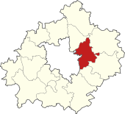
SWARZĘDZ – the Town
Poznań
municipality
Swarzędz
municipality
The documentary evidence for a settlement of Swarzędz comes from 1366.
Today Swarzędz has ca. 30 000 inhabitants and has a common border with Poznań – the Capital of Greater Poland Voivodeship. Swarzędz has a land area of only 8.58 km², therefore it is the fourth most densely populated city in Poland.
Poznań County
Zalasewo
Below we present some information about the places of interest in our town and the surrounding area. At the end we will give some information about our school.
Welcome to 52°24′30″N 17°04′17″E
Enjoy the presentation!

Slide 3
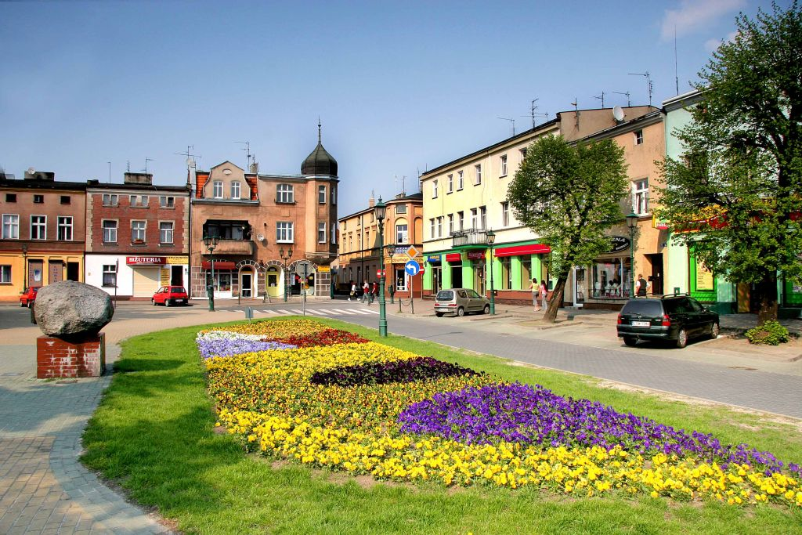
The Market Square
The Market Square is the main point of the town.
The social and commercial activities have focused here over the years. A large number of local handicrafts caused a systematic development of the town. The central point of the Market Square is the Town Hall with the office of the Mayor of the town and the local authorities.
Notes:
Na rynku oprócz kupców, siedzibę swoją znalazły też lokalne władze miasta.

Slide 4
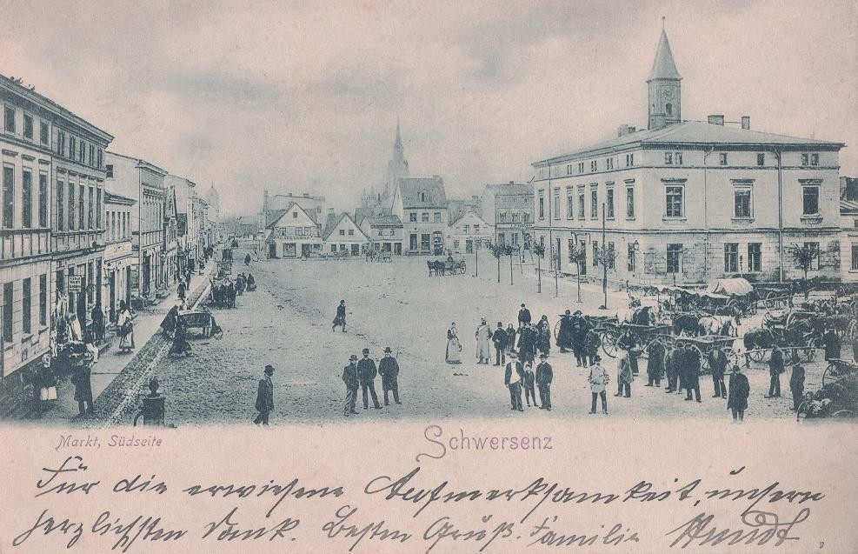
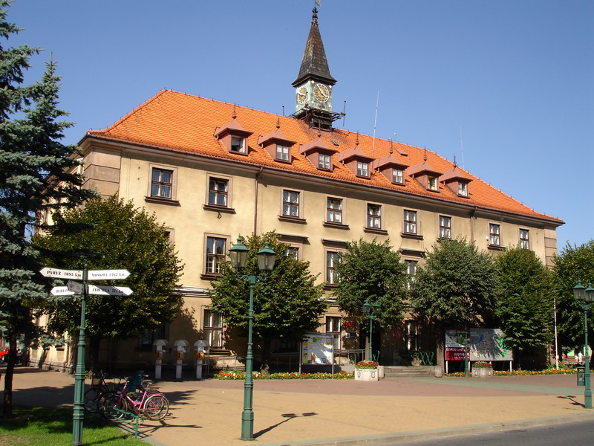
The Town Hall
The town hall was built in 1860. During the German occupation from 1939 to 1945 it was rebuilt by the Germans.
Today the town hall is the office of Mayor of Swarzędz

Slide 5
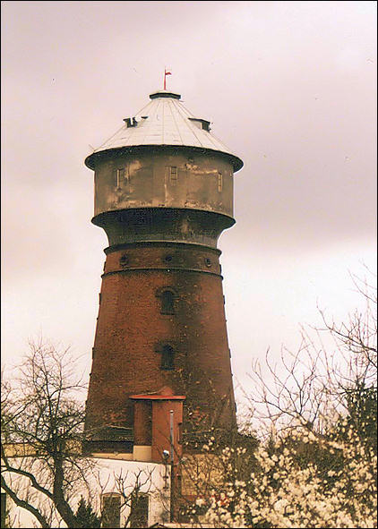
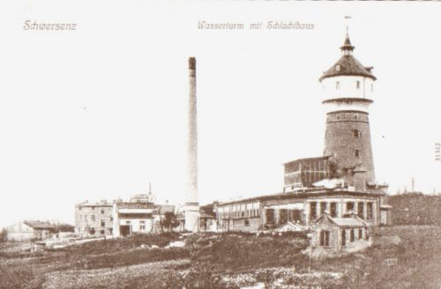
The Water Tower
Built around 1903.
The water tower is a building in the form of a tower. At the top there is a water tank, used to provide a stable pressure in the pipe.
The water tower covers a temporary increase in demand for water. The tank must be located high above the ground to ensure a proper water pressure.
On railway stations the water tower was used to supply steam locomotives in the water.
Notes:
Wieża ciśnień bywa mylona z wieżowym zbiornikiem na wodę.

Slide 6
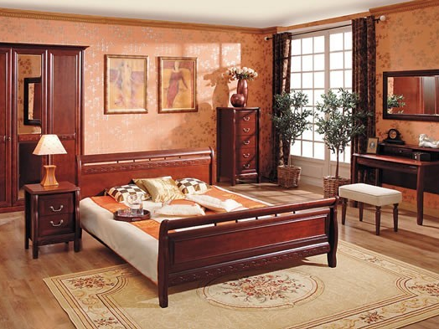

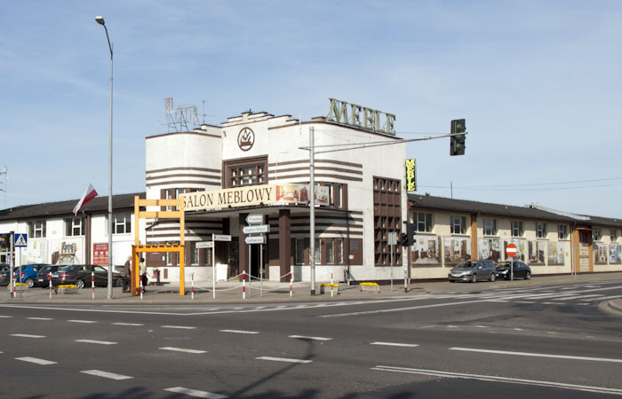
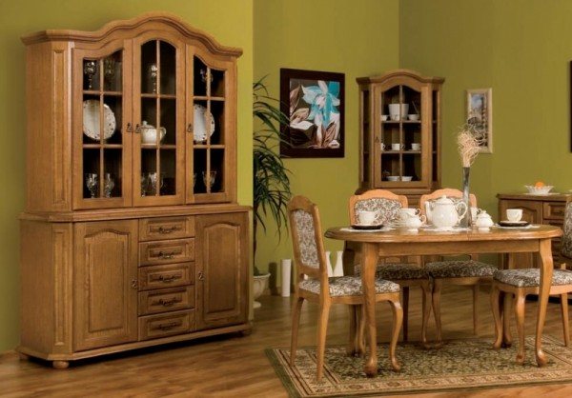
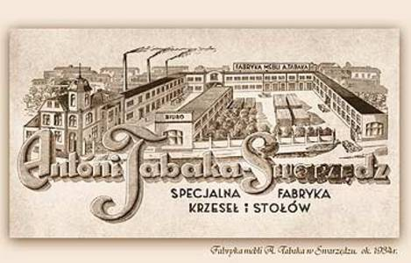
The Town of Carpenters
Swarzędz is known as a town of carpenters. In 1905 Antoni Tabaka grounded a first furniture factory. After the WWII the factory has been nationalized and continued to produce furniture as „Swarzędzkie Fabryki Mebli” with a green logo, well known in many countries. The factory existed until 2009.

Slide 7
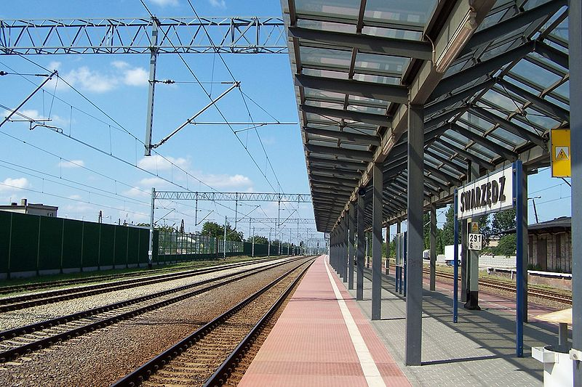
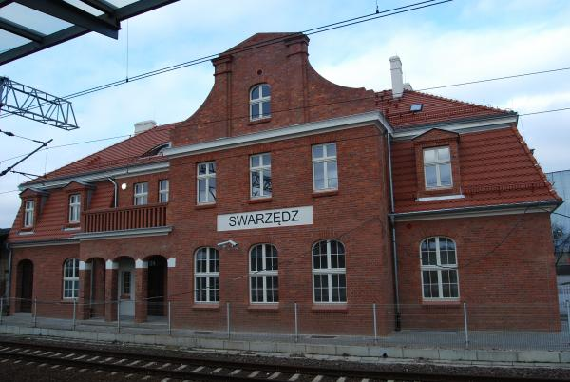
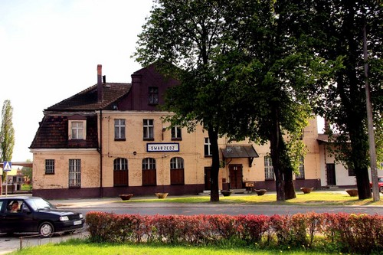
The railway station
The railway station in Swarzędz was previously called Schwaningen, Schwersenz
Swarzędz railway station is located on the European railway route E-20 connecting Paris with Moscow, via Berlin, Poznań and Warsaw

Slide 8
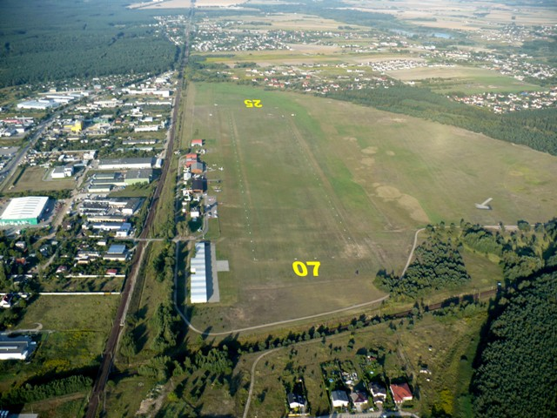

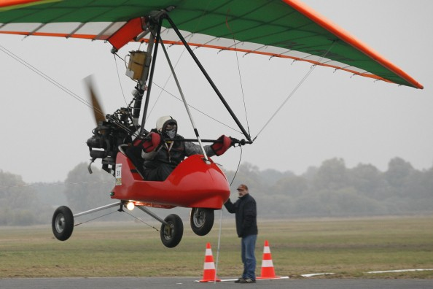
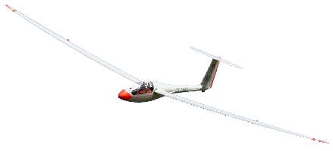
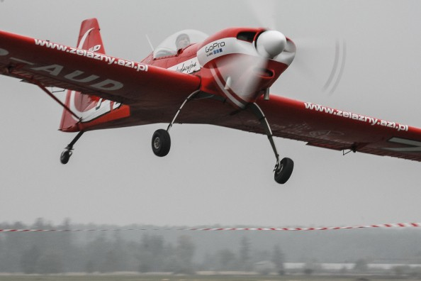
Aero Club Ligowiec
Poznań-Kobylnica Airport
Known as: Ligowiec Airport.
ICAO code: EPPK
Owner: Aero Club Poznań
Grounded: 1919
Runway 07: 750x100 (grass)
Runway 20: 870x200 (grass)

Slide 9
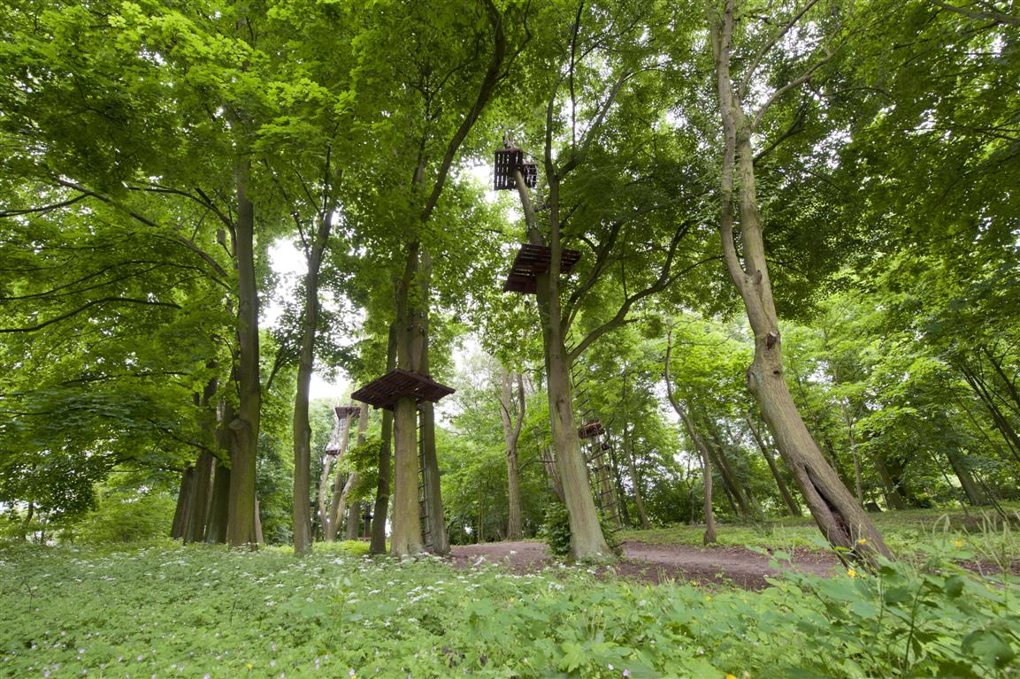
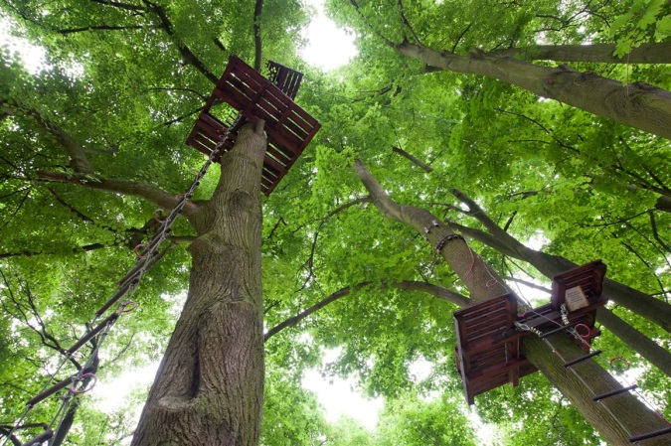

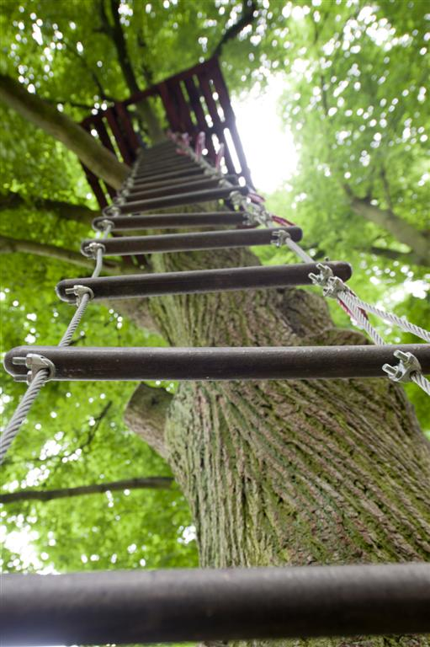
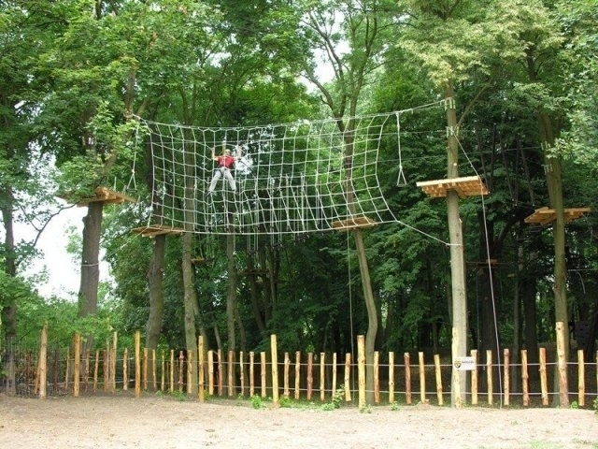
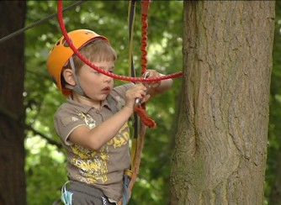
The Cascader Park
The Cascader Park is an adventure park in Kobylnica near Swarzędz.
The park offers unforgettable experiences on ropes and zip-lines for everyone. All paths have a graded levels of difficulty. You don't have to be super-fit to enjoy it.

Slide 10
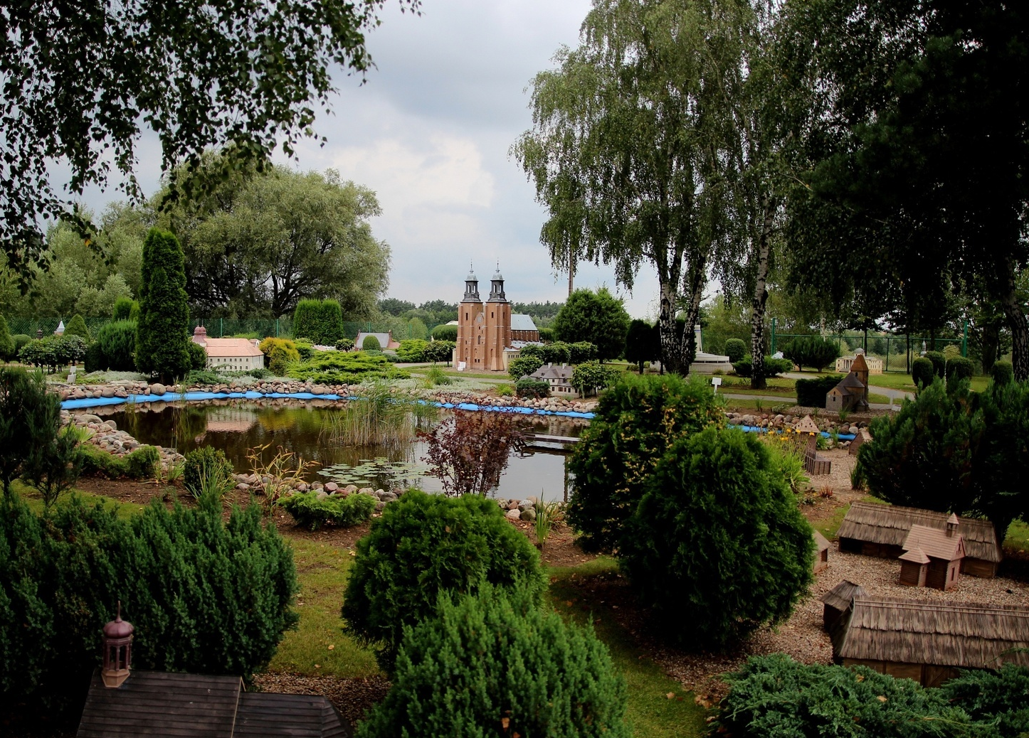
The Miniature Park
An open space miniature park is located in Pobiedziska, near Swarzędz. It shows 35 miniatures of well known buildings from our region in scale 1:20.
Opened in may 1998

Slide 11


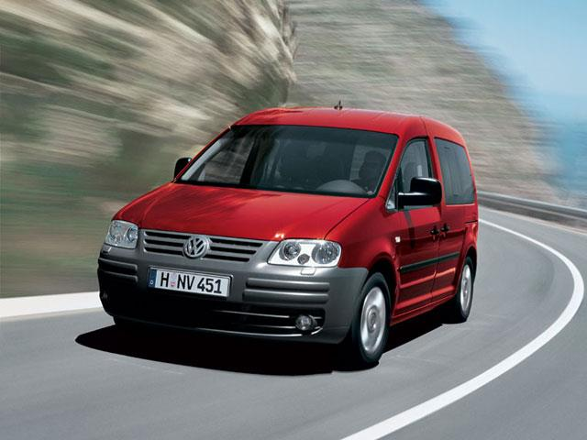
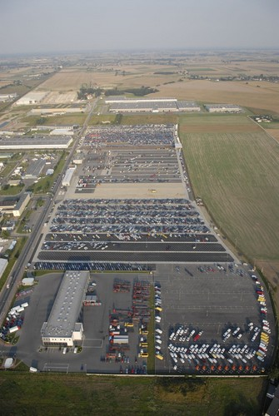
Volkswagen
In Swarzędz is located a warehouse of ready-made cars from Volkswagen-Poznań factory.
If you have an VW-Caddy you can be sure, it is made in Poznań, because the VW factory in Poznań is the only one in the world, that produces VW-Caddy
In Swarzedz there is also the factory of special vehicles such as ambulances, postal vehicles, etc.

Slide 12
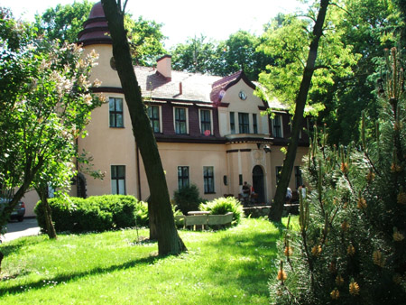
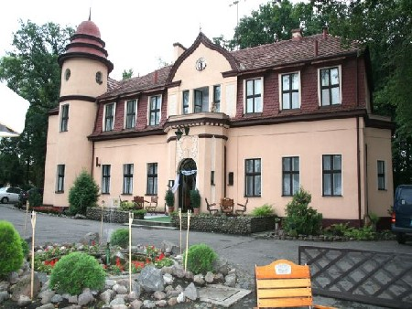
The Mansion
„Under the Lime Tree”
The hunting style mansion "Under the Lime Tree" was built in early twentieth century. It is located in the old park, which features an unique and Europe's largest open-air beekeeping museum.
The exhibition shows the environment of bees, beekeeping history, and a rich collection of equipment related to the work carried out in an apiary.

Slide 13
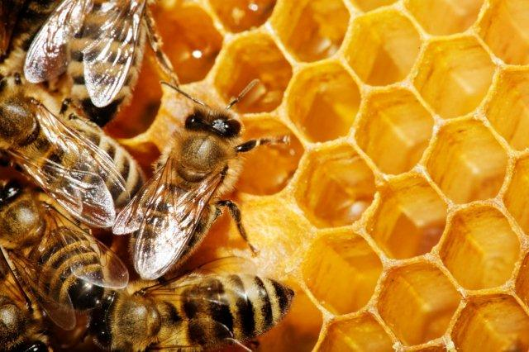
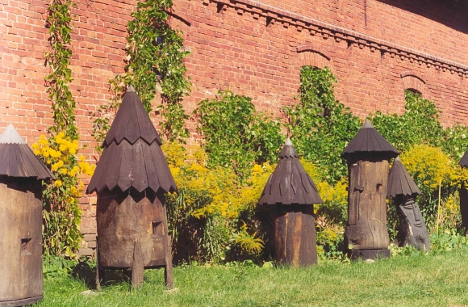
The Open-Air
Beekeeping Museum
The open-air beekeeping museum is the main point of all excursions to Swarzędz.
The museum presents the history of beekeeping in Poland. In the museum you can arrange a presentation, where you can taste all sorts of honey and do your own souvenir-candle from the bees-wax.
Notes:
Pływalnia ”Wodny Raj”

Slide 14

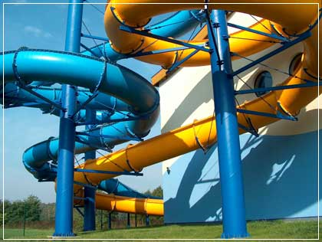
The ”Water Paradise”
The big attraction for the whole family is a swimming pool „The Water Paradise". This modern sport utility has a large car park (also adapted for the disabled) and is located in a convenient place near the Swarzędz Lake.
In addition to various water activities there is a bowling course, coffee shop and a beauty center.
Notes:
Oprócz rozmaitych atrakcji wodnych znajduje się tam też kręgielnia, kawiarnia i gabinet odnowy biologicznej.

Slide 15
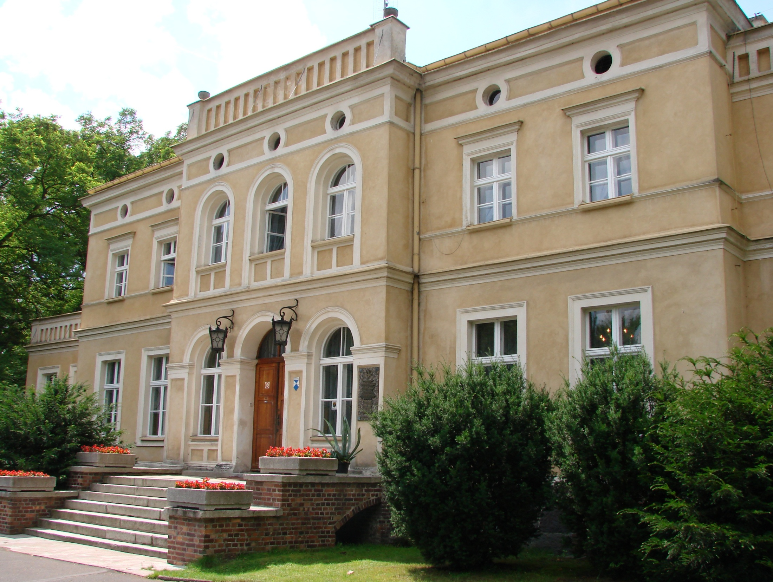
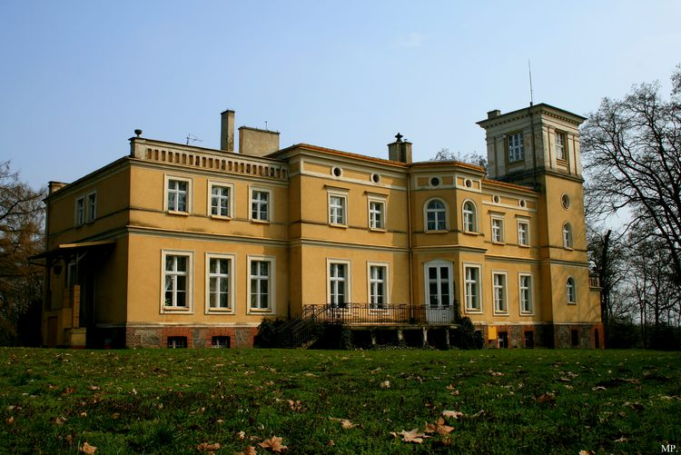
The Mansion in Uzarzewo near Swarzędz
Mansion was built in 1880 and is surrounded by a huge park with about 1000 trees, including six very old monuments-trees.
Today it houses the Museum of the Natural Environment and Hunting.
The museum presents the history of hunting from the pre-historic to the latest. It shows the equipment of the first hunters, the old hunting techniques, weapons and hunting trophies.

Slide 16
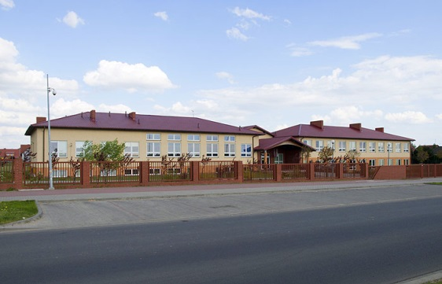
Swarzędz - Zalasewo
52°23′23,36″N 17°04′31,65″E
Zalasewo is a small village within the Swarzędz municipality approximately 3 kilometres south of Swarzędz. Today Zalasewo is a part of Swarzędz and is therefore described as Swarzędz-Zalasewo. It consists mainly of the newly built houses of people who previously lived in Poznań or Swarzedz. Zalasewo is a sleeping room for them and they commute mainly to Poznań to work. The number of new buildings grows very rapidly.
One of the new buildings is our school.

Slide 17


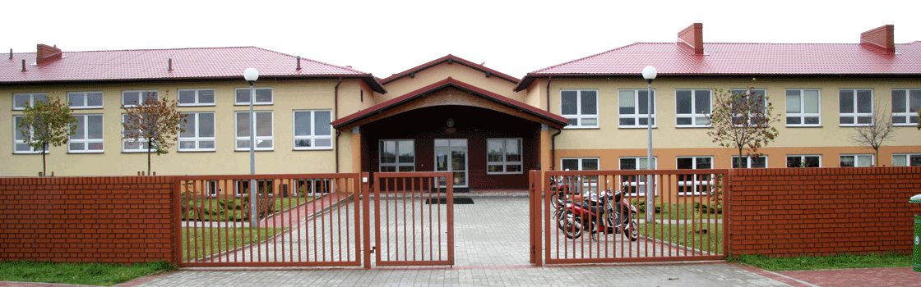
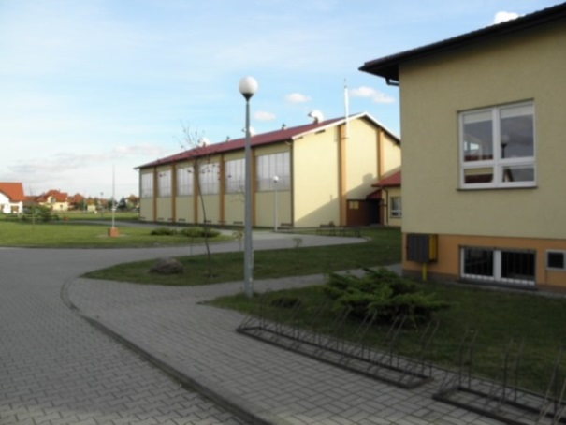
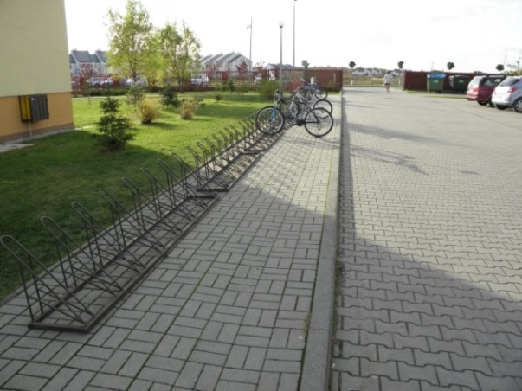
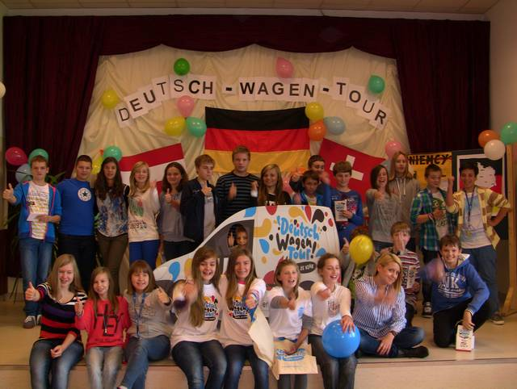
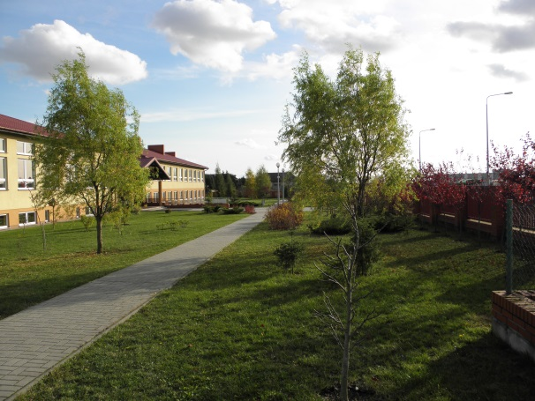
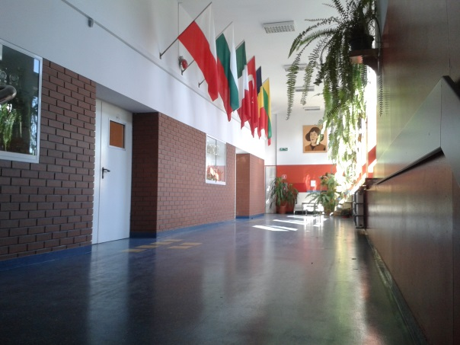
Our School
The new building of our school was built in 2005, so the school has been relocated from Swarzędz to Swarzędz-Zalasewo
Today we are 399 pupils

Slide 18
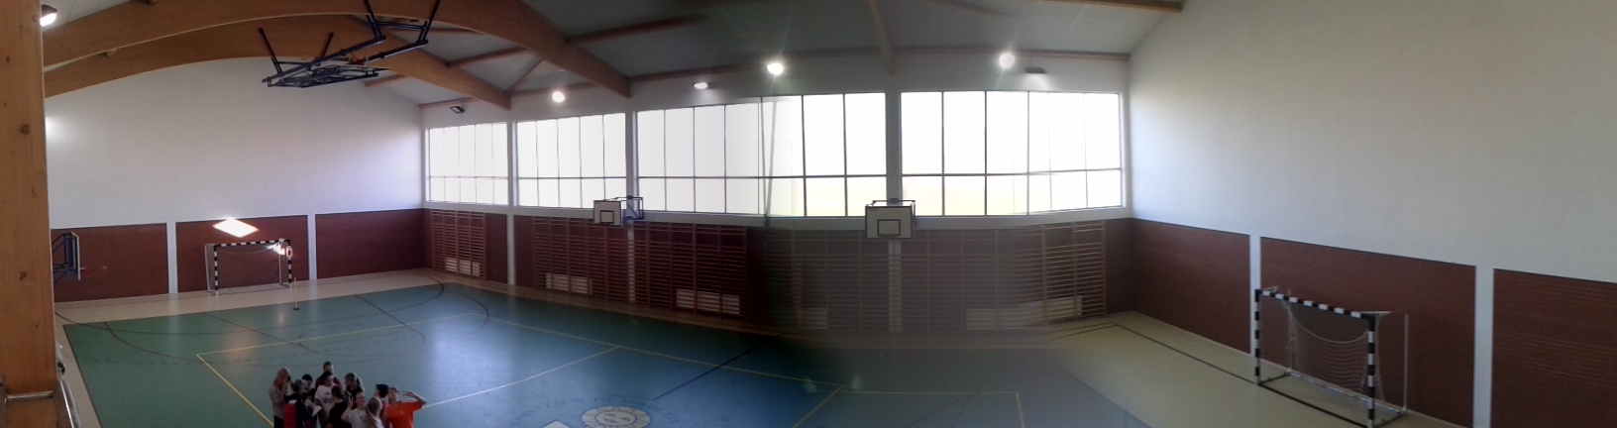
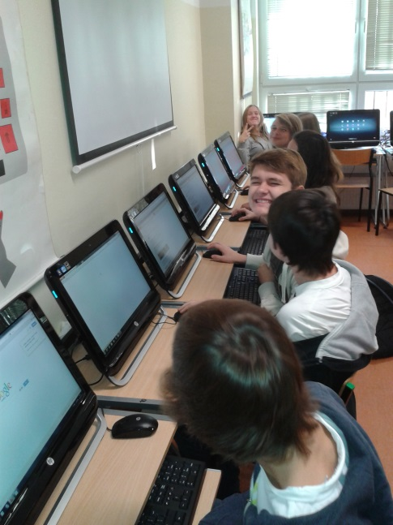
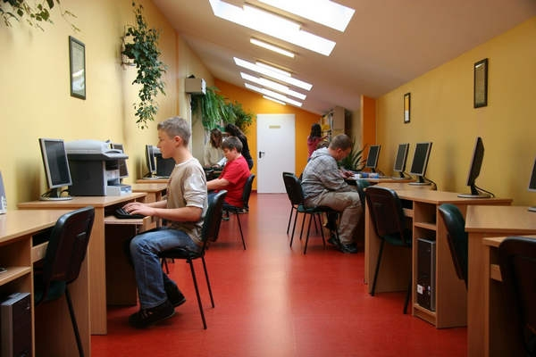
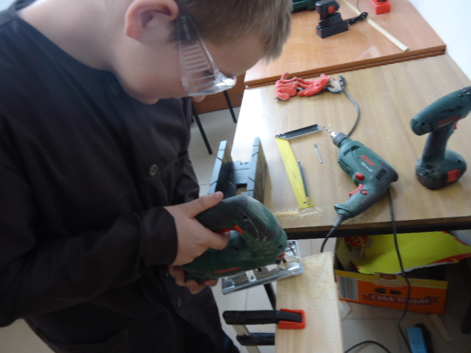
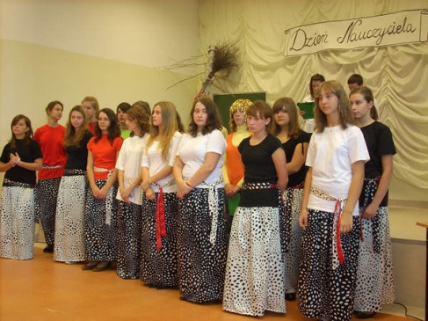
Our School
We learn in a very modern environment with access to the latest technology
We have many different activities
Sport
Theatre group
Choir
Handyman club
Journalist club
Language (English, German)
„You can be Einstein”
and many others

Slide 19
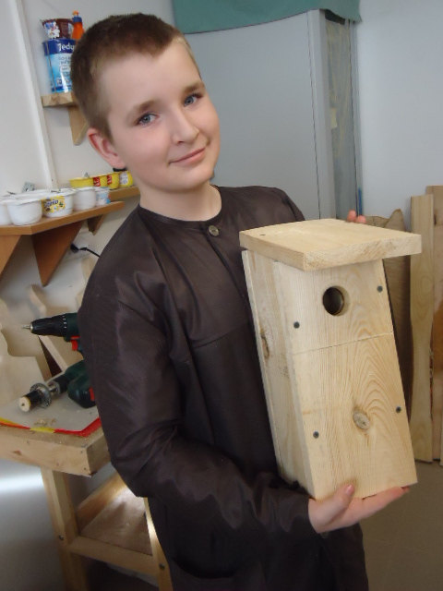
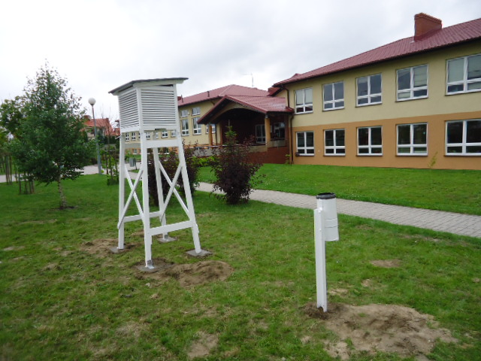
We take care about our environment
We learn about how to take care about our environment, because we know that it is our future

Slide 20
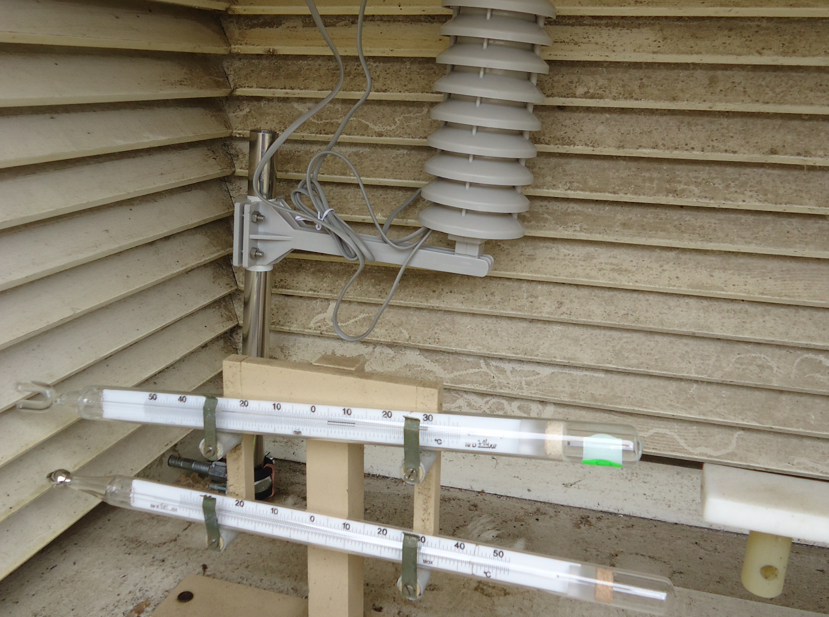
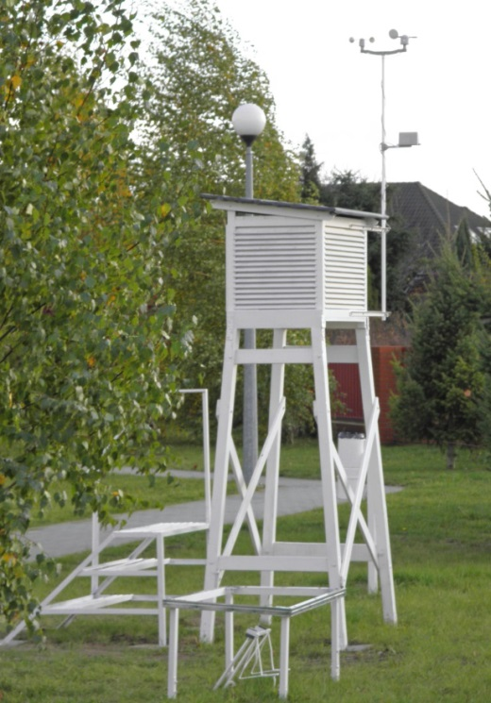
Our projects
We participate in many different projects:
Meteorological - We have our own weather station equipped with the necessary equipment for basic measurements of weather. We publish our observation on http://www.meteo-zalasewo.cba.pl/
"Climate Project" an international project, in which we work together with schools from the other countries such as Great Britain, Sweden , Slovenia, Turkey, the Netherlands, Italy and Spain. The main objective of this cooperation is the exchange of information on climate impact on social life in different countries.
We are going to participate in project „GLOBE” (The Global Learning and Observations to Benefit the Environment) very soon!
http://www.globe.gov/

Slide 21
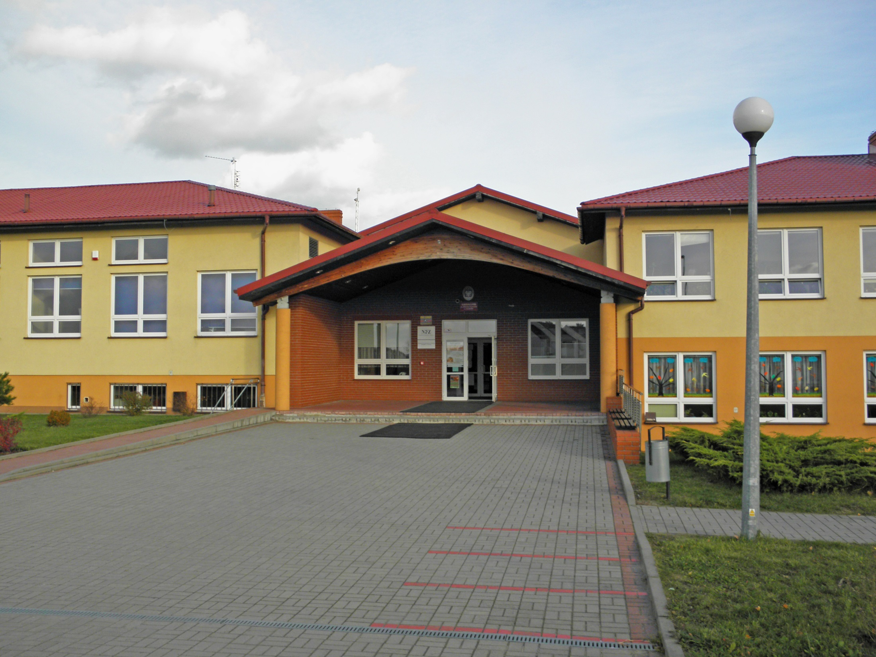
See you in Swarzędz-Zalasewo!
http://www.gimko.pl/

