Slide 1
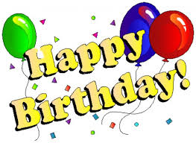
My name isLera. I’m 8. 23October is my birthday!!! It is wonderful because autumn is a fantastic season!!! My birthday is the best!!! I like it very much!!!!

Slide 2
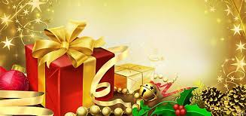
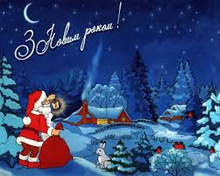
Good morning, friends!
New Year’s coming.
People are getting ready for the holiday!!!
Holiday is on the way♥ Happy holiday!!!

