Slide 1
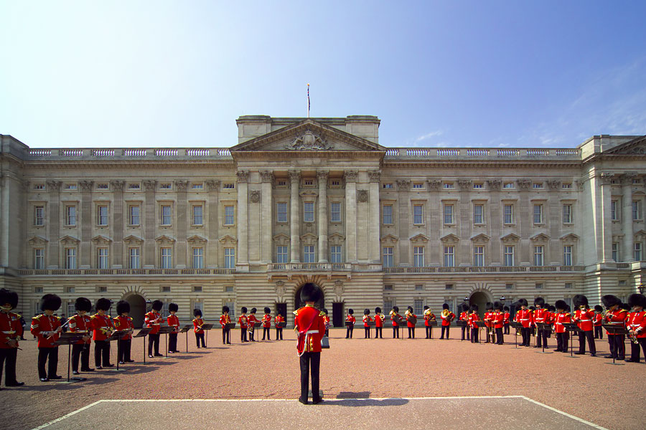
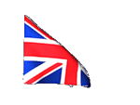
English
tradition

Slide 2
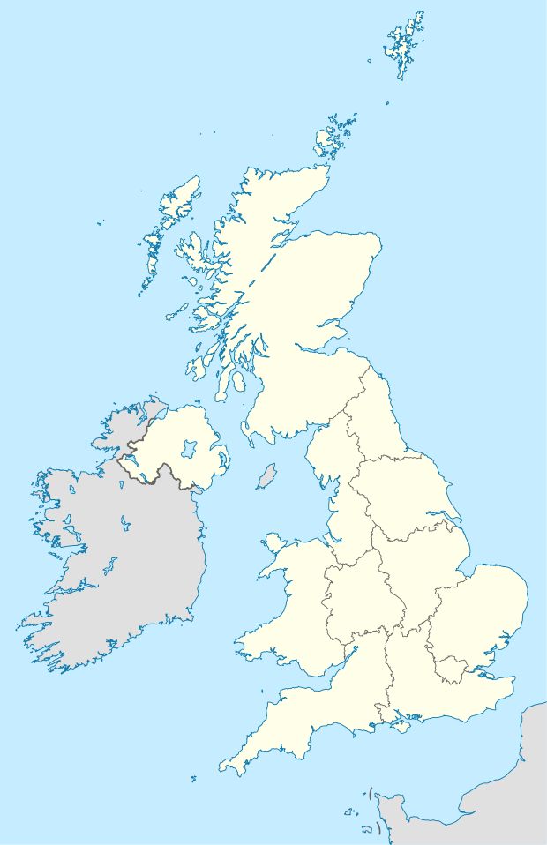


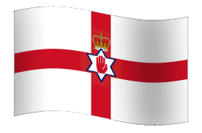
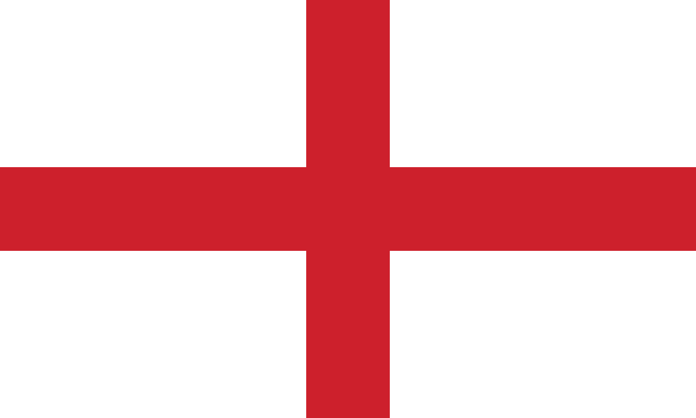
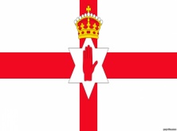
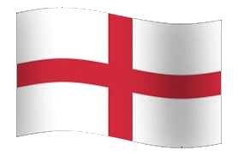
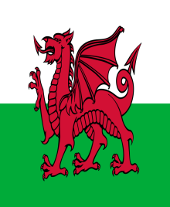
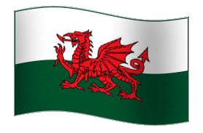
Kingdoms
Great Britain
Scotland
Northern Ireland
England
Wales

Slide 3
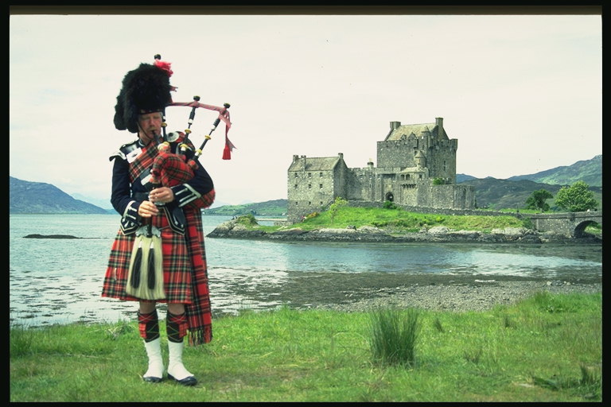
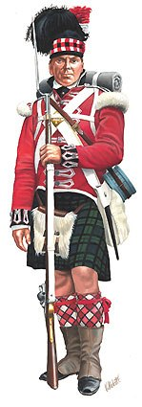
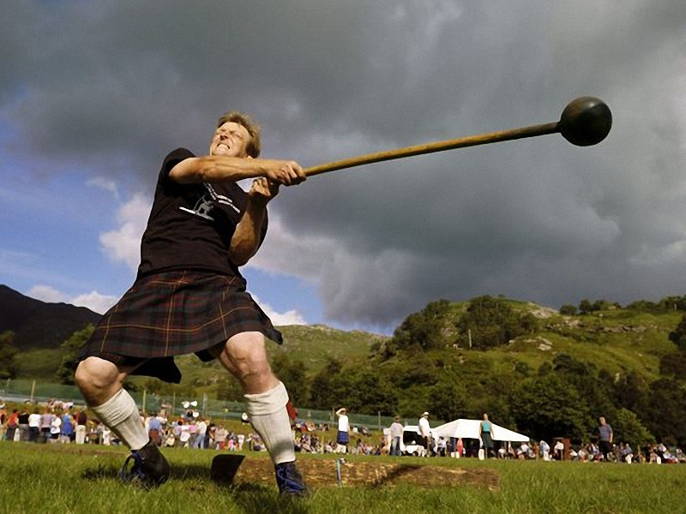
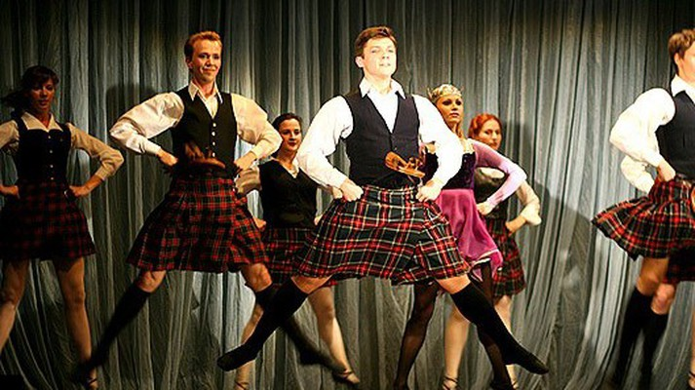
Traditions of Scotland
Facts
The tradition of the Scottish armed forces to wear the kilt
The dance also belongs to the tradition of Scotland, which the inhabitants keep it carefully and earnestly.
Sports tradition of Scotland throwing the core attached to the stick.

Slide 4
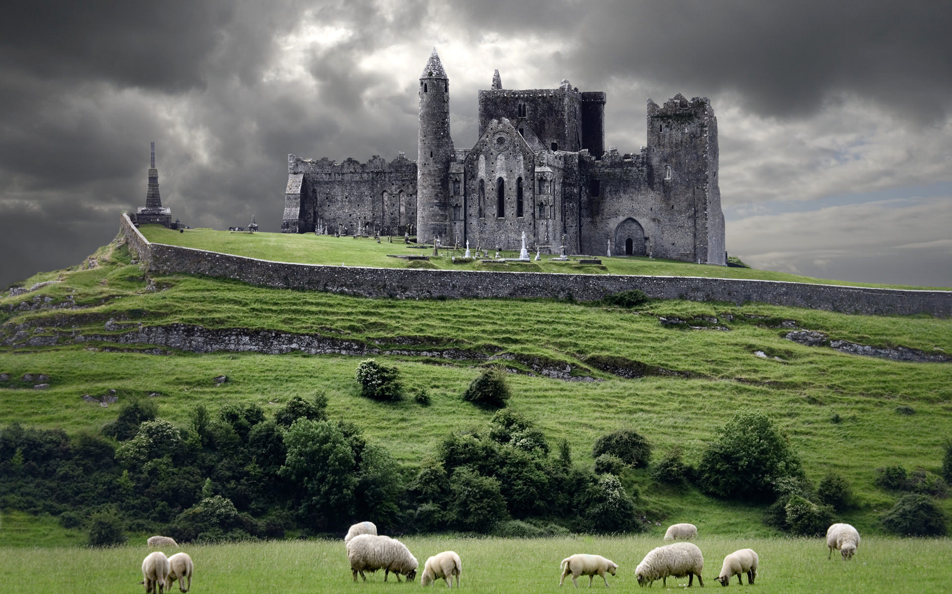
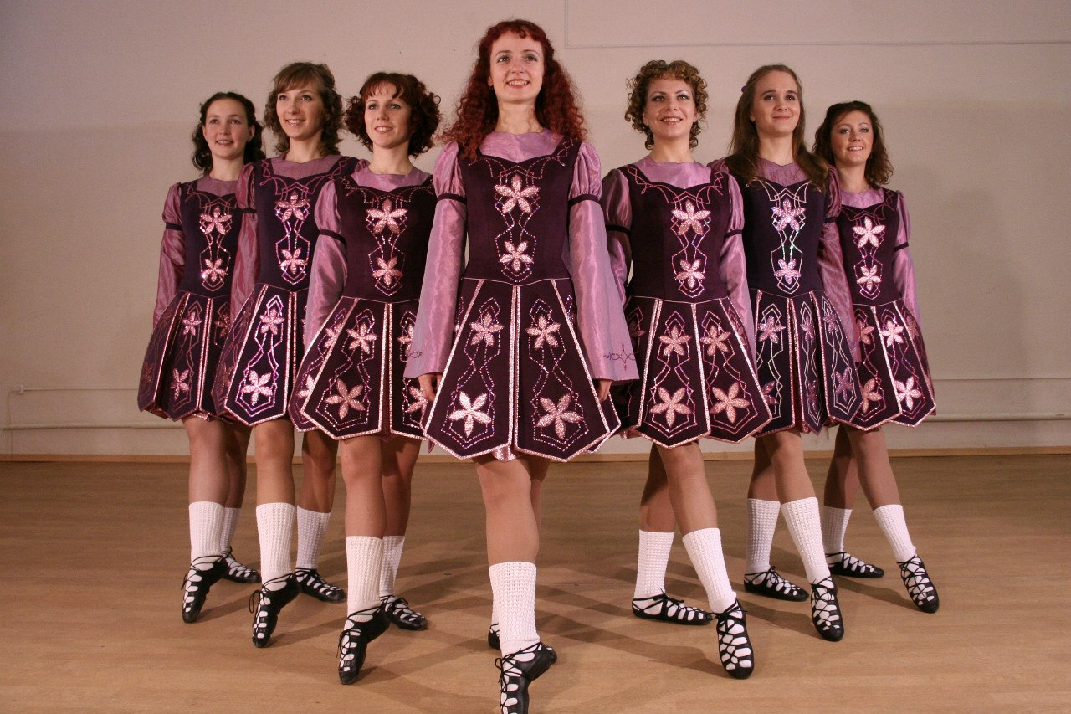
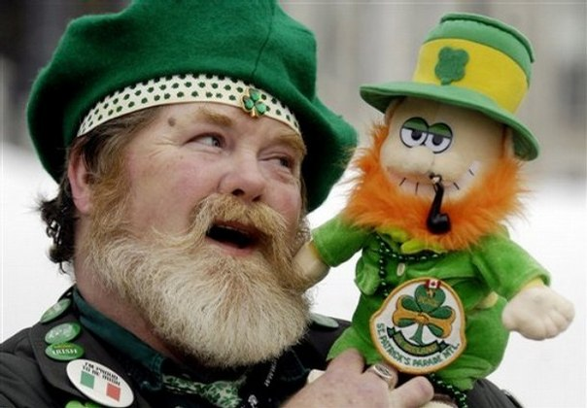
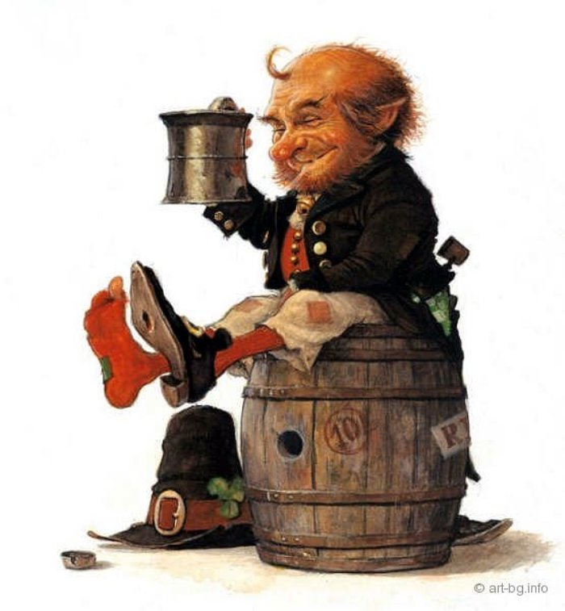
Traditions of Northern Ireland
Facts
In both Irelands love to celebrate St. Patrick's day
Irishmen are not indifferent to alcohol
The Irish are known for their dancing

Slide 5
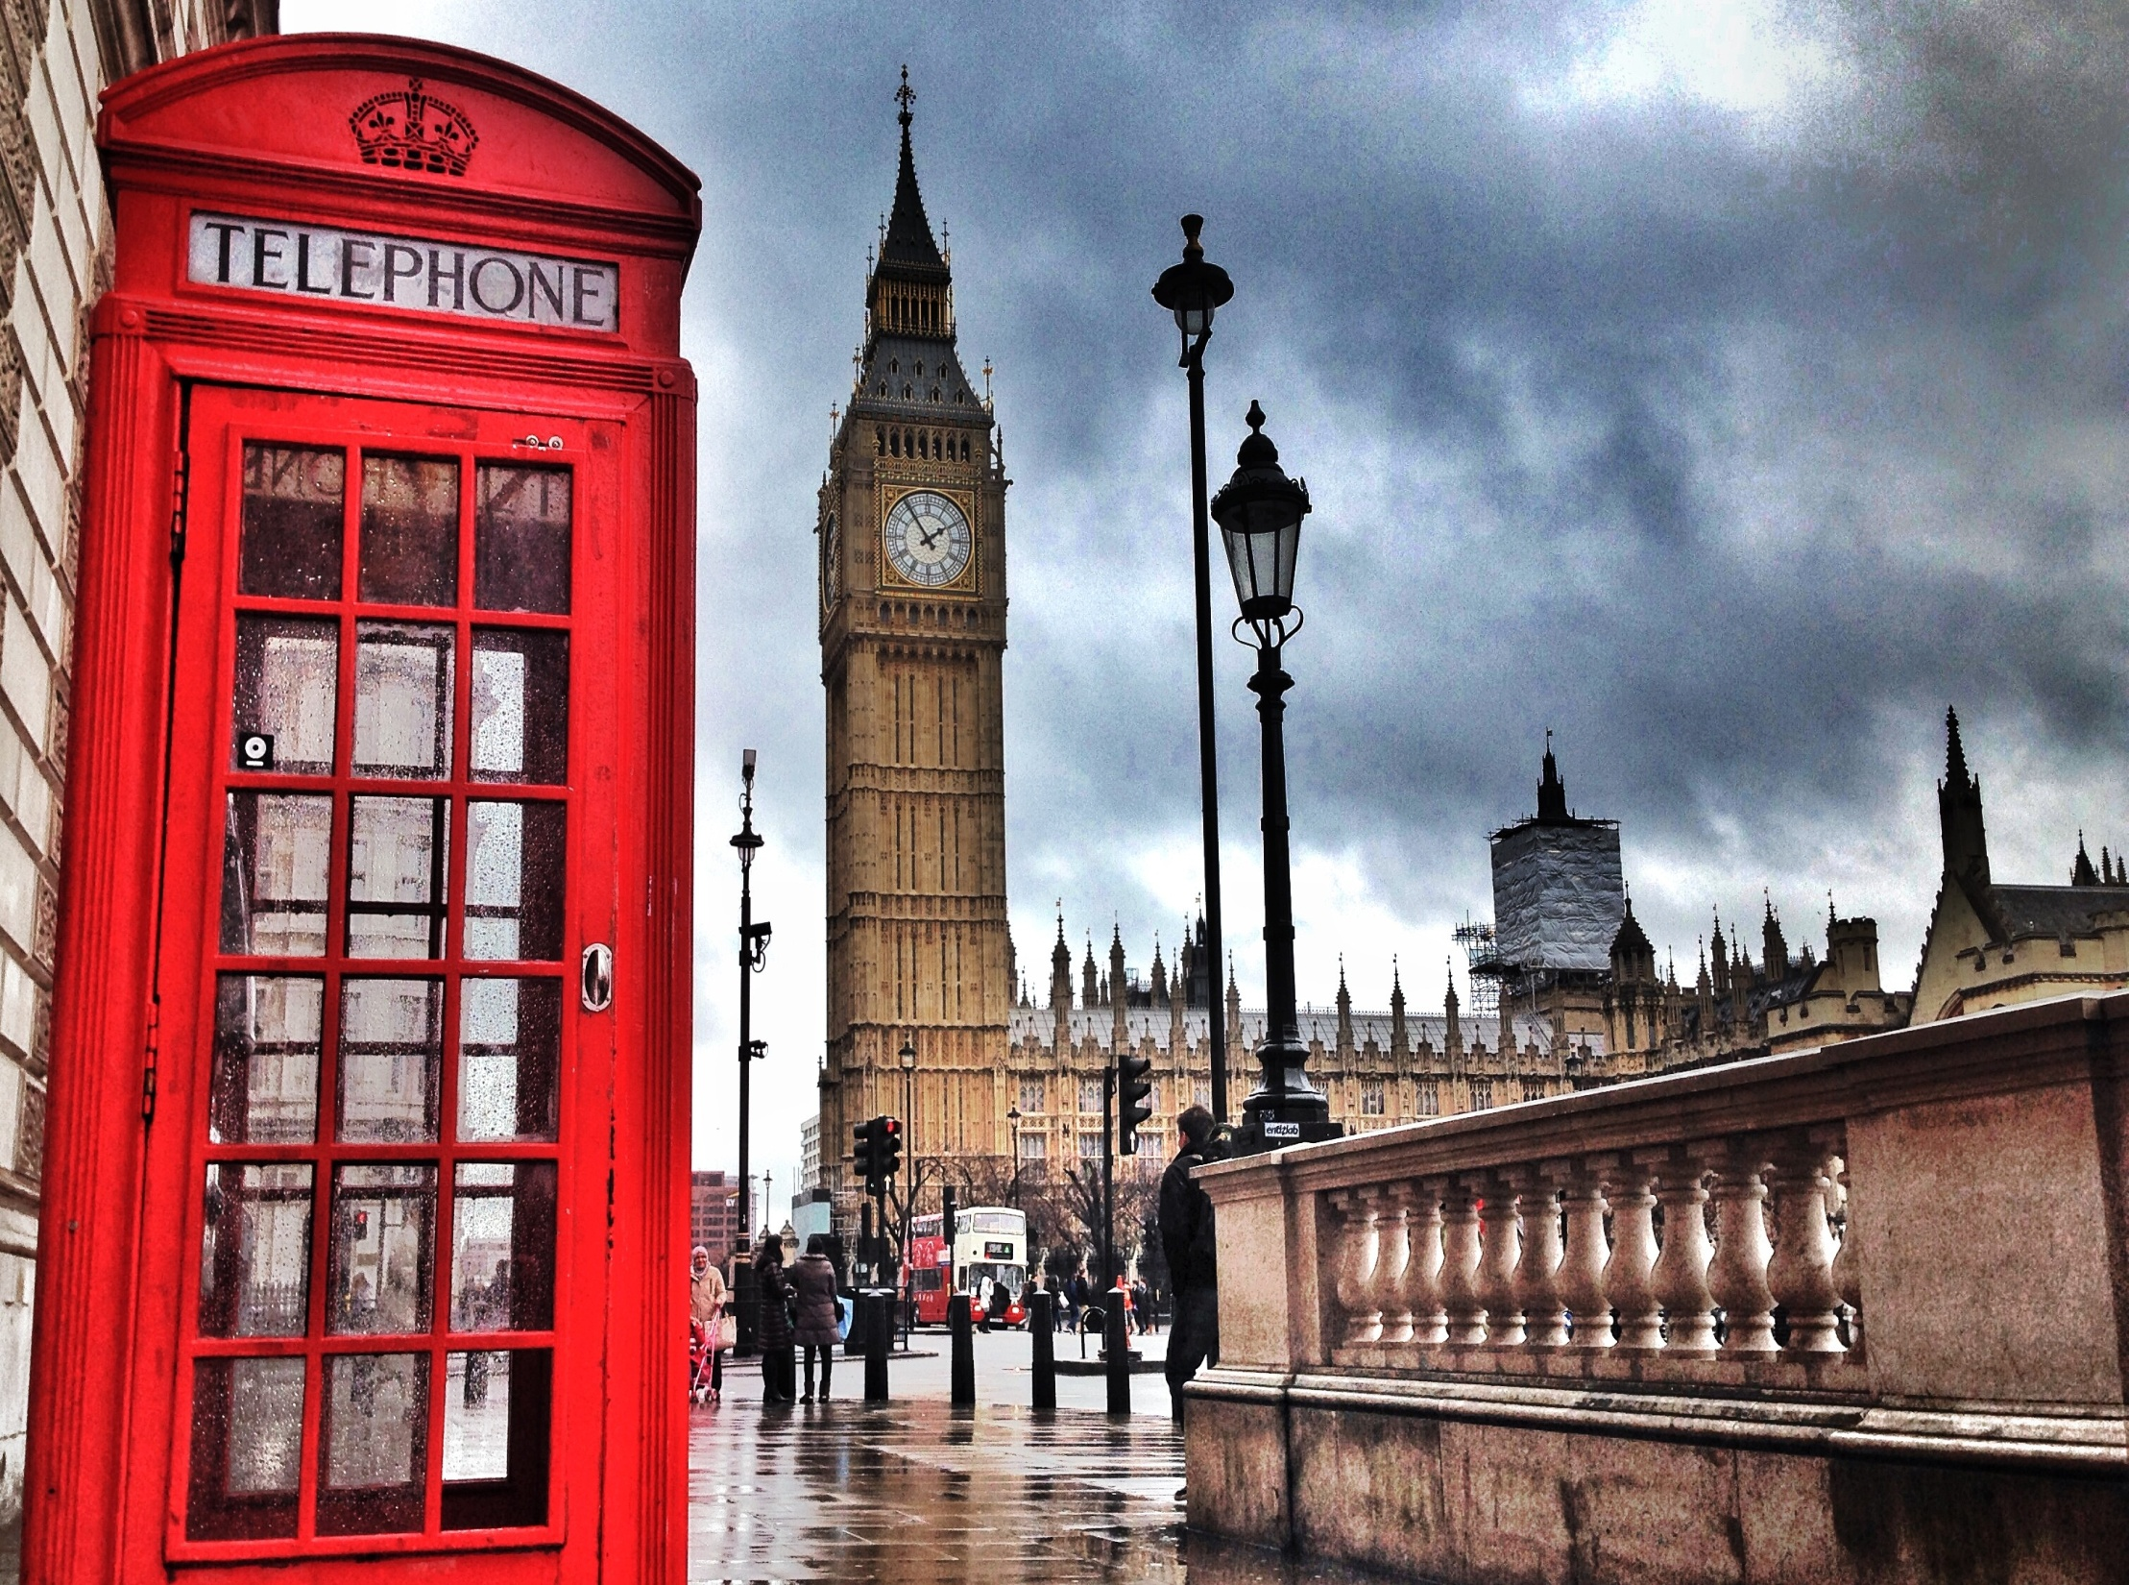
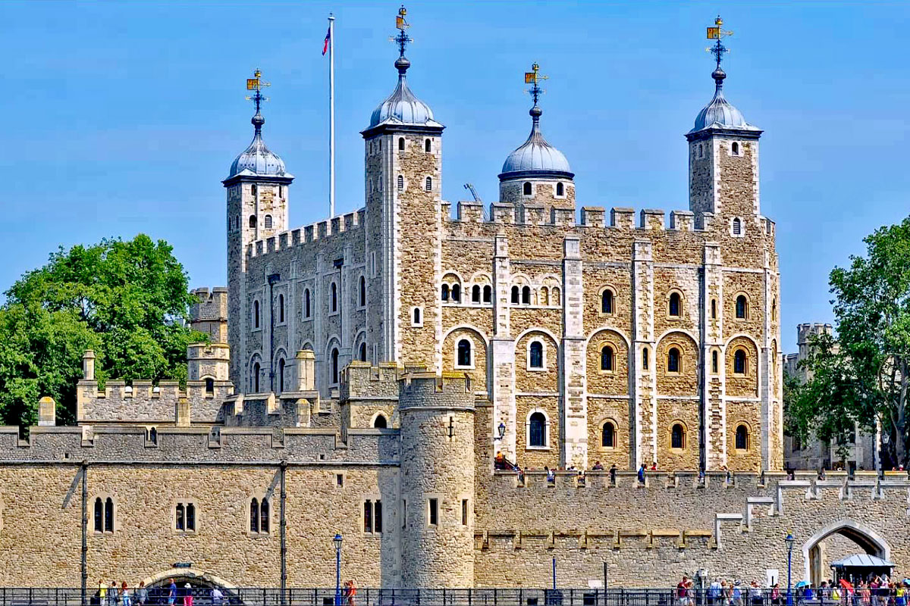
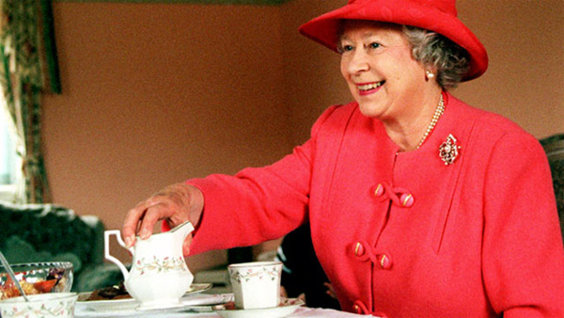
English tradition
Tea is an integral part of the lives of Britons, as potatoes or bread. There is even a saying: "Seven cups of tea will help Wake up, nine cups will help you sleep".
The British are a nation of couch potatoes. They say: "My home is my castle" and I don't like that the neighbors interfered in their lives.

Slide 6
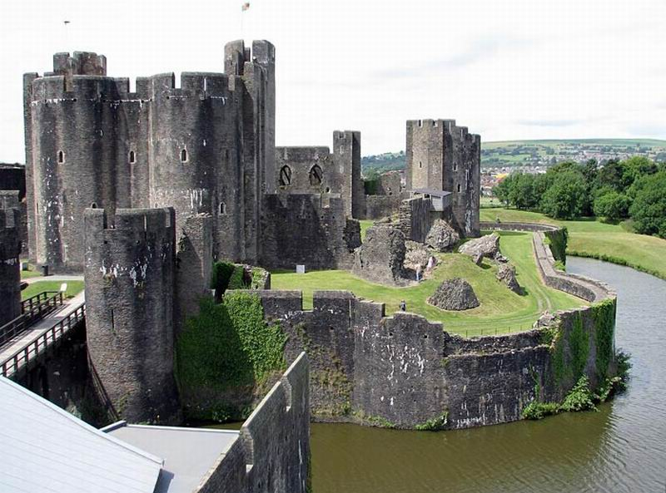
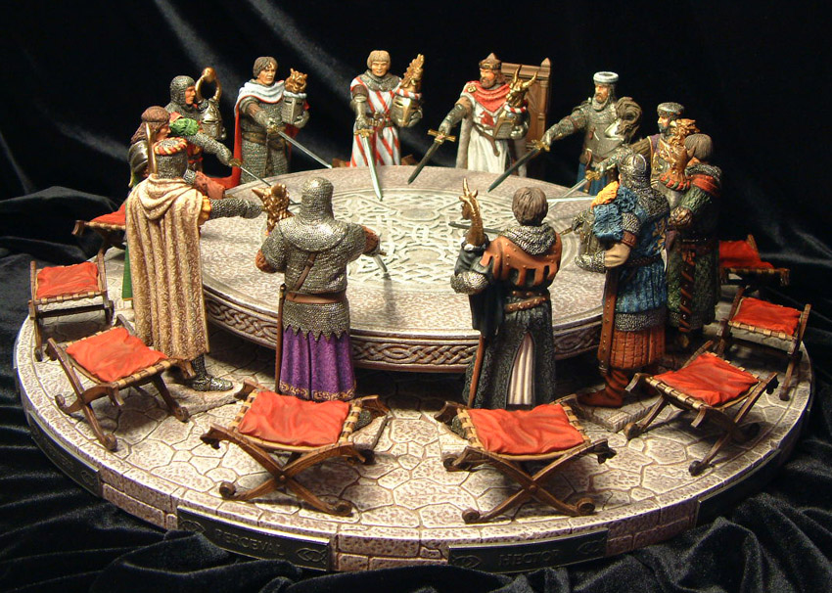
Traditions Of Wales
Wales Kingdom of honor he's known her since ancient times

Slide 7
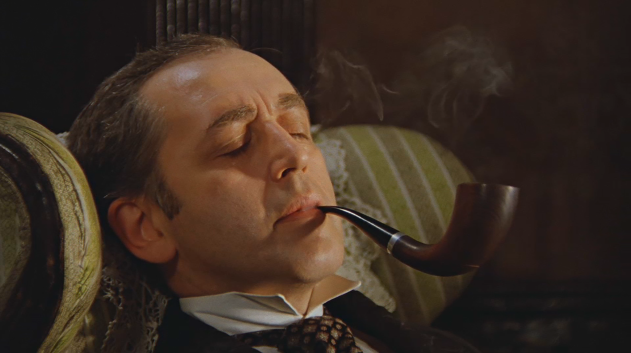
The End

