Slide 1
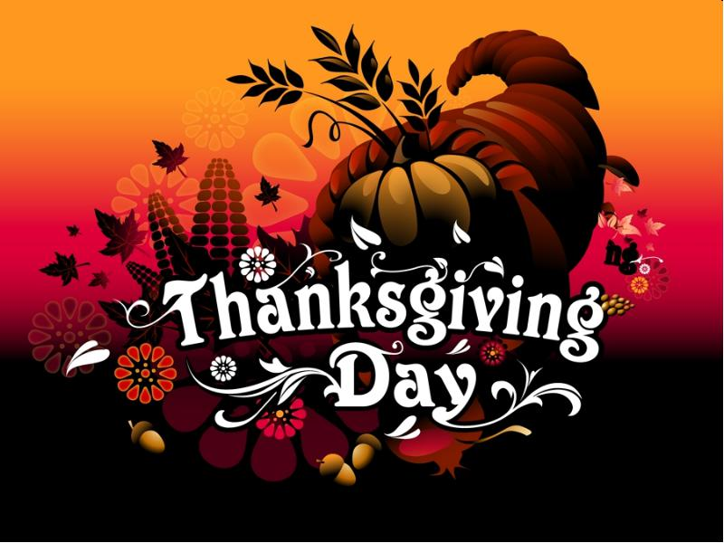
Thanksgiving Day
Thanksgiving Day is a national holiday celebrated primarily in the United States and Canada as a day of giving thanks for the blessing of the harvest and of the preceding year.

Slide 2
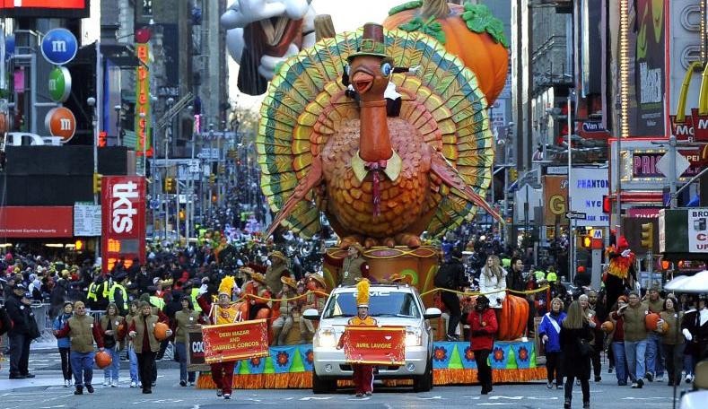
10 Interesting Facts About Thanksgiving Day

Slide 3
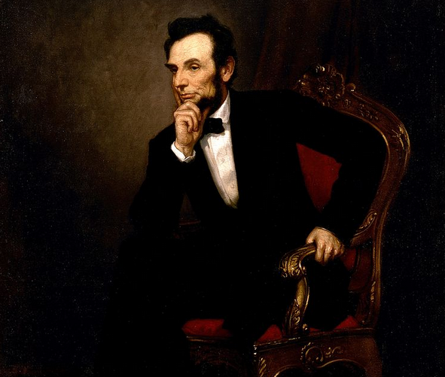
1. Abraham Lincoln announced it to be an official holiday
In 1863 Lincoln was the first president of the USA who proclaimed an official holiday when people give thanks.

Slide 4
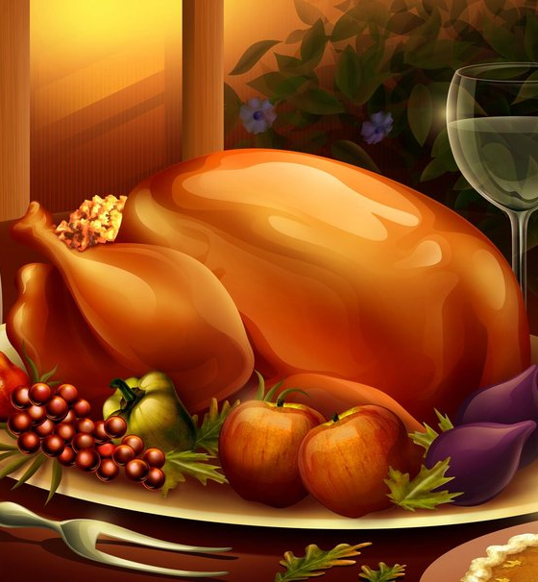
2. There was no turkey on the first Thanksgiving Day
First time people celebrated Thanksgiving in 1621. It lasted for 3 days. It was some kind of the harvest feast. People who celebrated that holiday were Pilgrims, the English Protestant settlers and the tribe of the Wampanoag. The menu that they had during that celebration differed greatly from the modern one. Their meals consisted of corn, shellfish and deer meat.

Slide 5
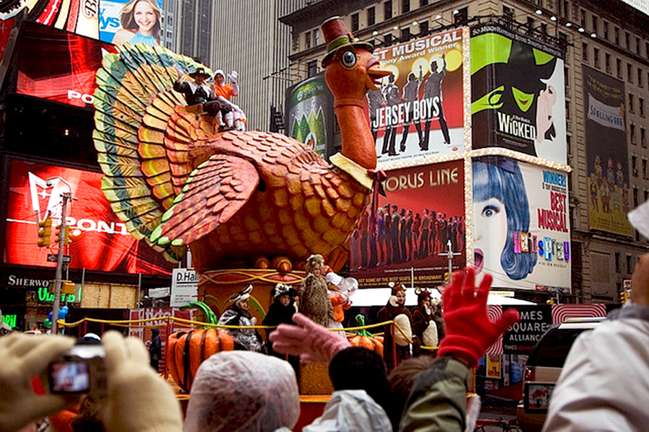
3. Popular parade which takes place in North America on Thanksgiving Day
Every year people in North America can witness the most popular parade which takes place on Thanksgiving Day. About 3.5 million people can observe this show in New York City. Others usually watch at home.

Slide 6
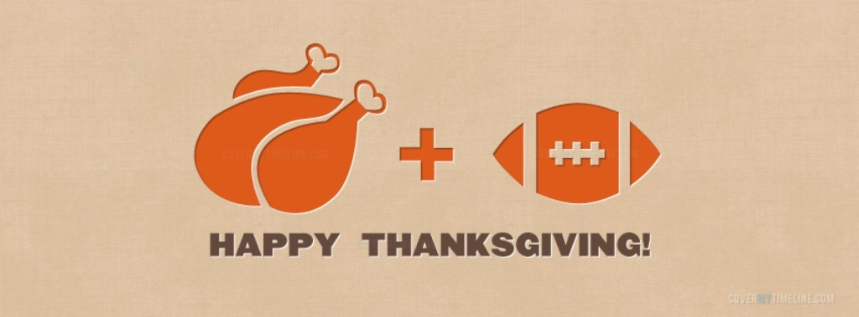
4. Football is the major entertainment of the day
Definitely watching football is the most popular activity among Americans on Thanksgiving. The history of this tradition began in 1934.

Slide 7
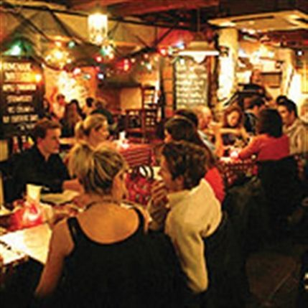
5. The most profitable night of the year for bar sales
During the night before Thanksgiving Day so many people visit different bars and cafes that it makes it the most profitable night for bar sales. The reason is that everybody meets with friends and relatives on this day. And the most popular place for that is a local bar.

Slide 8
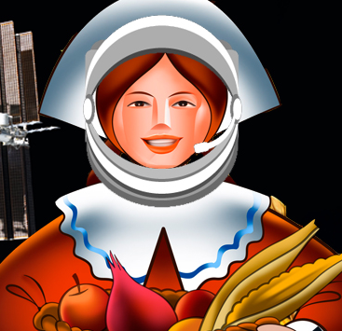
6. Astronauts celebrate Thanksgiving
Maybe some people will be greatly surprised with the fact that Thanksgiving is celebrated even by astronauts in space, even when they are apart from their families and friends. Their Thanksgiving menu consisted of rehydrated mash potatoes, turkey smoked in foil pouches and rehydrated green beans with mushrooms.

Slide 9

7. The Tryptophan doesn’t make you sleepy
Scientists say that turkey meat has a special amino acid Tryptophan. It can make you feel sleepy. But it doesn’t mean that if you eat a usual portion of turkey during Thanksgiving dinner you will fall asleep at once. There is not enough amount of tryptophan in it.

Slide 10
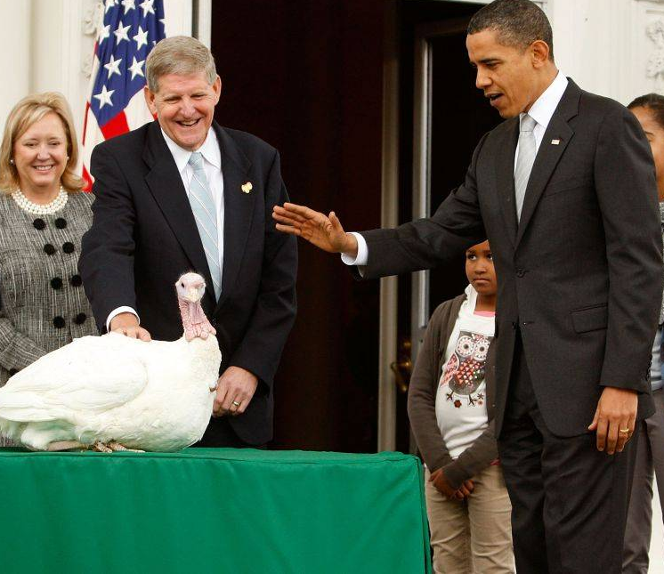
8. Every year the president pardons two turkeys
Once the president Truman chose a turkey on Thanksgiving Day and sent it to the farm. In such way he showed that the turkey was gifted a peaceful life. That happened in 1947. Since that time it has become a tradition. Nowadays the President selects two turkeys and Americans vote for their names. After that people can observe a public pardon of the President.

Slide 11

9. The day after Thanksgiving
The Americans call the day after Thanksgiving “Black Friday”. At first it got such name in 1960 in Philadelphia. Traditionally “Black Friday” is the beginning of the shopping season during holidays.

Slide 12
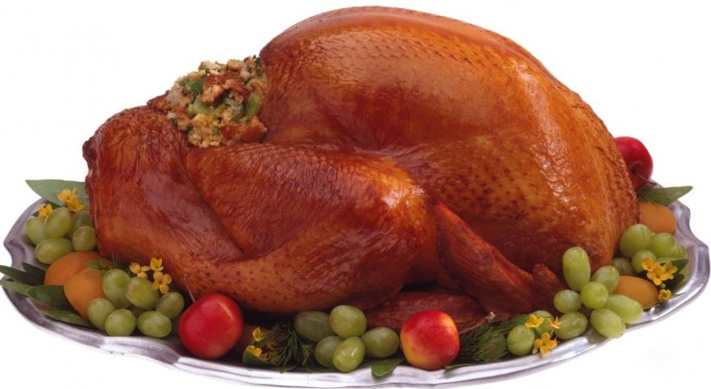
10. Every year 45 million turkeys are eaten on Thanksgiving
Annually people in the U.S. eat tremendous amounts of food. Researches show that about 45 million turkeys are consumed during Thanksgiving dinner. If Americans follow the same tendency this year they will spend about five billion dollars buying turkeys and trying to make their Thanksgiving menus perfect.

Slide 13
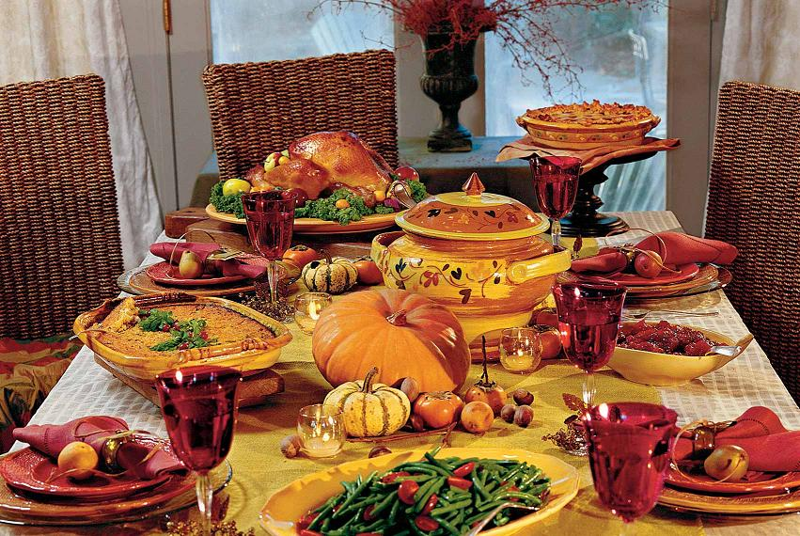
Thank you for your attention

