Slide 1
If I dared, I’d begin to create something like music with the help of color.
(Vincent Van Gogh)

Slide 2
Trend of painting | Painters and their craft | Coloring | Impressions, judgments | Other words

Slide 3
Trend of painting | Painters and their craft | Coloring | Impressions, judgments. | Other words.
Landscape, still life, decorative folk art, an icon, abstractionism | Artist, to reveal the person’s nature, to evoke, to glorify, to depict, a marine artist, to specialize in portraiture, to develop one’s own style of painting, to be in advance of one’s time. | Soft, brilliant, muted, light and shade, hot and agitated, harsh, to predominate. | Dull , moving, lyrical, romantic, to hold up people’s spirits, to make more humane and kind. | In the background, in the left hand corner, to belong to the brush of.

Slide 4
3 alternative questions with trend collocations
3 special questions with painters and their craft collocations
3 general questions with coloring and expressions collocations and words
3 disjunctive questions with other words.

Slide 5
Look at the model. Repeat it all together.
-Is it a still life or a landscape?
-What did Pablo Picasso specialize in?
-Do hot and agitated colors predominate in his palette?
-There is a beautiful landscape in the background of the picture, isn’t there?

Slide 6
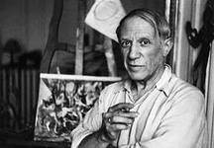

Slide 7
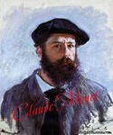

Slide 8
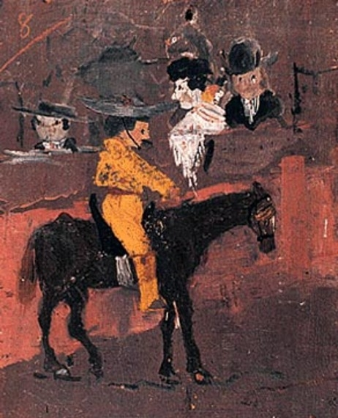

Slide 9
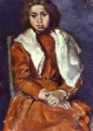

Slide 10
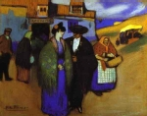

Slide 11
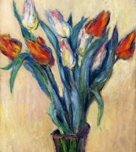

Slide 12
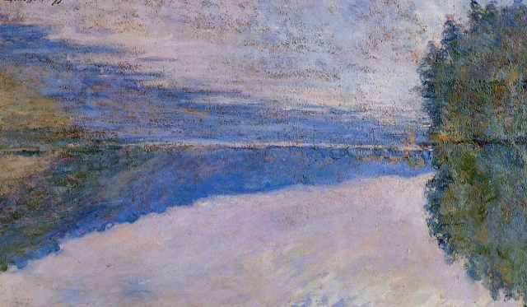

Slide 13
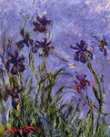

Slide 14
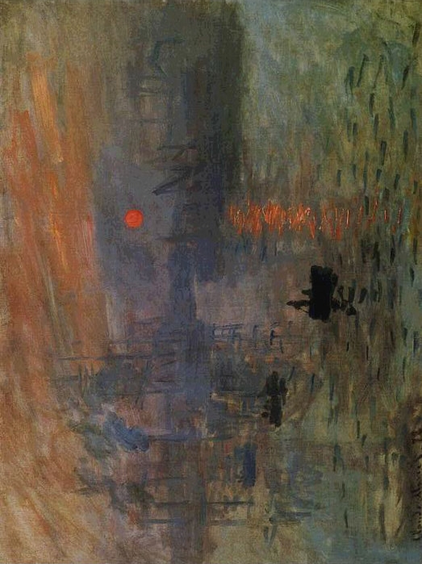

Slide 15
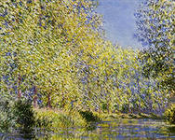

Slide 16
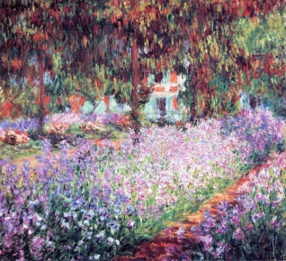

Slide 17
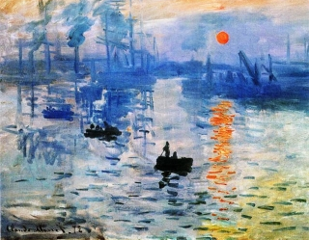

Slide 18


Slide 19
Pablo Picasso 3, | Claud Monet 1,

