Slide 1
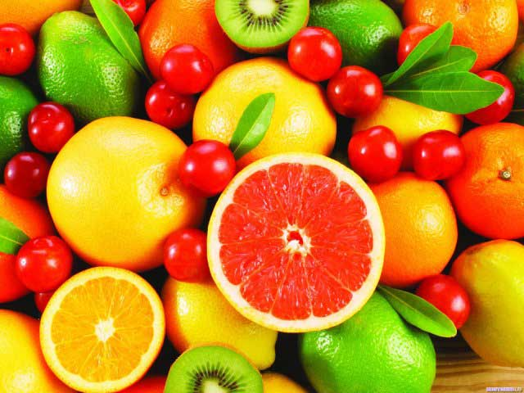
Vitamins.

Slide 2

Vitamins - is required by the body organic materials which can not be synthesized by itself (with rare exceptions) and fed with food. Vitamins provide the vital processes in the body affect our overall health.

Slide 3
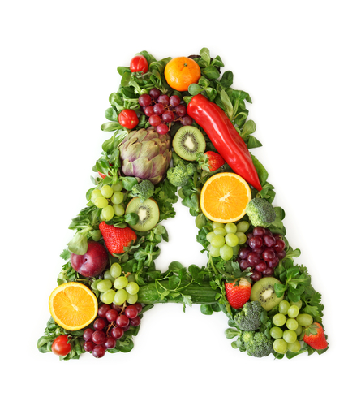
Vitamin

Slide 4
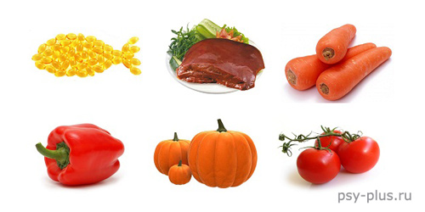
Vitamin A is responsible for the body's growth and vision. Popularly known malady called "night blindness" associated just with a lack of vitamin A. To meet the daily requirements needed only 1 mg of this vitamin. Carrots, beef liver, fish oil, tomatoes, green onions, red pepper, butter - these are products where vitamin A is present in decent volumes.

Slide 5
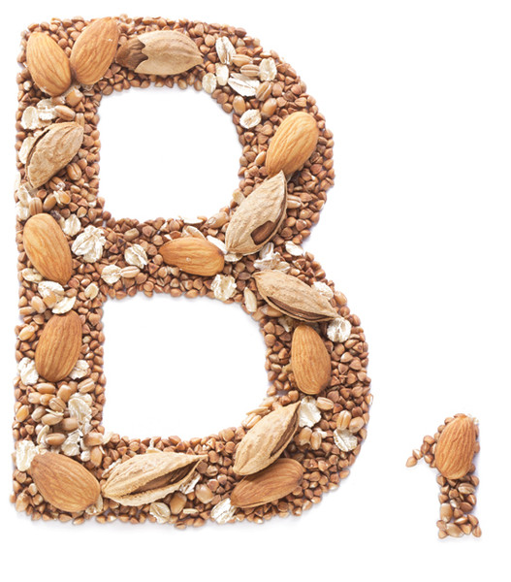
Vitamin

Slide 6
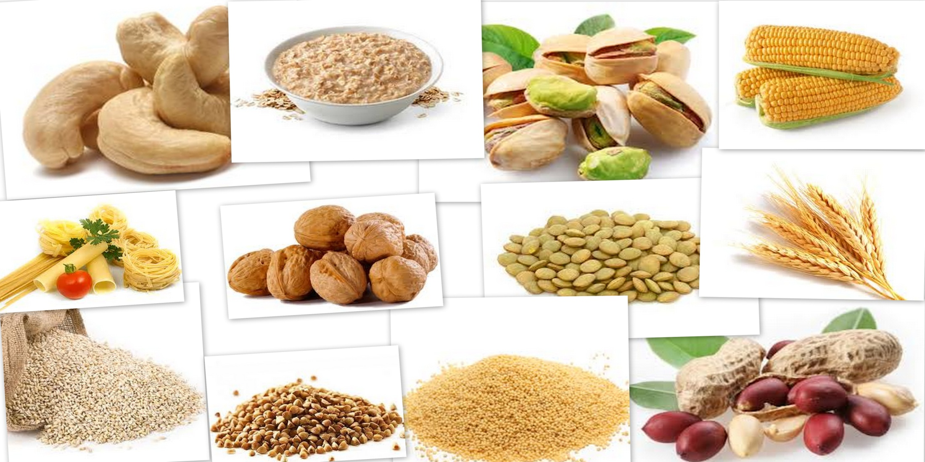
Vitamin B1 controls carbohydrate and amino acid metabolism, which is important for the normal functioning of the nervous system (both central and peripheral). Lack of vitamin B is accompanied by increased irritability, cardiovascular disorders, digestive problems and insomnia. The most valuable source of vitamin B - dried brewer's yeast.

Slide 7
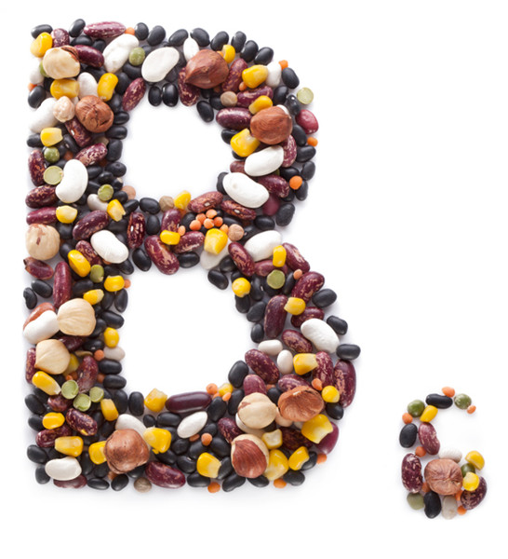
Vitamin

Slide 8
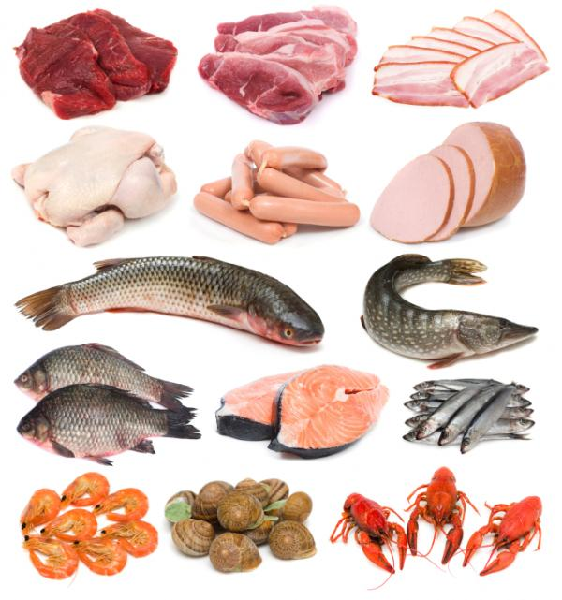
Vitamin B6 is involved in many metabolic processes in the body. Its daily rate equal to 2 mg. Deficiency of vitamin B6 leads to nervous disorders and skin irritations. The most rich in vitamin B6 are meat, soya beans.

Slide 9
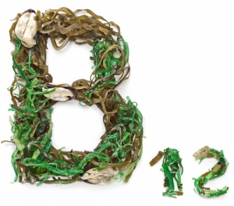
Vitamin

Slide 10
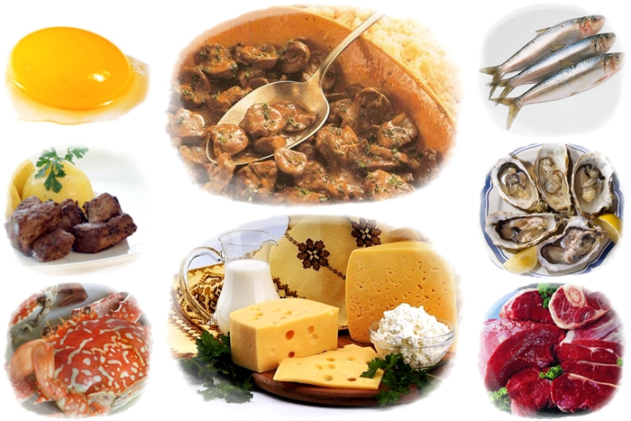
Lack of vitamin B12 provides a whole bunch of problems: general weakness, dizziness, loss of appetite. And only then day necessary only 3 micrograms of vitamin B12. Add it possible reserves by eating meat, fish, dairy products. In plant foods, this vitamin is almost completely absent.

Slide 11
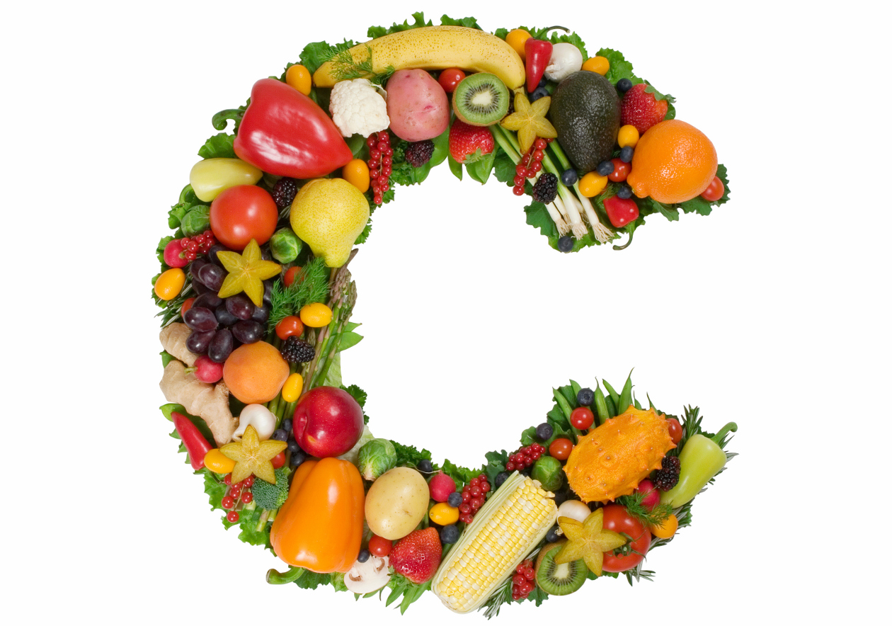
Vitamin

Slide 12
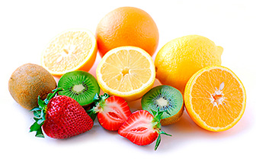
Vitamin C - ascorbic acid is a daily need for which is 70 mg - more than the norm of other vitamins combined. Lack of vitamin C in the best case results in fatigue, and at worst - in terms of the disease turning into a chronic form.
The best sources of vitamin C are the products - fresh herbs, fresh raw vegetables and fruits. Especially a lot of it in the dog rose and blackcurrant.

Slide 13
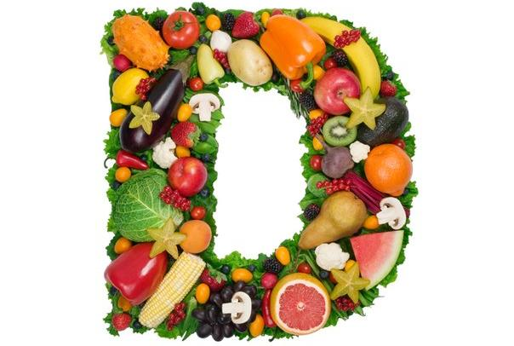
Vitamin

Slide 14
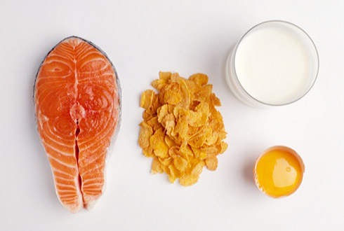
Vitamin D is involved in the development and growth of various body tissues. With food the body, he practically does not arrive. Sources of vitamin B is fish oil, fish eggs, egg yolk, butter, cheese, milk. Little is contained in mushrooms. Vitamin D does not break away from water, heat, freezing, canning.

Slide 15
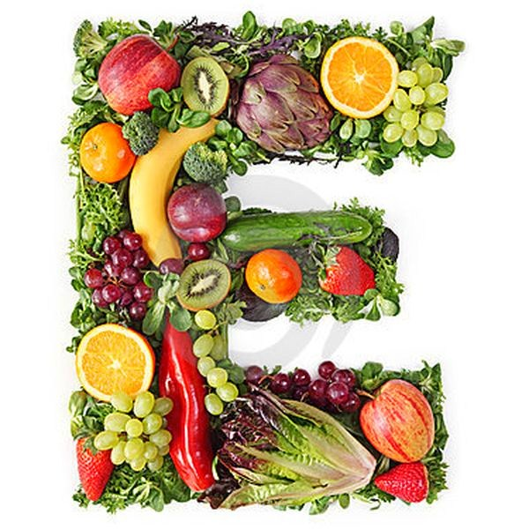
Vitamin

Slide 16
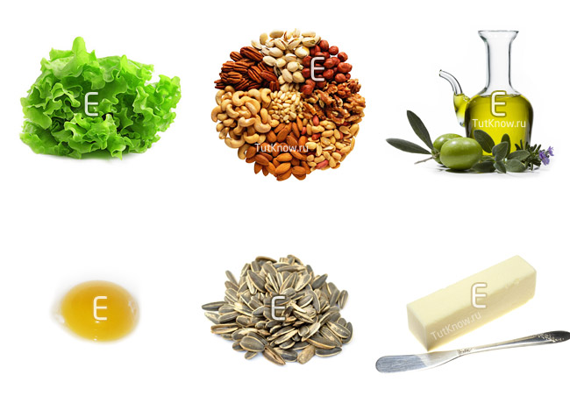
From vitamin E depends on the normal functioning of the reproductive system. Vitamin E also enhances the uptake of fats and proteins. The daily requirement is 10 mg. Quite a lot of vitamin E in bread and cereals, is contained in lettuce leaves and sprouted wheat and cottonseed oil, almost all green vegetables, eggs and animal fat, but the richest of its content is vegetable oil.

Slide 17
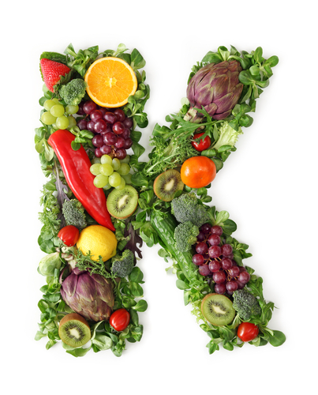
Vitamin

Slide 18
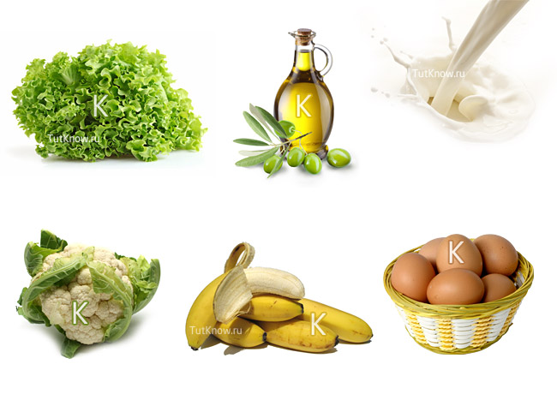
Vitamin K is necessary for normal blood clotting. All green plants have vitamin K content is more or less proportional to the content of chlorophyll therein. A lot of this vitamin in leaves of nettles, goutweed, birch, linden, raspberry and wild rose. Vitamin K is found in soybean oil, liver, casein, walnuts, cabbage - cabbage, cauliflower, broccoli, kohlrabi, all green leafy vegetables.

Slide 19
